Slide 1
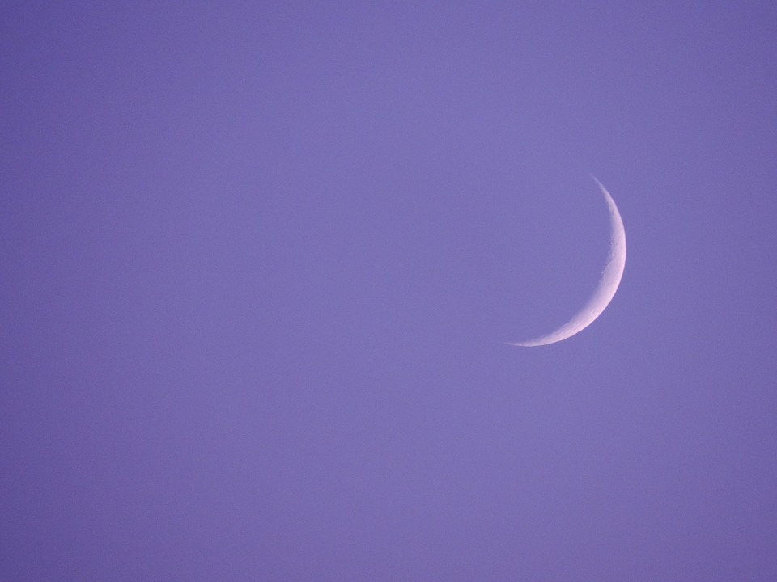
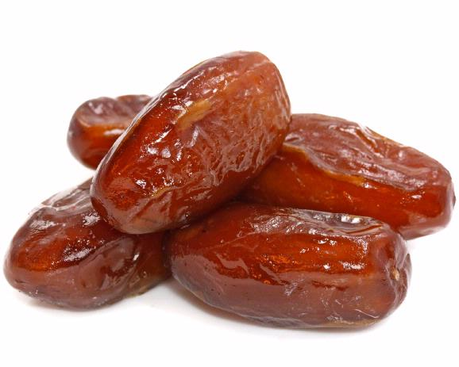
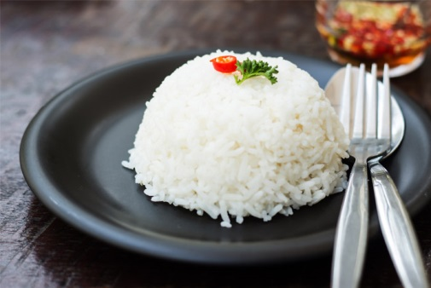
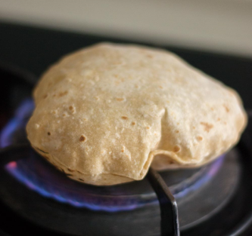
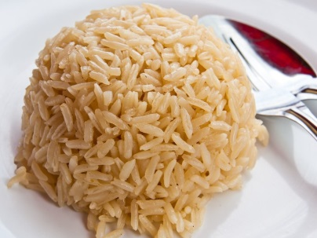
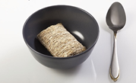
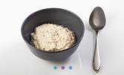
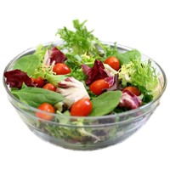
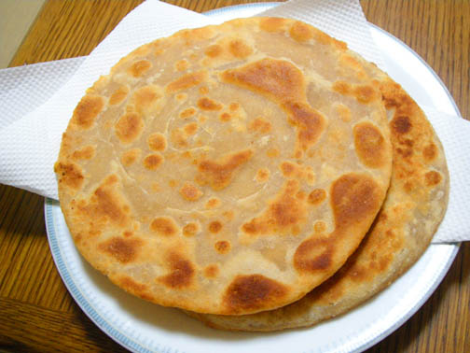
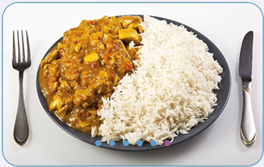
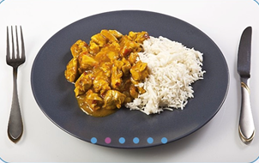
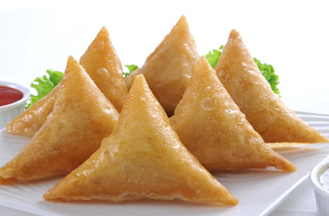
Helping people with diabetes make healthier choices during Ramadan
Notes:
WELCOME SLIDE
What are the best food choices for people breaking the fast/pre fast meal during Ramadan?

Slide 2
Dietary choices during Ramadan: Helping people make better choices
Key points to be considered:
Portion sizes
Carbohydrate content
Glycaemic index
Cooking methods
Healthier options
Hydration

Slide 3
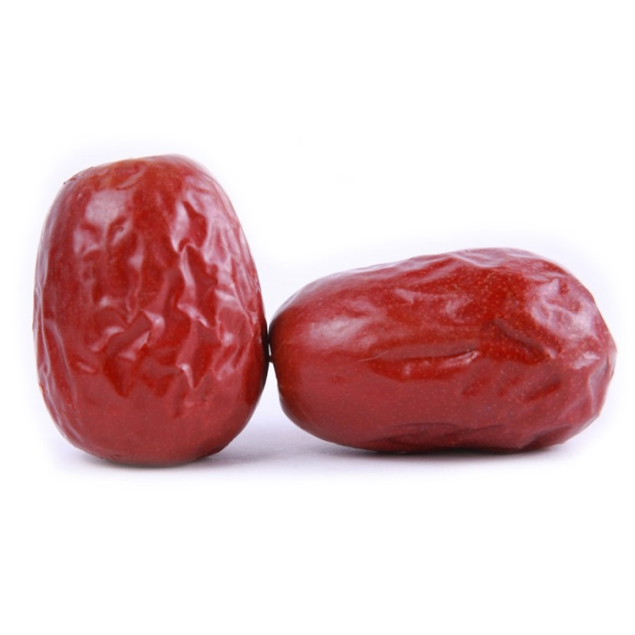
Portion sizes: breaking the fast
Notes:
1-2 dates is the recommended portion size for breaking the fast due to high sugar content (5g per date)

Slide 4
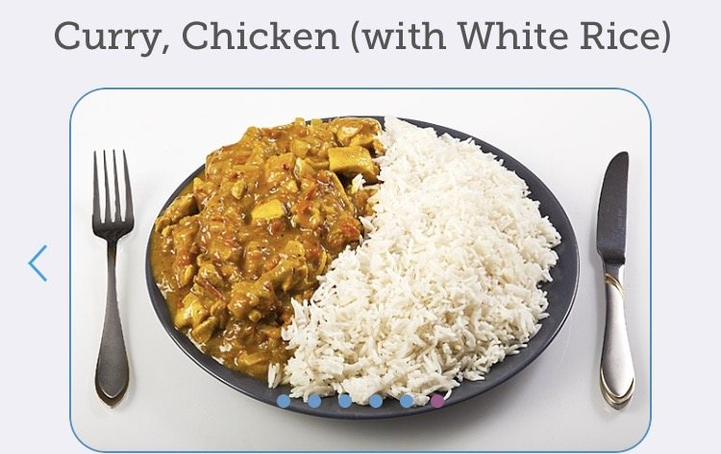
Portion sizes continued…
Notes:
35g carbs – smaller portion
126g carbs – large portion
Amount of carbohydrate has the most impact on blood glucose. Be mindful of portions of carbohydrates.
Meals should be balanced i.e. some protein, carbs and veg/salad.
By incorporating more veg/salad this reduces the portion size of carbs and protein as well as overall calorie content.

Slide 5
Glycaemic Index
Brown or basmati rice
White rice
Notes:
Lower GI foods can help keep blood glucose stables by releasing glucose slowly into the blood e.g. brown or basmati rice

Slide 6
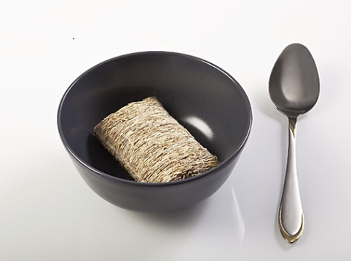
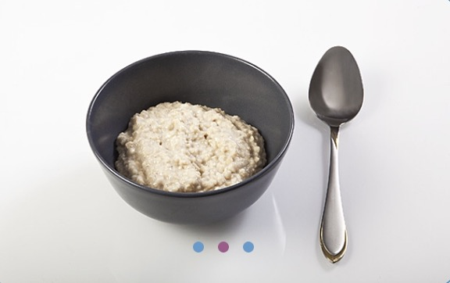
Glycaemic index continued…
Shredded Wheat
Porridge
Notes:
Low GI foods are beneficial at meal before sunrise (Suhoor/Sehri) e.g. porridge, shredded wheat

Slide 7
Cooking methods: breads
Paratha
Chapatti
Notes:
Which one would be the better choice and why???
Paratha
Made by baking wholewheat and then shallow frying (increase sat fat and kcal)
Thicker and more substantial than chapatis as they have either been layered by coating with ghee or oil and folded repeatedly
Commonly stuffed with potataoes, dal, cheese etc
Chapati
Wholewheat flour, cooked in an open flame (no added fat/oil in frying)
Less dense (encourages smaller portion size – therefore reduces kcal and Carbohydrates)

Slide 8
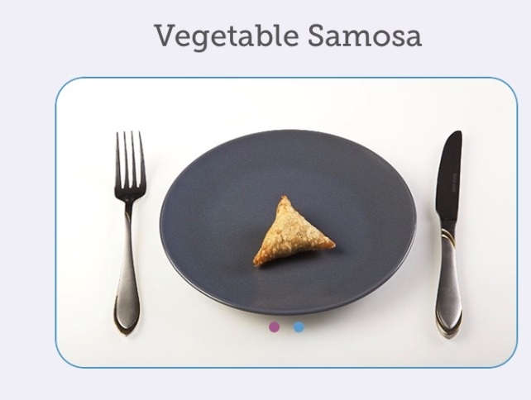
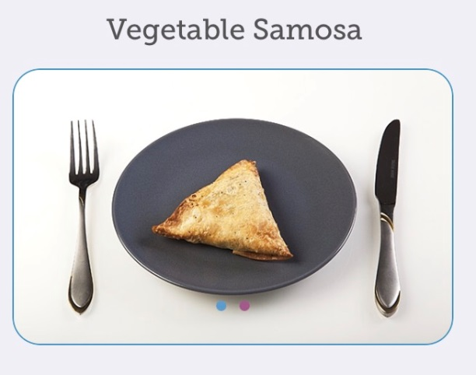
Cooking methods: samosas
Notes:
Problems??
Sizes of samosa
Small samosa- 6g carbs
Large samosa- 22g carbs
Made from MAIDA (wheat flour)
What could we advise our patients…….
Size of samosa Small =6g CHO Large 22g CHO
Mix the flours Maida (refined flour), Atta (Whole wheat flour) will increase fibre, lower GI.
Instead of deep frying, bake them in the oven reduces Kcal and saturated fat.
Swap potatoes for veg such as peas, cauliflower, carrot, or lean cooked meat. This will reduce carbohydrate.
Average Kcal Comparison
Baked 180kcal
Fried 310kcal

Slide 9
Healthier options
Notes:
Galub Jamin
-Approximately 17g carb per galub jamin
-Milk solid based South Asian sweet popular in Indian/Nepal/Pakistan/Bangladesh
-Milk solids are kneaded into dough, deep fried, soaked in light sugary syrup.
-Normally eaten at Eid.
-High fat
All indian sweets high sugar high fat, deep fried eg. Rasgulla, Balushahi/Badushah (like a doughnut), Baklawa/Baklava, Ras malai, Barfi/Barfee
Approx 5g carb per fruit kebab, low fat.
Other options lassi, Chai latte, natural yoghurt and fruit smaller portion of starchy carb with main

Slide 10
Hydration

Slide 11
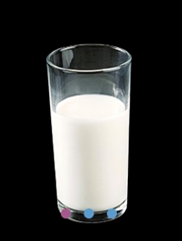
Hydration continued…
Notes:
Each 150mls
OJ – 12g CHO
Milk – 7g CHO

Slide 12
Key messages
Watch portion sizes (particularly of carbohydrates)
Opt for lower glycaemic index foods
Choose foods lower in fat (avoid deep fried foods)
Choose foods and drinks lower in sugar including fruit juice

Slide 13
Acknowledgements
Thanks to Carbs and Cals for images used

Slide 14
Diabetes and Ramadan
Meeting Educational Requirements, Improving Treatment
Dr Sarah N Ali
Consultant in Diabetes and Endocrinology
Royal Free London NHS Foundation Trust

Slide 15
Mrs Observant
72 year old Pakistani Housewife
Known IHD and Hypertension
BMI 36 kg/m²
T2DM
MF 1g bd
Gliclazide 120mg am + 80mg pm
HbA1c 72 mmol/l
Pre-proliferative changes on most recent retinal screening
ACR slightly raised; eGFR 58
Wants to fast for Ramadan in 2 weeks

Slide 16
Mrs Observant
The best management option will be:
To advise not to fast and continue with rest of annual review
To increase Gliclazide dose as is HbA1c is above the target.
Switch to DPP-4 as lower risk of hypoglycaemia
To start long-acting insulin immediately as hyperglycaemia will have an impact on retinopathy
To start Dapaglifozin (SGLT-2) as it reduces the risk of hypoglycaemia and it is an oral agent.

Slide 17
Background
In 2010, Muslims constitute 23% of the world’s population (~1.6 billion people)
In 2013, International Diabetes Federation: 382 million people living with diabetes
Extrapolated globally there are ~ 90 million Muslims with diabetes.
UK: Patients with diabetes estimated just fewer than 3 million
Diabetes affects around 10–15% of the UK Muslim population, with South Asian people having the highest rates of diabetes mellitus
~ 400 000 British Muslims have diabetes
Notes:
number is increasing at a rate of ~ 3% each year

Slide 18
Ramadan – Timeframe
Months of Islamic calendar
Muḥarram
Safar
Rabīʿ I
Marked by period of fasting (sunrise to sunset)
Each day, fasting for 11–12 hours (equatorial countries) to 16–20 hours (countries away from the equator)¹
Ramadan will occur during the hot summer months over the next decade in most of the Muslim world¹
Rabīʿ II
Jumādā
Jumādā II
Rajab
Shaʿbān
Ramadān
Shawwāl
Dhū al-Qaʿda
Dhū al-Ḥijja
0
29–30
Days
Almaatouq. Diabetes Metab Syndr Obes 2012;5:109–19

Slide 19
Fasting in Ramadan
The holy month of Ramadan forms one of the five pillars of Islam
Fasting is obligatory with some exceptions:
“(Fasting) for a fixed number of days; but if any of you is ill or on a journey the prescribed number (should be made up) from days later.” (Holy Qur’an 2:184)
Notes:
Most Muslims with diabetes often do not consider themselves unwell and exempted
The most extensive study to date investigating the effects of fasting in Muslim patients with diabetes is the Epidemiology of Diabetes and Ramadan (EPIDIAR) study, performed across 13 countries and involving ~ 13 000 patients.
The EPIDIAR study reported that 43% of patients with Type 1 diabetes and 79% with Type 2 diabetes fast, irrespective of the advice given to them
Furthermore, ~ 80% of Muslims with diabetes fast for at least 15 days
Extrapolating these figures suggests that ~ 320 000 Muslims with diabetes in the UK and > 50 million Muslims globally with diabetes will fast for at least half of Ramadan
EPIDIAR study conducted during winter months, largely in countries within the northern hemisphere when the duration of fasts was short
No available data on how many Muslims with diabetes fast in Ramadan during summer time

Slide 20
Ramadan
29–30 days
Abstain from eating and drinking during the daylight hours: dawn to sunset
Two meals per day:
Suhoor (preceding dawn)
Iftar (sunset)
The Islamic year follows a lunar calendar:
Ramadan advances forward in the Gregorian calendar by 11 days/ yr
Non-equatorial countries in the northern hemisphere: for next decade, Ramadan in summer
In non-equatorial countries: daylight hours vary significantly between summer and winter months
Length of fasts in summer being 16–20 hrs
Compared with 7–11 hrs in winter.
Notes:
There are no restrictions on intake outside these hours.

Slide 21
Fasting in Ramadan
)شَهْرُ رَمَضَانَ الَّذِي أُنْزِلَ فِيهِ الْقُرْآنُ هُدًى لِلنَّاسِ وَبَيِّنَاتٍ مِنَ الْهُدَىٰ وَالْفُرْقَانِ ۚ فَمَنْ شَهِدَ مِنْكُمُ الشَّهْرَ فَلْيَصُمْهُ ۖ وَمَنْ كَانَ مَرِيضًا أَوْ عَلَىٰ سَفَرٍ فَعِدَّةٌ مِنْ أَيَّامٍ أُخَرَ ۗ يُرِيدُ اللَّهُ بِكُمُ الْيُسْرَ وَلَا يُرِيدُ بِكُمُ الْعُسْرَ وَلِتُكْمِلُوا الْعِدَّةَ وَلِتُكَبِّرُوا اللَّهَ عَلَىٰ مَا هَدَاكُمْ وَلَعَلَّكُمْ تَشْكُرُونَ(
الآية رقم [185] من سورة ]البقرة[
تفسير الميسر )فمن حضر منكم الشهر وكان صحيحًا مقيمًا فليصم نهاره. ويُرخَّص للمريض والمسافر في الفطر، ثم يقضيان عدد تلك الأيام(
"The month of Ramadan in which was revealed the Quran, a guidance for mankind and clear proofs for the guidance and the criterion (between right and wrong).
So whoever of you sights the month (Ramadan), he must fast
“And whoever is ill or on a journey, the same number (of days which one did not fast must be made up) from other days.”
Allah wants ease for you and does not want hardship for you”
The Holy Qur’an: Chapter 2; Verse 185

Slide 22
Exemptions to fasting during Ramadan?
Risk of harm is prohibited in Islam¹
Individuals exempted from fasting¹
Children
Pregnant women
Travellers
Menstruating females
Individuals with reduced mental capacity
Those who are ill
(وَمَنْ كَانَ مَرِيضًا أَوْ عَلَىٰ سَفَرٍ فَعِدَّةٌ مِنْ أَيَّامٍ أُخَر( البقرة 185
“And whoever is ill or on a journey, the same number (of days which one did not fast must be made up) from other days.”
(وَلَا تُلْقُوا بِأَيْدِيكُمْ إِلَى التَّهْلُكَةِ ) البقرة 195
“And let not your own hands throw you into destruction”
Most patients with diabetes are asymptomatic and do not consider themselves as having an illness and fast during Ramadan²
Epidemiology of Diabetes and Ramadan (EPIDIAR) study: ~13 000 patients
43% with Type 1 diabetes fast
79% with Type 2 diabetes fast
~80% of Muslims with diabetes fast for at least 15 days
Extrapolating: ~320 000 Muslims with diabetes in the UK will fast for at least half of Ramadan
Notes:
‘And let not your own hands throw you into destruction’ (Sura 2: Verse 195)
‘And do not destroy one another: for, behold, God is indeed a dispenser of grace unto you’ (Sura 4: Verse 29)

Slide 23
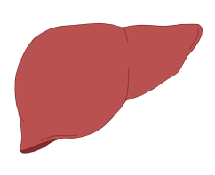
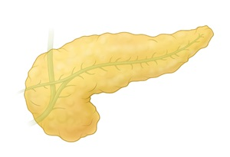
How does fasting affect patients with diabetes?
Pathophysiology of prolonged fasting* in normal individuals
Ketogenesis¹
Peripheral tissues
Key differences in patients with type 2 diabetes
Glucose
Excessive glycogen breakdown
Increased gluconeogenesis and ketogenesis
Liver
Ketones used as fuel¹
Glycogen stores depleted
Hyperglycaemia
Ketoacidosis
Pancreas
Insulin secretion decreased
*More than several hours without food or water
Al-Arouj M et al. Diabetes Care 2010;33:1895-902K; Karamat MA et al. J R Soc Med 2010;103:139−47

Slide 24
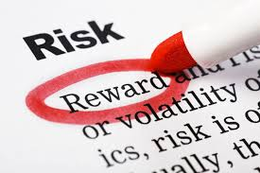
Risks associated with fasting
In certain circumstances, fasting can be detrimental
If an individual is advised by a medical professional that fasting would be potentially detrimental, most Muslims and their religious authorities would agree that the individual should abstain
Risks:
Hypoglycaemia
Hyperglycaemia
Dehydration
Increased risk of thrombosis, occurring in association with dehydration and hyperglycaemia
Risks are greater as the length of fast increases
NB. Not fasting only, represents cycles of daytime fasting and night-time re-feeding. Fasting and indulgent eating and feasting

Slide 25
Risks associated with fasting
Hypoglycaemia
Decrease in food intake
Particularly, patients on sulfonylureas, other insulin secretagogues or insulin therapy.
Hyperglycaemia and diabetic ketoacidosis
Related to excessive reductions in medication doses
Increase intake of food and/ or sugar.
Individuals with Type 1 diabetes more prone to developing ketoacidosis, particularly if their glycaemic control was suboptimal prior to Ramadan
Dehydration
Long fasts with restrictions on fluid intake increase the risk of dehydration.
Risk greater in countries and/or seasons where fasts are longer and if hyperglycaemia is present due to osmotic diuresis
Can present syncope and falls, heat exhaustion and increased blood viscosity leading to thrombosis
Thrombosis
Hyperglycaemia and hypovolaemia → hypercoagulability
Increased risk of thrombosis and strokes

Slide 26
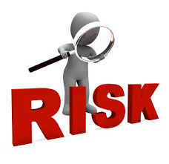
Pre-Ramadan assessment
Preparation is paramount
Consultation before Ramadan early as possible (at least 1–2 months prior)
Or at next consultation
Risk assessment of fasting
Imperative to ensure patient feels supported in their choice to fast, their choice is respected and managed accordingly
There will be individuals who fast despite medical advice.

Slide 27
Risk stratification
High Risk - Advised not to fast Type 1 diabetes Poor glycaemic control, defined as HbA1c > 69mmol/mol (> 8.5%) Hypoglycaemic unawareness Severe episodes of hypoglycaemia (loss of consciousness or requiring third party assistance) in three months prior to Ramadan Recurrent episodes of hypoglycaemia in three months prior to Ramadan History of diabetic ketoacidosis in the three months prior to Ramadan History of hyperosmolar hyperglycaemic coma in the three months prior to Ramadan Comorbidities: advanced macrovascular complications, renal disease, liver disease, cognitive dysfunction, uncontrolled epilepsy Acute illness, including a diabetic foot infection or foot ulcer Pregnant women Frequent intense physical labour
Moderate Risk – May fast if patient and health-care professionals are happy, with collaboration of care between all involved Moderate glycaemic control, defined as HbA1c 58 to 69mmol/mol (7.5 to 8.5%) and no major complications of diabetes Well-controlled diabetes, defined as HbA1c <58mmol/mol (< 7.5%) treated with sulphonylurea, short-acting insulin secretogogue, insulin, or treated with a combination oral or oral and insulin treatment
Low Risk - Should be able to fast with advice Diet-controlled diabetes Diabetes well-controlled with monotherapy (Metformin, DPP-4 inhibitors, Acarbose, GLP-1 agonists, SGLT2 inhibitors or thiazolidinediones) and otherwise healthy
Ali S et al. Guidelines for managing diabetes in Ramadan. Diabetic Medicine 2016

Slide 28
Topics to cover
Full annual review
Investigations: Bloods (HbA1c, lipid profile, renal function) and urinary albumin to creatinine ratio.
Risk stratification: assess suitability to fast
Risks of fasting
including when to stop fasting
Medication review and alteration of medications for safe fasting
Blood glucose monitoring
Dietary advice
Exercise
Regular light and moderate exercise generally safe
Rigorous exercise not recommended
Smoking cessation

Slide 29
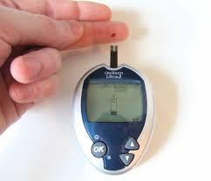
Blood glucose monitoring
Does not break the fast
Monitor BMs at beginning of the fast
Monitor BMs regularly every 4 hrs
Check BMs:
if any symptoms of hypoglycaemia
or if the patient becomes unwell
Stop fasting if:
Hypoglycaemia BM < 3.9 mmol/l at any time during fast
BMs 3.9 mmol/l at the start of fast & on insulin/ SUs
Hyperglycaemia BMs > 16.7 mmol/l

Slide 30
Meals in Ramadan
Abstain from eating and drinking during the daylight hours: dawn to sunset
Two meals per day:
Suhoor (preceding dawn)
Iftar (sunset)
Notes:
There are no restrictions on intake outside these hours.

Slide 31
Ramadan fasting-related awareness, practices and experiences in urban Pakistani diabetics
Retrospective survey of 1050 subjects
79% of subjects had school or college education
Masood SB, et al. Pak J Med Sci 2012;28(3):432-436

Slide 32
Breaking the fast when hypoglycaemic
In a real-world study in Pakistan, less than 15% of those who experienced symptoms of hypoglycaemia during Ramadan broke their fast
Masood SB et al. Pak J Med Sci 2012;28(3):432-436

Slide 33
Ramadan fasting-related awareness, practices and experiences in urban Pakistani diabetics Ramadan fasting-related experiences
Weight change after Ramadan | Male | Female | Total
Not answered | 4.3% | 2.7% | 3.2%
Weight loss | 12.8% | 18.5% | 16.6%
Weight gain | 35.6% | 38.1% | 37.2%
No change | 47.3% | 40.8% | 43.0%
Masood SB, et al. Pak J Med Sci 2012;28(3):432-436

Slide 34
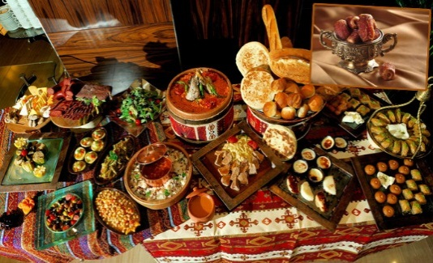
CREED Study Food intake in Ramadan
Average number of meals consumed each day during Ramadan
1 | 54 | (1.7)
2 | 2076 | (64.1)
3 | 1030 | (31.8)
4 or more | 79 | (2.4)
Change in size of meals | 1657 | (51.7)
Eat smaller meals | 662 | (40.5)
Eat larger meals | 972 | (59.5)
Predominant change in the type of meals
Eat more carbohydrate | 1084 | (61.8)
Eat more protein | 1032 | (58.9)
Eat more fat | 690 | (39.4)
Babineaux SM et al. Diabet Med 2015. doi: 10.1111/dme.12685. [Epub ahead of print]

Slide 35
Ramadan fasting-related awareness, practices and experiences in urban Pakistani diabetics Ramadan fasting-related experiences
Weight change after Ramadan | Male | Female | Total
Not answered | 4.3% | 2.7% | 3.2%
Weight loss | 12.8% | 18.5% | 16.6%
Weight gain | 35.6% | 38.1% | 37.2%
No change | 47.3% | 40.8% | 43.0%
Masood SB, et al. Pak J Med Sci 2012;28(3):432-436

Slide 36
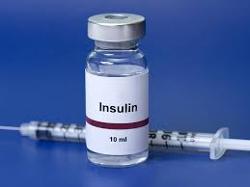
Managing patients with Type 1 diabetes
Patients with Type 1 diabetes should be discouraged from fasting
Carbohydrate counting is of great assistance
Safest regime:
basal–bolus regime (preferably with insulin analogues)
insulin pump
frequent BM monitoring
Basal long-acting insulin
Reduce by 20% and taken with evening meal (Iftar)
Omit mid-day rapid-acting insulin whilst fasting
Insulin pumps
basal infusion rates programmed and individualized
boluses of insulin at meal times/ if hyperglycaemia occurs
Not widely available, costly
Time and good preparation are required for patients to adjust pump therapy

Slide 37
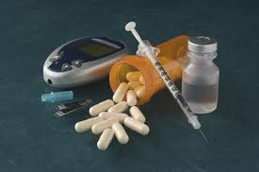
Managing patients with Type 2 diabetes
Diet-controlled diabetes
Risks of fasting low
Possibility of postprandial hyperglycaemia occurring with indulgent eating
Eat sensibly and increase physical activity
Metformin
Hypothetical risk of severe hypoglycaemia is low
Total dose of metformin over 24 hrs can stay the same.
Lunchtime dose can be taken at Iftar
Acarbose
No data in Ramadan
Acarbose has a low independent risk of hypoglycaemia
Dose does not need to be changed provided taken with meals during Ramadan
Short-acting insulin secretagogues (meglitinides) - repaglinide and nateglinide
Associated with hypoglycaemia
Studies suggest safe in Ramadan
Taken with the two meals of Ramadan, but used with caution

Slide 38
Managing patients with Type 2 diabetes
Sulfonylureas
Increasing insulin release from pancreatic beta-cells
Should be used with caution in Ramadan
Particularly longer-acting sulfonylureas, such as glibenclamide and gliclazide MR
Once-daily sulfonylureas:
switch the timing to take with the evening Iftar
Patients with history of hypoglycaemia on sulfonylureas, consider switching to dipeptidyl peptidase-4 (DPP– 4) inhibitors
Shorter-acting sulfonylureas:
Reduce morning dose with Suhoor
Larger dose taken with Iftar
Notes:
consider switching to an alternative class of glucose-lowering therapy with a lower risk of hypoglycaemia, such as dipeptidyl peptidase-4

Slide 39
Managing patients with Type 2 diabetes
Thiazolidinediones
In Ramadan, most likely safe
Not associated with hypoglycaemia
May augment hypoglycaemia caused by other medications used in combination
Increase in appetite
Glucose-lowering benefits take 2–4 weeks: not alternative as immediate pre-Ramadan switch

Slide 40
Managing patients with Type 2 diabetes
DPP–4 inhibitors
Not independently associated with an increased risk of hypoglycaemia
Vildagliptin most studied in Ramadan: (VECTOR/ VIRTUE/ STEADFAST)
Reduced HbA1c levels
Fewer hypoglycaemic events contrast to SUs
Better treatment adherence
Potentially less weight gain
Those patients on dual therapy of DPP–4 inhibitors and SUs, with suboptimal control [HbA1c > 58 mmol/mol (> 7.5%)], stopping SUs challenging

Slide 41
Managing patients with Type 2 diabetes
SGLT2 inhibitors
Risk of hypoglycaemia low
Weight loss due to net calorie loss
Risk of dehydration and postural hypotension
No available clinical evidence for their use and safety during Ramadan
Recommendation:
Use with caution
Drink at least 2 L of water/ day to reduce the risk of dehydration
Initiation on an SGLT2 inhibitor prior to Ramadan should be avoided
Diabetic ketoacidosis and SGLT2 inhibitors
May 2015, U.S. FDA: warning of increased risk of DKA with atypical mild-to-moderate glucose elevations (euglycaemic diabetic ketoacidosis)
In Ramadan fasting, test for ketones periodically throughout the fasting period
Pay close attention for any signs of ketoacidosis:
difficulty breathing, nausea, vomiting, abdominal pain, confusion, and unusual fatigue or sleepiness

Slide 42
Managing patients with Type 2 diabetes
Glucagon-like peptide 1 receptor agonists
Considered relatively safe during Ramadan
Act in a glucose-dependent manner: low hypoglycaemic profile
Few studies in Ramadan
LIRA-Ramadan study: RCT in two UK centres (n = 99) compared SUs with liraglutide in combination with metformin
Weight loss, improved HbA1c and fewer hypoglycaemic events
Notes:
The study was a 33-week, open-label, multinational clinical trial involving 343 people (172 for Victoza®, 171 for sulfonylurea). The study included people with type 2 diabetes with intent to fast during Ramadan, HbA1c 7-10%, BMI ≥20 kg/m2, and treated with a stable dose of metformin and sulfonylurea (at maximum tolerated dose). Study participants were randomised to either switch to Victoza® (1.8 mg) or continue pre-trial sulfonylurea, both in combination with pre-trial metformin. Victoza® doses were escalated over 3 weeks, and followed by a 6- to 19-week treatment maintenance period preceding Ramadan. The primary endpoint was change in fructosamine from start to end of Ramadan (4-week period). Secondary endpoints included number of confirmed hypoglycaemic episodes during Ramadan as well as HbA1c reduction, HbA1c target <7% with no hypoglycaemic episodes and weight change at end of Ramadan from baseline.

Slide 43
Managing patients with Type 2 diabetes
Insulin
Insulin doses should be adjusted and individualized during Ramadan
Patients well controlled on twice-daily mixed insulin:
Morning dose should be taken instead with Iftar (at dusk)
Evening dose halved and taken with Suhoor (at dawn)
Basal-bolus regimes:
Short-acting insulins with two meals of Ramadan
Basal insulin administered with larger evening Iftar meal
Reduce basal insulin dose by 20%

Slide 44
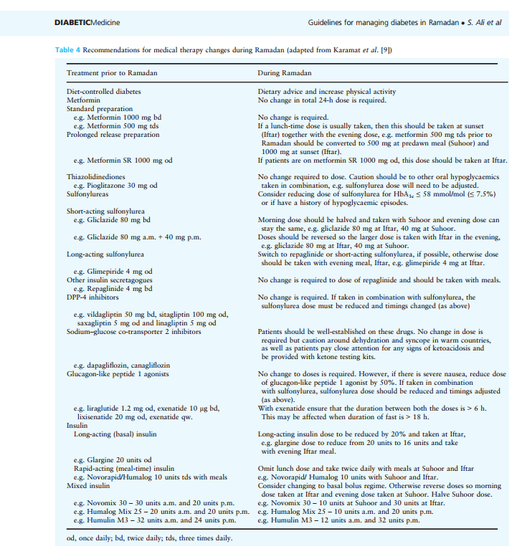

Slide 45
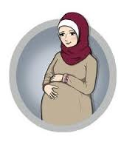
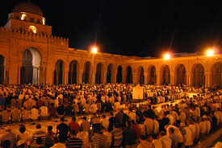
Special circumstances
Pregnancy
Pregnant women with diabetes are exempt from fasting
Maternal and foetal risks associated with poor glycaemic control in pregnancy
Smoking
Muslims must abstain from smoking during fasting hours
Opportune time for smoking cessation
Study of smoking cessation in British Pakistani and Bangladeshi adults: Ramadan had a positive impact on willingness to quit smoking
Taraweeh prayers
Nightly special prayers held in Ramadan
Repeated cycle of rising, kneeling and bowing
Often people will walk to the mosque
Accounted for in exercise regime
Carry water and treatment for hypoglycaemic events

Slide 46
Case study 1: patient characteristics
Patient:
Ahmed, aged 46 years
He is an accountant and plays football once a week as the only source of exercise.
He has had type 2 diabetes for 3 years
HbA1c: 57 mmol/mol (7.4%)
BMI: 29 kg/m²
Current treatment: Metformin 1,500 mg daily
Additional Notes:
Ahmed lives with his wife and 3 children. He usually plays football with his friends every Saturday afternoon. He’s looking forward to fasting during Ramadan and enjoying the festivities of the month as he often meets family and friends for Iftar or Suhur during Ramadan.
46

Slide 47
If you decide to add an agent after metformin, which agent would it be?
A
Add SU
B
Add DPP-4i
C
Add TZD
D
Add SGLT-2i
E
Add GLP-1RA
F
Add insulin

Slide 48
Case study 1: What are Ahmed’s management challenges?
Patient:
Ahmed, aged 46 years
He is an accountant and plays football once a week as the only source of exercise.
He has had type 2 diabetes for 3 years
HbA1c: 57 mmol/mol (7.4%)
BMI: 29 kg/m2
Current treatment: Metformin 1,500 mg daily
1.
3.
Overweight
Routine exercise
Additional Notes:
Ahmed lives with his wife and 3 children. He usually plays football with his friends every Saturday afternoon. He’s looking forward to fasting during Ramadan and enjoying the festivities of the month as he often meets family and friends for Iftar or Suhur during Ramadan.
2.
Potential for increased caloric intake during Ramadan
48

Slide 49
Would you change or adjust Ahmed’s medication prior to Ramadan?
A
Yes
B
No

Slide 50
Ahmed – advice on weight management
Ahmed is overweight (BMI 29) and admits to frequent overeating during Ramadan
Weight effects of commonly used antidiabetic drug classes in the general T2DM population
Weight gain | Weight neutral | Weight loss
Insulin | DPP-4 inhibitors | GLP-1 receptor agonists
Sulphonylureas | α-glucosidase inhibitors | SGLT-2 inhibitors
Thiazolidinediones | Metformin
Meglitinides
Adapted from ADA recommendations. Diabetes Care 2015;38:140–149

Slide 51
Case study 2: patient characteristics
Patient:
Fatima, aged 37 years
She is a physical education teacher.
She has had type 2 diabetes for 3 years (developed during 2nd pregnancy)
HbA1c: 61 mmol/mol (7.7%)
BMI: 27.5 kg/m²
Current treatment: Metformin 1500 mg/daily, glimepiride 2mg OD (added 3 months ago when HbA1c was 8.1%)
Additional Notes:
Since adding glimepiride, Mrs Fatima’s weight increased by 1.5 kg. She attends your clinic 3 months before Ramadan and her latest HbA_{1c} is 7.7%. She experienced symptoms of hypoglycaemia twice during busy days at work. She usually doesn’t do many home CBG measurements and she heard from a friend that it should not be done in Ramadan.
51

Slide 52
What is Fatima’s risk grade?
A
High risk
B
Moderate risk
C
Low risk

Slide 53
Case study 2: What are Fatima’s management challenges
Patient:
Fatima, aged 37 years
She is a physical education teacher.
She has had type 2 diabetes for 3 years (developed during 2nd pregnancy)
HbA1c: 61 mmol/mol (7.7%)
BMI: 27.5 kg/m²
Current treatment: Metformin 1500 mg/daily, glimepiride 2mg OD (added 3 months ago when HbA1c was 8.1%)
1.
Young age
5.
Active job
2.
Overweight
4.
Past
hypoglycaemia
Additional Notes:
Since adding glimepiride, Mrs Fatima’s weight increased by 1.5 kg. She attends your clinic 3 months before Ramadan and her latest HbA_{1c} is 7.7%. She experienced symptoms of hypoglycaemia twice during busy days at work. She usually doesn’t do many home CBG measurements and she heard from a friend that it should not be done in Ramadan.
3.
Infrequent CBG monitoring
53

Slide 54
What advice would you give her to improve her glycaemic control?
A
Increase SU dose
B
Switch from SU to GLP-1 receptor agonist
C
Switch from SU to DPP-4 inhibitor
D
Switch from SU to SGLT-2 inhibitor
E
Switch from SU to TZD
F
Continue SU and add any of the above

Slide 55
What is your advice regarding home CBG testing during Ramadan?
A
No need to test as she’s not on insulin
B
CBG testing is forbidden during Ramadan
C
Important to do CBG testing during Ramadan

Slide 56
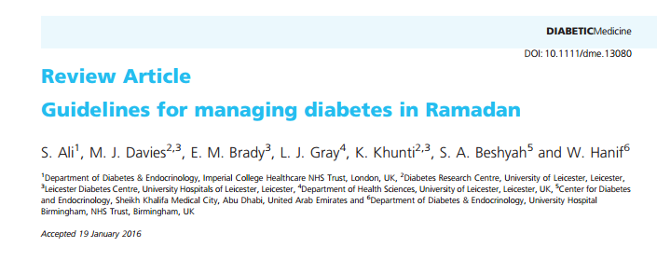
Ramadan: Further reading

Slide 57
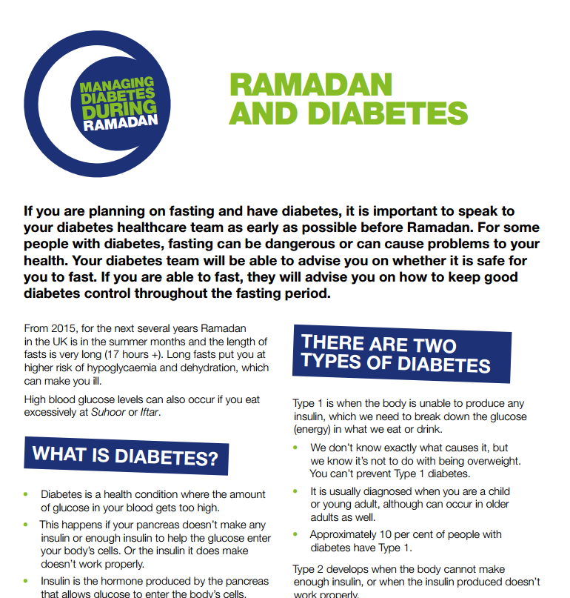
Ramadan: further reading for patients
https://www.diabetes.org.uk/guide-to-diabetes/managing-your-diabetes/ramadan/
http://www.mcb.org.uk/be-careful-with-your-health-this-ramadan/

