Slide 1

Prevention of CVD in Diabetes
Dr Peter Winocour
3rd Herts Diabetes Conference 2016

Slide 2
Prevention of CVD in DM
1.Type 1 DM important but separate issue
2. DM is NOT necessarily a CVD risk equivalent
3. Multiple Risk Factors amplify CV Risk
Combined Management Delivers Benefit – Steno
4.Lifestyle – diet, exercise and smoking cessation
5. Lipid management – non HDLC < 2.5
6. Renal (GFR and albuminuria) amplify CVD risk
7. Aspirin only for established CVD – renal
8. BP targets individualised especially in elderly
9. CCF specific input – link with CKD-anaemia

Slide 3


Where is the guidance ?

Slide 4
Type 1 Diabetes
CVD risk contingent on age, duration of diabetes, HbA1c , renal status
Statins in majority over the age of 40 ? unless just diagnosed, thin and fit with no other CVD risk
Younger patients aged 30-40 with high CVD risk justify statins, such as long duration with renal complications , insulin resistance features or poor DM control with additional risk e.g. severe retinopathy–smoking
Aged 18-30 only if advancing nephropathy
Caution in women of child bearing potential

Slide 5
Lipids – Threshold for Initiation and Targets
The higher non HDLC the higher the baseline risk
There is no lower non-HDLC limit if CVD risk high
Current non HDL cholesterol target < 2.5 mmol/l where statins initiated on basis of CVD risk
High intensity statins (atorvastatin 80 mg) with established CVD or non HD CKD and not at target

Slide 6
What about statin intolerance ?
Alternative statin and titration trial
Ezetimibe
Fenofibrate – non lipaemic benefits
Future – PCSK9I – alirocumab and evilocumab

Slide 7
When to use Aspirin ?
Secondary prevention – established CHD, PVD, non haemmorhagic CVA
Proteinuric nephropathy and CKD3-5
Dosage 75 mg has modest evidence base
Potential bleeding and cancer prevention

Slide 8
BP targets – ‘different strokes…’
140/80 for majority
130/70 for renal
Role for microvascular protection with ACEI-ARB independent of BP effect
Conservative in frail elderly
Sick day rules

Slide 9
The emerging importance of CCF Comorbidity and outcome
 | Mortality |  | Heart Failure hospitalisation
 | HR | P value | HR | P value
Chronic kidney disease | 1.50 | 0.0212 | 1.59 | 0.0005
Anaemia | 1.69 | 0.0017 | 1.44 | 0.0034
Diabetes | 1.74 | 0.0004 | 1.31 | 0.0239
Prevalence of co morbidity was the same regardless of ejection fraction
Notes:
Age sex EF frequently fall out of these analyses

Slide 10
Intensified multifactorial intervention has sustained beneficial effects at stage of microalbuminuria in T2DM
Number of cardiovascular disease events among patients on intensive vs. conventional therapy¹
In type 2 diabetes with
albuminuria, intensified multifactorial
intervention* had sustained beneficial
effects on vascular complications
and on rates of death¹
After mean of 13.3 years† 20%
absolute risk reduction for death
21 year follow up shows median
7.9 years of life gained
Only 80 active and 80 placebo Rx !
* tight glucose regulation and the use of renin–angiotensin system blockers, aspirin, and lipid-lowering agents
† 7.8 years of multifactorial intervention and an additional 5.5 years of follow-up
CABG=coronary artery bypass graft, PCI=Percutaneous Coronary Intervention
Intensive therapy
Conventional therapy
40
35
30
25
No. of cardiovascular events
20
15
10
5
0
Death from cardiovascular causes
Stroke
Myocardial infarction
CABG
PCI
Revascul-
arisation
Amputation
Reference:
1. Gæde P, Lund-Anderson H, Parving H-H, et al. N Engl J Med 2008;358:580-91 2. Gaede P et al , Diabetologia 2016.

Slide 12
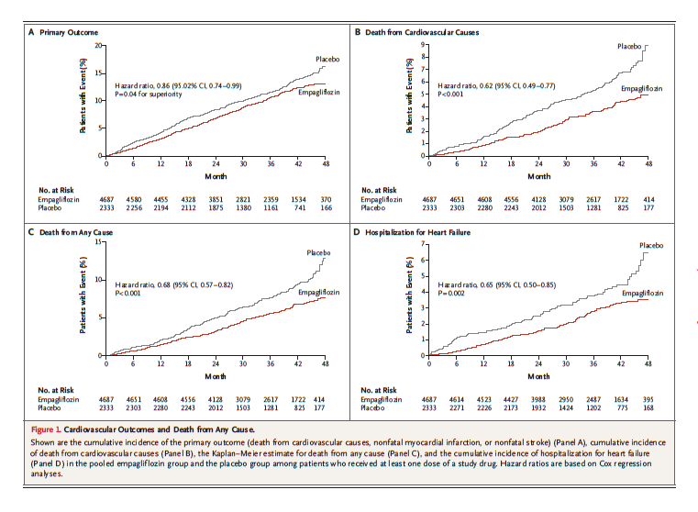

Slide 13
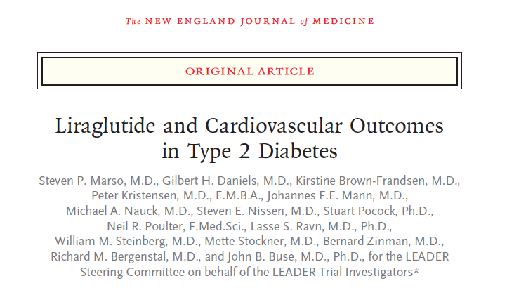


Slide 14
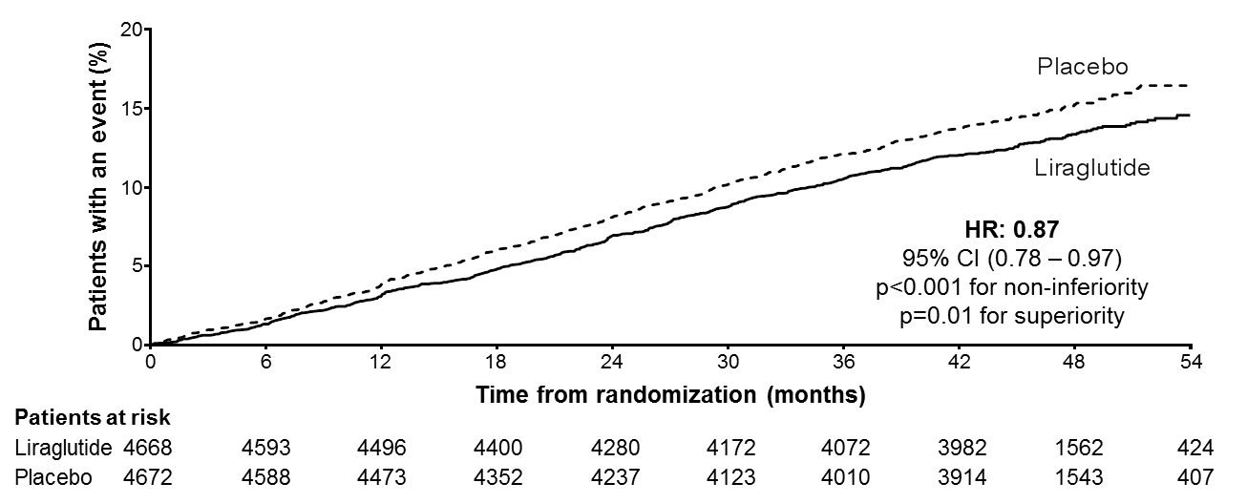
LEADER: Primary outcome
CV death, non-fatal myocardial infarction, or non-fatal stroke
The primary composite outcome in the time-to-event analysis was the first occurrence of death from cardiovascular causes, non-fatal
myocardial infarction, or non-fatal stroke. The cumulative incidences were estimated with the use of the Kaplan–Meier method, and the
hazard ratios with the use of the Cox proportional-hazard regression model. The data analyses are truncated at 54 months, because less
than 10% of the patients had an observation time beyond 54 months. CI: confidence interval; CV: cardiovascular; HR: hazard ratio.
Presented at the American Diabetes Association 76th Scientific Sessions, Session 3-CT-SY24. June 13 2016, New Orleans, LA, USA.
Notes:
The primary outcome was the time from randomization to a composite outcome consisting of the first occurrence of cardiovascular death, nonfatal (including silent) myocardial infarction (MI), or nonfatal stroke.
Reference: Primary manuscript
Source: KM plot: EOT Figure 14.2.45 / ID14201320
HR: EOT Table 14.2.43/ID14201300_primary_analysis_fas.txt
P-value: EOT Table 14.2.44/ID14201310_primary_analysis_pvalues_fas.txt

Slide 15
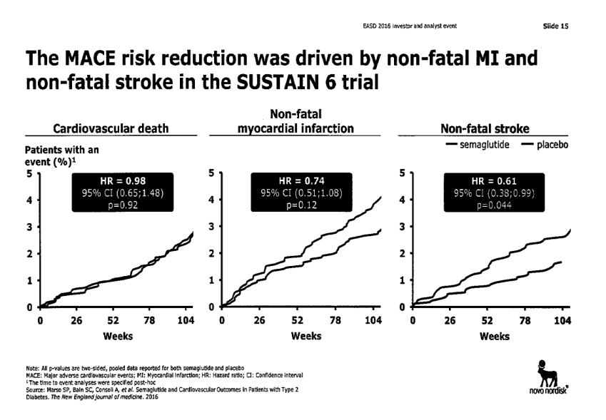
SUSTAIN CVD events- Semaglutide Weekly GLP1

Slide 16
Prevention of CVD in DM
1.Type 1 DM impt but separate issue
2. DM is NOT necessarily a CVD risk equivalent
3. Multiple risk factors amplify risk ? Benefit
4.Lifestyle – diet, exercise and smoking cessation
5. Lipid management – non HDLC < 2.5
6. Renal (GFR and albuminuria) amplify CVD risk
7. Aspirin only for established CVD – renal
8. BP targets individualised esp elderly
9. CCF specific input – link with CKD-anaemia

Slide 17
Prevention of CVD in DM - The future
1.? Potential role for gliflozins for heart failure and renoprotection in DM at high risk for CVD
? No impact on empa on IHD or CVA
2. ? Potential role for GLP1 analogues in IHD-CVA reduction in DM at high risk for CVD as alternative to intensive insulin based regime
No impact of GLP-1 analogues on CCF
3. Statins-ACEI or ARBs and occasional use of PCSK9 and ASA
Potassium sparing therapies ?

