Slide 1


Prevention of Type 2 DM after GDM
Thomas Galliford
Consultant Physician and Endocrinologist
West Herts Hospitals NHS Trust

Slide 2





Slide 4
Prevention of Type 2 DM after GDM
Diabetes in pregnancy
Gestational diabetes mellitus
  Diagnosis
  Management
  Complications
Risk of developing type 2 diabetes
Prevention of type 2 diabetes
  Pre-diabetes
  Screening
  Future

Slide 5
Pregnancy and diabetes
Approx 650,000 pregnancies in UK/yr
2-5% involve mothers with diabetes
GDM / type 1 diabetes / type 2 diabetes (87.5% / 7.5% / 5%)
 | Prevalence | Number of pregnancies in England
Total singleton pregnancies |  | 600,200
Type 1 diabetes | 0.3% | 1,800
Type 2 diabetes | 0.2% | 1,200
Gestational diabetes | 3.5% | 20,400
Total diabetes in pregnancy |  | 23,400
www.nice.org.uk

Slide 6
Gestational Diabetes Mellitus
Definition
Any impairment of glucose tolerance first recognised in pregnancy
Risk factors
pre-pregnancy body mass index above 30 kg/m2
previous gestational diabetes
family history of diabetes (first-degree relative with diabetes)
previous macrosomic baby weighing ≥ 4.5 kg
family origin with a high prevalence of diabetes
70% will need oral agents +/or insulin

Slide 7
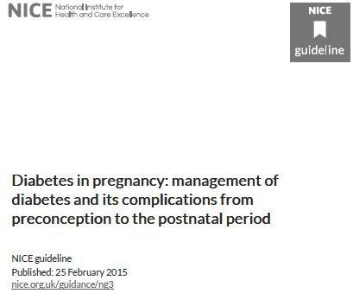
GDM – latest guidance
New NICE guidance based on QALYs
  If willing to pay £20,000 per QALY (no Rx)
  If willing to pay £30,000 per QALY most cost effective
  → WHO 1999:
LABORATORY PLASMA GLUCOSE (mmol/L)
 | Fasting | 2 hour
GDM | ≥ 5.6 | ≥ 7.8
Normal | < 5.6 | < 7.8

Slide 8
Screening for GDM
Plasma glucose (fasting or non-fasting)
  Raised fasting or random BG
  → 75g OGTT
Note of risk factors for GDM
  Any x 1 → booked for 75g OGTT at 24-28 weeks
Random BG ≥ 11mmol/L = GDM
  No need for OGTT
Previous GDM
  Offer home CBG testing OR OGTT approx 16/40

Slide 9

Treatment of diabetes in pregnancy
Frequent SMBG, 4-7 times daily
See every 2 – 4 weeks
Dietician review
Weights
Treatment
  Diet
  Metformin
  Insulin
TIME | BG (mmol/L)
Fasting | < 5.3
1-hour | < 7.8
2-hour | < 6.4

Slide 10
ACHOIS study NEJM 2005; 352(24): 2477 - 2486
Prospective interventional study to examine whether screening and treatment to reduce maternal glucose levels reduce pregnancy risk
Methods:
  OGTT 24 – 34 weeks (WHO definition for GDM, if +ve → blinded and randomized)
  Dietary advice, monitoring and treatment to achieve normoglycaemia vs. no treatment unless attending team felt appropriate on the basis of indications that arose
  Primary outcomes infants – serious perinatal complications
  Primary outcomes mothers – IOL, c-section
Results:
  490 (Rx group) vs. 510 (no Rx group) women
  Relative risk of serious perinatal complications 1% vs 4% (adjusted for maternal age, ethnicity, parity)
  IOL: 39% vs. 29%
  C-section rates similar

Slide 11
HAPO – Hyperglycaemia and Adverse Pregnancy Outcomes
NEJM 2008; 358(19): 1991-2002
25000 patients from 15 centres
75g OGTT at 24-32/40
1º outcomes:
  BW > 90th centile
  C-section
  Neonatal hypoglycaemia
  Cord blood c-peptide > 90th centile
2º outcomes:
  Premature delivery
  Dystocia/birth injury
  Need for NICU
  Hyperbilirubinaemia
  PET

Slide 12
HAPO – Hyperglycaemia and Adverse Pregnancy Outcomes
NEJM 2008; 358(19): 1991-2002
25000 patients from 15 centres
75g OGTT at 24-32/40
1º outcomes: OR
  BW > 90th centile 1.38
  C-section 1.55
  Neonatal hypoglycaemia 1.11
  Cord blood c-peptide > 90th centile 1.08
2º outcomes:
  Premature delivery 1.05
  Dystocia/birth injury 1.18
  Need for NICU 0.99
  Hyperbilirubinaemia 1.21
  PET 1.00

Slide 13
Risk of developing type 2 diabetes
Depends what paper you read!
  Old studies
  Variable ethnicity
  Different diagnostic criteria
What is useful?
  Incidence of type 2 diabetes following GDM
  Predictors of type 2 diabetes following GDM
  What is the risk for women with GDM?
    Systemic reviews
    Meta-analysis
    → education and intensive screening of these groups
    →prevention

Slide 14
Gestational Diabetes and the Incidence of Type 2 Diabetes
Diabetes Care 2002; 25: 1862 – 1868
PubMed search 1965 – 2001
  28 studies
Culmulative incidence of diabetes ranged from 2.6% to > 70% (6 wks post-partum to 28 years)
Longest study: Boston Mass = 50% after 6 yrs, 70% after 28 yrs
Women from mixed or non-white cohorts progress to type 2 diabetes at similar rates
Whites and non-whites appear to progress to type 2 diabetes at similar rates (however fewer studies in white cohort)
Progression greatest in first 5 years post-partum

Slide 15
Predictors of Postpartum Diabetes in Women with Gestational Diabetes Mellitus
Diabetes 2006; 55: 792 – 797
Prospective study from Germany recruiting between 1989 – 1999
  302 patients
  53% culmulative 8yr progression to type 2 diabetes
Risks:
  autoAbs (HR 4.1)
  Requirement of insulin during pregnancy (HR 4.7)
  BMI > 30 (HR 1.5)
  Women with more than two prior pregnancies (HR 2.5)
No association:
  FHx
  Maternal age
  Child’s birth weight
  CRP at 9 months

Slide 16
Type 2 diabetes mellitus after gestational diabetes: a systematic review and meta-analysis Lancet 2009; 373(9677): 1773-9
Identified cohort studies between 1960 and 2009
  20 studies selected including 675455 women
  Calculated unadjusted relative risks
  Sub-group analysis incl. ethnicity, maternal age, BMI
→ Increased risk of developing type 2 diabetes compared with those who had a normoglycaemic pregnancy – relative risk 7.43
  “there is no reference to the power that the term ‘gestational diabetes’ has to transform a happy pregnant woman into an anxious or depressed one

Slide 17

44 page Guide to Gestational Diabetes
“After having gestational diabetes, you are at an increased risk of developing the condition in future pregnancies, and you’re also more likely to develop Type 2 diabetes later on.”

Slide 18
Dietary advice when pregnant
“weight gain varies greatly during pregnancy”
“most women gain between 10kg and 12.5kg (22-26lb)”
“a healthy diet is an important part of a healthy lifestyle at any time”
“you don’t need a special diet”
“you will probably find that you are hungrier than usual but you don’t need to eat for two even if you are having twins”
“you need to be careful with your diet if you develop gestational diabetes, your Doctor or Midwife will advise you”
NICE: Public health guideline [PH27] July 2010 “Do not weigh women repeatedly during pregnancy as a matter of routine”

Slide 19
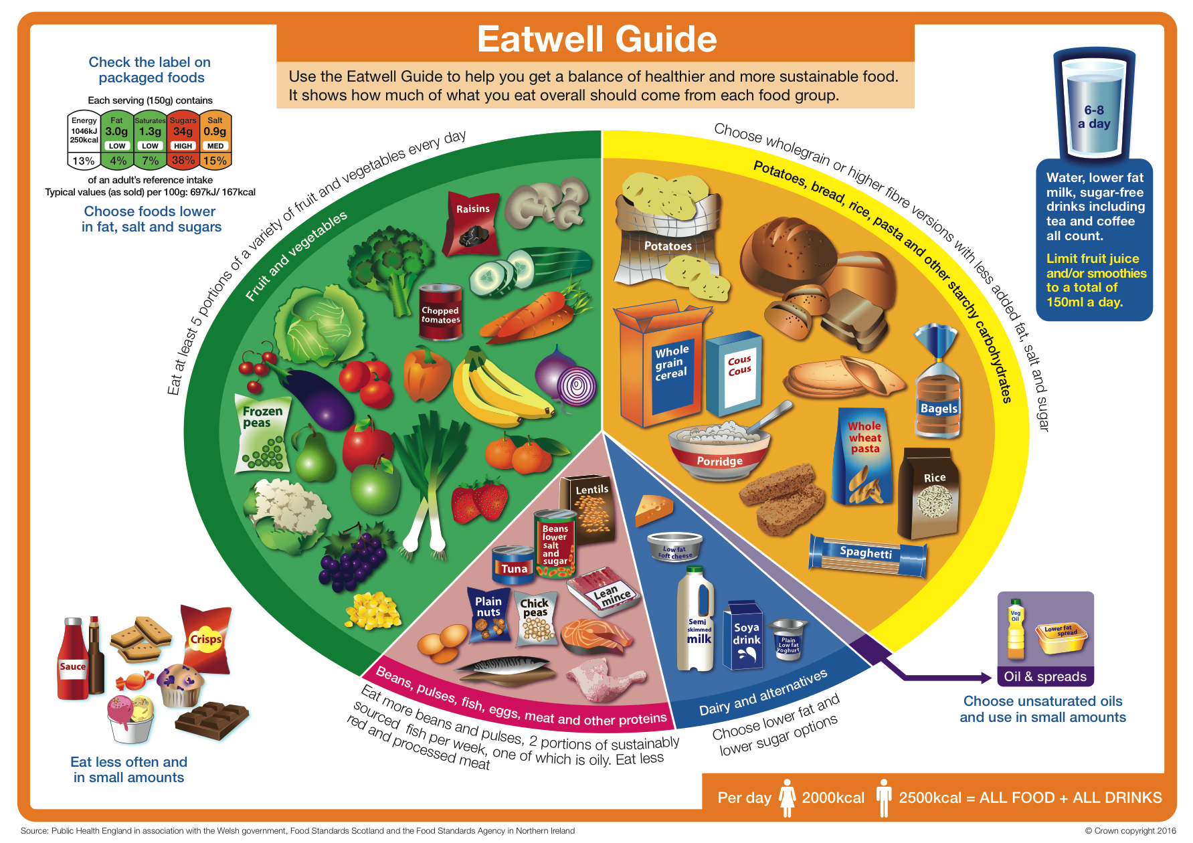

Slide 20
Prevention of type 2 DM after GDM
No intervention trial to date except one that examined troglitazone that was subsequently discontinued because of hepatotoxicity in other populations
Complications in discontinuity of care
  Loss to any follow-up post delivery
  Maternal underestimates of risk
  Difficulties in continued implementation of exercise and diet

Slide 21
Pre-diabetes
Synonyms
  IFG, IGT, borderline diabetes
Not recognised by the WHO
  ADA – HbA1c 5.7% / 39mmol/mol
Simply put means that blood glucose levels higher than normal and at greater risk of developing type 2 diabetes
Are we screening this cohort?
How do we improve screening uptake?

Slide 22
Screening for type 2 diabetes in mothers with previous GDM
Main NPID outcomes
  Growing proportion of pregnancies in women with T2 DM
  44.9% vs. CEMACH 27.3%
  Proportion of mothers with type 2 diabetes up by 60%
Post-natal screening
  No 6 week OGTT
→ Fasting glucose
  Annual HbA1c and/or fasting glucose

Slide 23
DIAMIND trial – Diabet Med 2015; 32(10):1368-76
Randomized controlled trial assessing whether an SMS reminder system for women, after GDM, would increase their attendance for OGTT by 6 months
Subjects:
  GDM in recent pregnancy
  Mobile phone
  normal glucose prior to discharge
  n = 140 sent SMS at 6/52, 3/12, 6/12 vs. n = 136 sent x1 SMS at 6/12
Results:
  SMS group = 104 vs. control 103

Slide 24
Reduction in the incidence of type 2 diabetes with lifestyle intervention or metformin - DPPR Group. NEJM 2002; 346(6): 393-403
Methods
  3234 persons without diabetes (50% from ethnic minorities)
  Elevated fasting and post-prandial glucose concentrations
  BMI > 24
  Placebo vs. metformin (850mg tds) vs. intensive lifestyle modification
    Aim 7% weight loss
    150 minutes of physical activity/wk
    16 lesson curriculum covering diet, exercise and behaviour modification; 1 to 1 basis in first 24wks and subsequent individual monthly sessions and group sessions
Primary Outcome
  Diabetes diagnosed on annual OGTT or semi-annual fasting glucose

Slide 25
DPPR – Results

Slide 26
DPPR - Results
High rates of diabetes
Lifestyle intervention reduced the incidence of diabetes by 58%
Metformin reduced the incidence of diabetes by 31%
To prevent one case of DM in 3 years:
  6.9 persons would have to participate in the lifestyle intervention program
  13.9 would have to receive metformin
Results the same regardless of ethnicity, BMI, age

Slide 27
The future - big decisions to be made…
NHS England – Diabetes Prevention Strategy
Public Health policy
  Childhood obesity strategy
Governmental role
  Childhood obesity strategy????
  Advertising restrictions
  Some supermarket promotions banned
  Extension of sugar tax
School role re: exercise
Prevention of type 2 diabetes study in mothers with GDM!

Slide 28
Summary
Diabetes in pregnancy
Gestational diabetes mellitus
  Diagnosis
  Management
  Complications
Risk of developing type 2 diabetes
Prevention of type 2 diabetes
  Pre-diabetes
  Screening
  Future

Slide 29


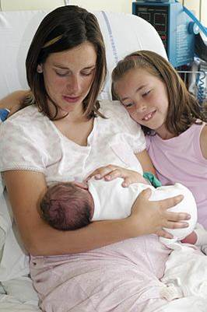


Many thanks
Any questions?

