Slide 1

Prevention of Hypoglycaemia
Dr Andrew Solomon
Consultant in Diabetes and Endocrinology ENHT
Hertfordshire Diabetes Conference
6th October 2016
Fielder Centre, Hatfield, Herts.

Slide 2
Does it matter?
Ok to have a glucose of 1.8 once in a while?
Ok to have a glucose of 2.8 “ “ “
Ok to have a glucose of 3.8 “ “ “
Ok to have a glucose of 4.8 “ “ “

Slide 3
The Latest NICE Guidance for Type 1 and Type 2

Slide 4
Hypo prevention Type 2 NICE
Type 2 diabetes in adults: management
NICE guideline [NG28] Published date: December 2015 Last updated: July 2016
“Reducing the risk of hypoglycaemia should be a particular aim for a person using insulin or an insulin secretagogue”
“…if…drug not associated with hypoglycaemia, support the person to aim for an HbA1c level of 48 mmol/mol (6.5%). For adults on a drug associated with hypoglycaemia, support the person to aim for an HbA1c level of 53 mmol/mol (7.0%)”

Slide 5
Type 2 NICE
“Consider relaxing the target HbA1c level…………..[in] people who are at risk of falling, people who have impaired awareness of hypoglycaemia, and people who drive or operate machinery as part of their job”
“Consider pre-mixed (biphasic) preparations that include short‑acting insulin analogues, rather than pre‑mixed (biphasic) preparations that include short‑acting human insulin preparations, if: a person prefers injecting insulin immediately before a meal or hypoglycaemia is a problem ”

Slide 6
Type 2 NICE
“Consider switching to insulin detemir or insulin glargine from NPH insulin in adults with type 2 diabetes: who do not reach their target HbA1c because of significant hypoglycaemia or who experience significant hypoglycaemia on NPH insulin irrespective of the level of HbA1c reached”

Slide 7
Hypo prevention Type 1 NICE
Type 1 diabetes in adults: management
NICE guideline [NG17] Published date: August 2015 Last updated: July 2016
https://www.nice.org.uk/guidance/ng17/chapter/1-Recommendations
1.10.13If hypoglycaemia becomes unusually problematic or of increased frequency, review the following possible contributory causes:
inappropriate insulin regimens (incorrect dose distributions and insulin types)
meal and activity patterns, including alcohol
injection technique and skills, including insulin resuspension if necessary
injection site problems
possible organic causes including gastroparesis
changes in insulin sensitivity (including drugs affecting the renin–angiotensin system and renal failure)
psychological problems
previous physical activity
lack of appropriate knowledge and skills for self‑management.

Slide 8
Type 1 NICE
Hypoglycaemia ;assessment; and awareness
if there is a need to know blood glucose levels more than 4 times a day for other reasons (for example, impaired awareness of hypoglycaemia, high‑risk activities)
Identifying and quantifying impaired awareness of hypoglycaemia
1.10.1Assess awareness of hypoglycaemia in adults with type 1 diabetes at each annual review. [new 2015]
1.10.2 Use the Gold score or Clarke score to quantify awareness of hypoglycaemia in adults with type 1 diabetes, checking that the questionnaire items have been answered correctly. [new 2015]

Slide 9
Type 1 NICE
Hypoglycaemia :Management
Review insulin regimens and doses and prioritise strategies to avoid hypoglycaemia in adults with type 1 diabetes with impaired awareness of hypoglycaemia, including:
reinforcing the principles of structured education
offering continuous subcutaneous insulin infusion (CSII or insulin pump) therapy
offering real‑time continuous glucose monitoring. [new 2015]
“Consider real‑time continuous glucose monitoring for adults with type 1 diabetes who are willing to commit to using it at least 70% of the time and to calibrate it as needed, and who have any of the following despite optimised use of insulin therapy and conventional blood glucose monitoring:
More than 1 episode a year of severe hypoglycaemia with no obviously preventable precipitating cause.
Complete loss of awareness of hypoglycaemia.
Frequent (more than 2 episodes a week) asymptomatic hypoglycaemia that is causing problems with daily activities.
Extreme fear of hypoglycaemia.”

Slide 10
Type 1 NICE
Hypoglycaemia :Management
1.9 Referral for islet or pancreas transplantation
1.9.1Consider referring adults with type 1 diabetes who have recurrent severe hypoglycaemia that has not responded to other treatments (see section 1.10) to a centre that assesses people for islet and/or pancreas transplantation. [new 2015]

Slide 11

..Balance..

Slide 12
Balance of Medication
Efficacy and Safety
Ideally
-Glucose lowering effect
-Absence of hypoglycaemic effect
-Improved lipid/metabolic status
-Improved CVS event profile

Slide 13
Figure 2. Anti-hyperglycemic therapy in T2DM: General recommendations
Diabetes Care 2015;38:140-149; Diabetologia 2015;58:429-442
Notes:
Potential sequences of antihyperglycemic therapy for patients with type 2 diabetes are displayed, the usual transition being vertical, from top to bottom (although horizontal movement within therapy stages is also possible, depending on the circumstances). The figure denotes relative glucose lowering efficacy, risk of hypoglycemia, effect on body weight, other side effects and approximate relative cost for each drug class.
In most patients, begin with lifestyle changes; metformin monotherapy is added at, or soon after, diagnosis, unless there are contraindications.

Slide 14
Figure 2. Anti-hyperglycemic therapy in T2DM: General recommendations
Diabetes Care 2015;38:140-149; Diabetologia 2015;58:429-442
Notes:
Potential sequences of antihyperglycemic therapy for patients with type 2 diabetes are displayed, the usual transition being vertical, from top to bottom (although horizontal movement within therapy stages is also possible, depending on the circumstances). The figure denotes relative glucose lowering efficacy, risk of hypoglycemia, effect on body weight, other side effects and approximate relative cost for each drug class.
In most patients, begin with lifestyle changes; metformin monotherapy is added at, or soon after, diagnosis, unless there are contraindications.

Slide 15
Diabetes Care 2015;38:140-149; Diabetologia 2015;58:429-442
Notes:
Potential sequences of antihyperglycemic therapy for patients with type 2 diabetes are displayed, the usual transition being vertical, from top to bottom (although horizontal movement within therapy stages is also possible, depending on the circumstances). The figure denotes relative glucose lowering efficacy, risk of hypoglycemia, effect on body weight, other side effects and approximate relative cost for each drug class.
In most patients, begin with lifestyle changes; metformin monotherapy is added at, or soon after, diagnosis, unless there are contraindications.

Slide 16
Metformin intolerance or
contraindication
HbA1c ≥9%
Uncontrolled hyperglycemia (catabolic features,
BG ≥300-350 mg/dl, HbA1c ≥10-12%)
Diabetes Care 2015;38:140-149; Diabetologia 2015;58:429-442
Notes:
Potential sequences of antihyperglycemic therapy for patients with type 2 diabetes are displayed, the usual transition being vertical, from top to bottom (although horizontal movement within therapy stages is also possible, depending on the circumstances). The figure denotes relative glucose lowering efficacy, risk of hypoglycemia, effect on body weight, other side effects and approximate relative cost for each drug class.
In most patients, begin with lifestyle changes; metformin monotherapy is added at, or soon after, diagnosis, unless there are contraindications.

Slide 17
Figure 2A. Anti-hyperglycemic therapy in T2DM:
Avoidance of hypoglycemia
Diabetes Care 2015;38:140-149; Diabetologia 2015;58:429-442

Slide 18
Re-Audit of Severe Acute Hypoglycaemic Admissions in A & E
Identify topic
Implement Change
Audit
Set Standard
Analyse Data
Collect Data
Presented by: Karen Moore-Haines & Sarah Woodley.
Lister 19/05/2016

Slide 19
Background
Previous audit undertaken in 2014 by Dr Julia Prague, Dr Andrew Solomon and Dr Stella George.
Looked at all A&E attendences coded as hypoglycaemia during a 3 month period.
A limitation was that it only captured presentations that had a discharge summary created.
The re-audit was expanded to include a wide array of 33 data points for patients admitted in association with a hypoglycaemic episode (from hypo to discharged)
The re-audit started collecting data from March through to September 2015 and the initial cohort was 63 patients. However due to the usual constraints of obtaining notes, the audit managed to look at 38 patients notes in greater detail.

Slide 20
Aims
Compare the results of the re-audit to the previous audit
Characterise in more detail clinical features of patients presenting who had hypoglycemia
Find trends and patterns of admissions details for those patients admitted
Fit the data from the patients admitted with hypoglycemia into the wider demographics and informatics of the EAHSN data
Find possible proposals as a result of the re-audit for lasting change to enable better care for patients who arrive and/or are admitted with hypoglycemia

Slide 21
Standards
Relate the larger audit data to the published JBDS gold standards for managing hypoglycemia
Assess awareness of hypoglycaemia in adults with type 1 diabetes at each annual review (NG17)
Use the Gold score or Clarke score to quantify awareness of hypoglycaemia in adults with type 1 diabetes
Explain to adults with type 1 diabetes that impaired awareness of the symptoms of plasma glucose levels below 3 mmol/litre is associated with a significantly increased risk of severe hypoglycaemia
Any locally agreed best practice – Hypo Treatment Pathway

Slide 22
Methodology
Sample
Identify list of patients who have come into A & E with a diagnosis of ‘Hypoglycaemia’ on BIMS
Data Collection
All patients were included in the audit which were identified on BIMS between the date 1st March 2015 – 30th September 2015 (7 month period)
Identify list of patients admitted to the hospital via the Information team to ascertain ‘coding’ on discharge.

Slide 23
Results

Slide 24
Pre Hospital Information (n=38)
How was the patient conveyed to hospital?
Ambulance 27 (71%)
Self Presented 10 (26%)
Blank 1 (3%)
Patient admitted from?
Home 27 (71%)
Residential/Nursing Home 7 (18%)
Other 4 (11%)
Notes:
Conveyed by ambulance could be due to patients lack of knowledge of correct self treatment or lack of hypo awareness resulting of being beyond the point of self treating and requiring medical assistance!

Slide 25
Age and Gender (n=38)
 | Re Audit (n=38) | % | EAHSN Project (n=203) | %
Less than 10yrs | 6 | 16% | 1 | 0.5%
10yrs – 19yrs | 1 | 3% | 3 | 1.5%
20yrs – 29yrs | 2 | 5% | 18 | 9%
30yrs – 39yrs | 3 | 8% | 13 | 6%
40yrs – 49yrs | 1 | 3% | 35 | 17%
50yrs – 59yrs | 5 | 13% | 20 | 10%
60yrs – 69yrs | 4 | 11% | 32 | 16%
70yr and over | 16 | 42% | 81 | 40%
 | Re Audit (n=38) | % | EAHSN Project (n=203) | %
Male | 15 | 39% | 127 | 63%
Female | 23 | 61% | 76 | 37%
Notes:
(n=7) 18% of re-audit patients were under the age of 19yrs
However 6 of these patients did not have diabetes (see slide later)
As we would expect over 50% of patients are over the age of 60yrs

Slide 26
Length of stay (n=38)
Number of patients
Number of days
Notes:
Mean = 3.8days, Median = 1, Mode = 0 days

Slide 27
Ward Admitted to (n=26)
Ward | No. | %
Acute Med | 14 | 54%
General Med | 7 | 27%
Surgical | 1 | 4%
Childrens | 3 | 12%
Blank/Not Known | 1 | 4%
32% (n=12) of patients were discharged straight from the emergency department

Slide 28
Co-morbidities (n=30)
Notes:
Main Co-morbidities are 16% IHD, 11% Hypothyroidism, 11% Dementia
Some of the others are - Retinopathy, Alcohol induced pancreatitis, COPD, Bilateral Amputations knee, Severe hypoxic ischemic encephalopathy, PE, Uterine Ca, Diverticulitis, Liver disease, Benign Oesphageal Stenosis, Fanconi Syndrome, ventricular septal defect, persistent hyperinsulinemic Hypoglycaemia of infancy.

Slide 29
Type of diabetes (n=38)
 | N=38 | % | N=203 | %
Type 1 | 15 | 39% | 99 | 49%
Type 2 | 11 | 29% | 53 | 26%
Unconfirmed | 2 | 6% | 44 | 22%
Non Diabetes | 10 | 26% | 3 | 1%
Secondary |  |  | 4 | 2%
 | N=38 | % | N=203 | %
Conscious | 23 | 61% | 138 | 68%
Unconscious | 7 | 18% | 65 | 32%
Blank/Not known | 8 | 21% | - | -
Notes:
Almost 25% of patients who came into A & E with a Hypo event were non diabetes. We had very few patients who did not have diabetes who came through the main EAHSN project but this could be due to paramedics not referring as seen as a ‘hypo diabetes pathway’

Slide 30
Non Diabetic patients (n=10)
Ketotic hypoglycaemia (3yr Old)
Dementia, decreased oral intake
GORD, poor feeding (2yr Old)
Tumour induced hypoglycaemia
Unknown ref'd to GOSH for metabolic investigations (8yr old)
Unknown (15yr old)
? ETOH induced
Fanconi syndrome, congenital hyperinsulinism and VSD (1yr old)
Poor feeding (1yr Old)
Diagnoses include hypoglycaemia, arrhythmia or vasovagal.
Notes:
Some of the primary diagnosis of patients who have had a hypoglycaemic event but do not have diabetes.

Slide 31
Symptom which prompted presentation (n=38)
 | N=38 | %
Autonomic | 7 | 18%
Neuroglycopenic | 21 | 55%
Not Eating/Drinking | 4 | 11%
Hypo Unawareness | 3 | 8%
Not Known | 3 | 8%
50% of patients had other complications beyond the Hypo event, e.g. fall x 7, seizure, car crash
Notes:
Fall, Seizure and UTI were the main ones, others were:
Crashed his car
Aspiration pneumonia
? Chest Infection
?CVA

Slide 32
Blood Glucose (first recorded)
 | N=38 | % | N=203 | %
< 1 | 6 | 16% | 5 | 2%
1.1 - 2 | 8 | 21% | 71 | 35%
2.1 – 3 | 10 | 26% | 71 | 36%
3.1 – 4 | 5 | 13% | 36 | 18%
> 4.1 | 0 | 0% | 16 | 8%
Blank/Not Known | 9 | 24% | 1 | 0.5%
13% (n=5) of action taken was not appropriate on arrival to A & E
Only 45% of patients were given a long acting carbohydrate once the BM was greater than 4
Notes:
6 of the patients ‘with diabetes’ did not have a first recorded blood glucose documented.
A Mixture of treatments administered, from IM Glucagon, Dextrose Gel and oral carbs
13% of action not appropriate
Did not follow trust protocol
Pts BM’s not closely monitored and developed further hypo episodes, received 22 glucogels in <24hrs
No recording of long acting carb given x3

Slide 33
Current Diabetes Medication (n=38)

Slide 34
Driving and Admissions (n=38)
Only 5% of patients had driving discussed and documented in the notes.
The trust hypoglycaemic pathway was followed for 61% of patients.
18% had recent hypo admissions in the last year, and 50% had other recent admissions in the last year
Notes:
Other recent admissions were relating to:
LRTI
COPD
Encephalopathy
Fall
Cellulitis
ACS

Slide 35
Patient Referred to (n=38)
Notes:
26% of patients referred to Acute Diabetes Team and 92% of patients were entered on CIPTS.

Slide 36
Recent HbA1c taken before Hypo event (n=28)
HbA1c
Patient
Notes:
The mean HbA1c is 69

Slide 37
Recent HbA1c taken before Hypo event (n=28)
HbA1c
Patient
Notes:
The mean HbA1c is 69

Slide 38
Recent HbA1c taken before Hypo event (n=28)
HbA1c
Patient
Notes:
The mean HbA1c is 69

Slide 39
Known to hospital/community
 | N=38 | %
Known to Hospital | 16 | 42%
Not known to Hospital | 21 | 55%
Blank/Not Known | 1 | 3%
 | N=21 | %
Known to Community | 4 | 19%
Not known to Community | 5 | 24%
Blank/Not Known | 12 | 58%

Slide 40
Patient’s Creatinine on admission - (n = 24)
Notes:
67% (n=16) of patients had a Creatinine in their normal range on admission to hospital with a Hypo
23% (n=8) of patients had a abnormal Creatinine on admission to hospital with a Hypo.
14 patients we did not either have a creatinine on admission or a previous creatinine to compare

Slide 41
Coding (n=22)
Notes:
A coding of Hypoglycaemia could only be found for 22 of the patients who came to A & E, this maybe because the other patients have not been coded yet?

Slide 42
Patient Mortality (n=8)
21% of patients have since passed away
(Ages, 1yr, 43yrs, 52yrs, 66yrs, 79yrs, 83yrs, 87yrs and 92yrs)
2 of these patients did not have a diagnosis of diabetes (1yr old and 79yr old)

Slide 43
Patient Mortality (n=8)
DOB | Date of Hypo | Date of Death | Contributing Factors? | Seen by DOT at time of Hypo
07/01/1973 | 04/03/2015 | 28/10/2015 |  | Y
17/06/1924 | 03/06/2015 | 21/11/2015 | AKI, CR 845 | N
09/10/1933 | 14/09/2015 | 20/09/2015 | aspiration pneumonia | N
30/11/1964 | 17/08/2015 | 27/08/2015 | Out of hospital cardiac arrest, asystole | Y
27/07/1929 | 11/08/2015 | 11/08/2015 | hypoglycaemia, AKI, metabolic acidosis, raised ketones, high anion gap | Y
29/04/2015 | 24/07/2015 | 04/11/2015 | Cardiac arrest | N
29/11/1937 | 25/07/2015 | 14/08/2015 | Sepsis, Dementia | N
20/04/1950 | 18/07/2015 | 21/10/2015 | cardiac arrest, lactate 9.5, VBG ph 6.8 | Y
Notes:
The 2 patients highlighted in green do not have Diabetes.

Slide 44
Conclusions
~50% are over 60yrs of age
63% are Male from EAHSN project but 61% are Female from the re-audit
Majority of patients have a short stay (0-1 days)
Over 50% are admitted to Acute Med ward
Main Co-morbidities are IHD, Dementia and Hypothyroidism/Hypertyroidism
Majority of patients are Type 1,
EAHSN - 49% compared to 26% Type 2. Re-audit - 39% compared to 29% Type 2

Slide 45
Conclusions
Most common symptom which prompted presentation was ‘Neuroglycopenic’
A high proportion on patients coming through A & E with a hypo event do not have diabetes (26%)
The trust hypoglycaemic pathway was followed for 61% of patients.
Only 45% of patients were given a long acting carbohydrate once the BM was greater than 4
18% had hypo re-admissions in the last year
61% are either known to the Hospital or Community
It appears that creatinine remains unchanged on admission and therfore may not be a large contributing factor to hypo’s

Slide 46
Acknowledgements
Ed Hoy
Alina Barcan
Carol Knowles
Dr A Solomon

Slide 47
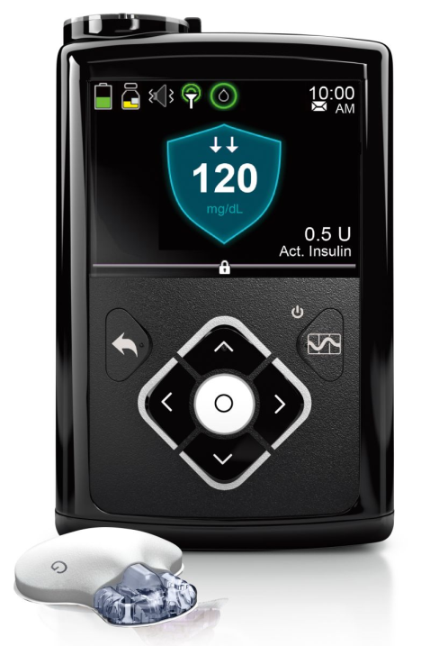
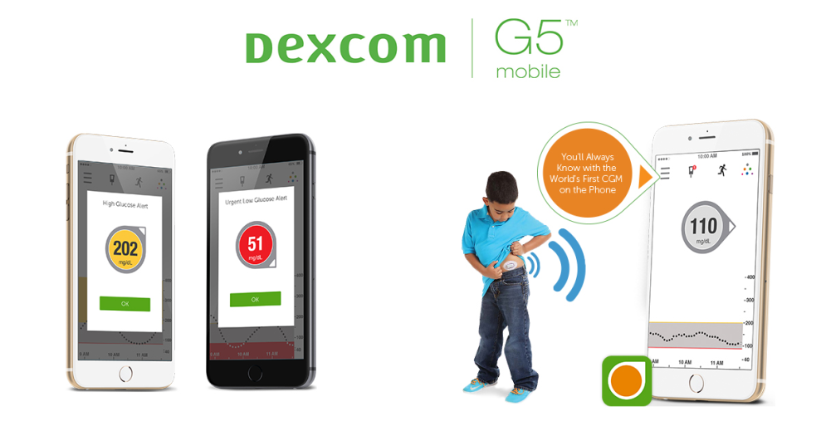
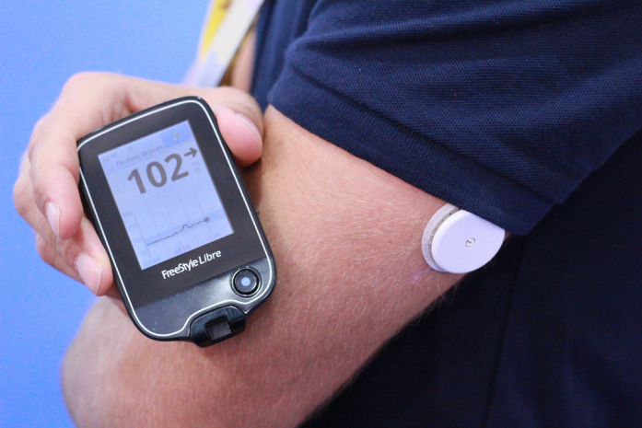
Finally …
new friends …new technologies……and

Slide 48
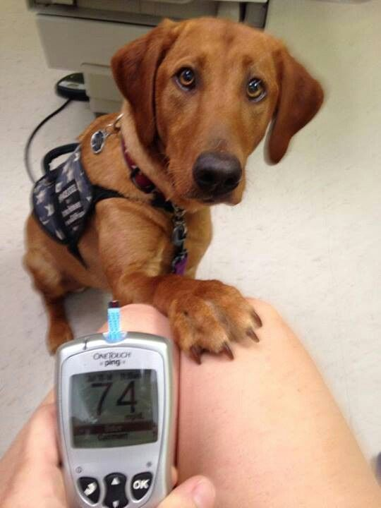
new ways of using best friends…

Slide 49


