Slide 1
Diabetes care in HVCCG for 2020
Dr Ana Pokrajac MD MSc FRCP
Consultant

Slide 2
Admiration and Respect!
Desirable future!
If those strategies worked, I would be redundant by 2020
Only providing spec input from Med

Slide 4
Brutal Reality
My pt numbers increasing, long waiting lists
By the time you get to see me in my DM renal clinic, life is not fun:
Your med list arm-length long
Your legs are at best painful if not chopped off
You attend dialysis 3x a week
Pleasure=reducing meds as your renal function declines

Slide 5
Jovial potential
Let’s spend all the money on finding the cure for Diabetes!

Slide 6
Next best
Not improving care for T1DM of T2DM
Not prevention of complications or disability
Not primary or secondary care

Slide 8
Serve All!
Have insight in all results and able for informed decision making
Expert by experience but also knowledge
Engage with providers in a positive way (elements of MI)

Slide 9
My Diabetes My Way
Cloud-based, pt-held electronic records
Communicates with all applications (EMIS, ICE, SystemOne, InfoFlex, Optomize…)
Presents data in Pt-friendly way
Explains results
Results linked to educational resources
Accessible any time
No issues with loss papers etc

Slide 10
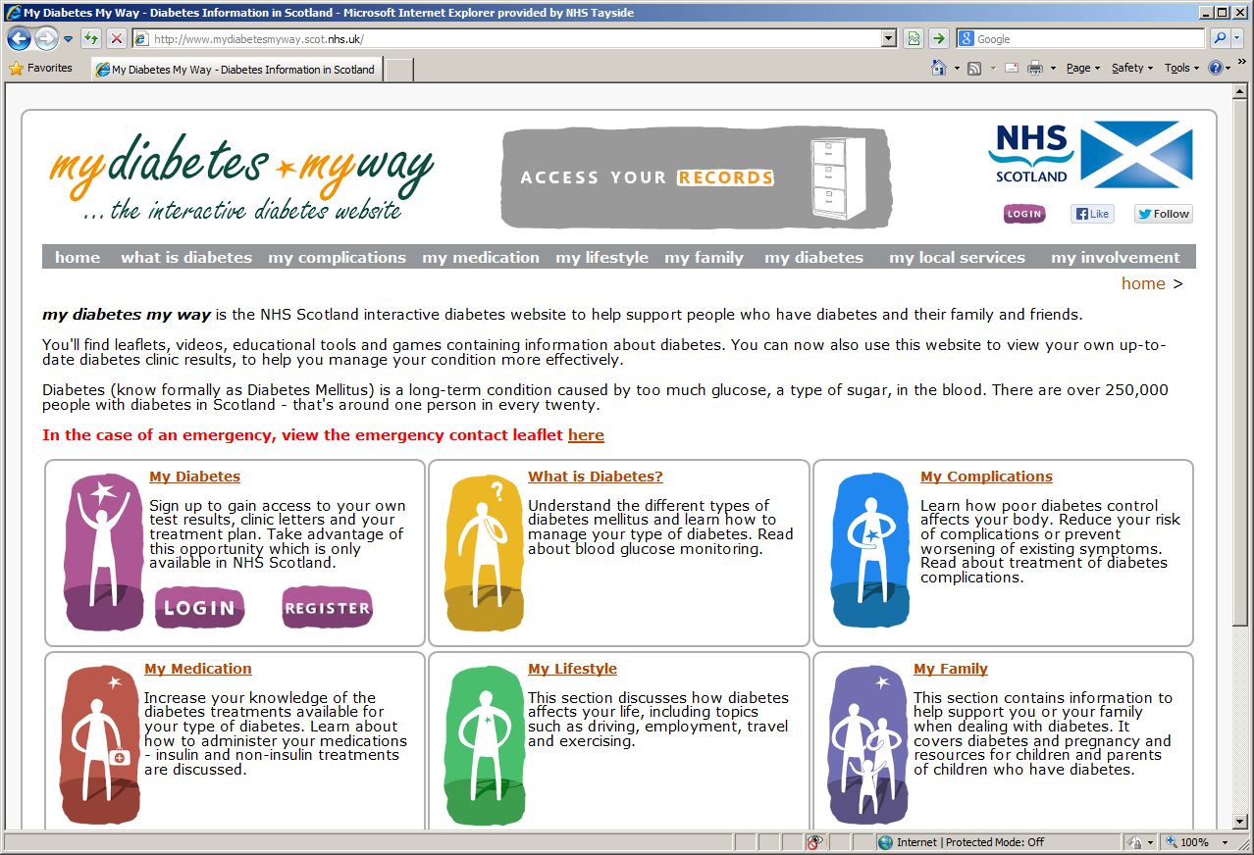

Slide 11
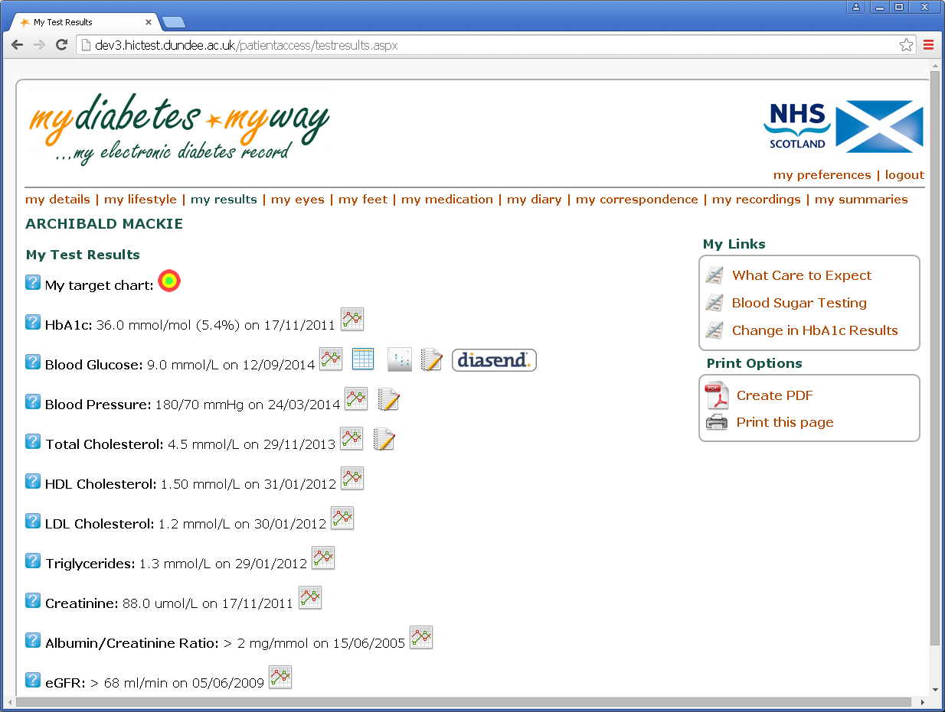
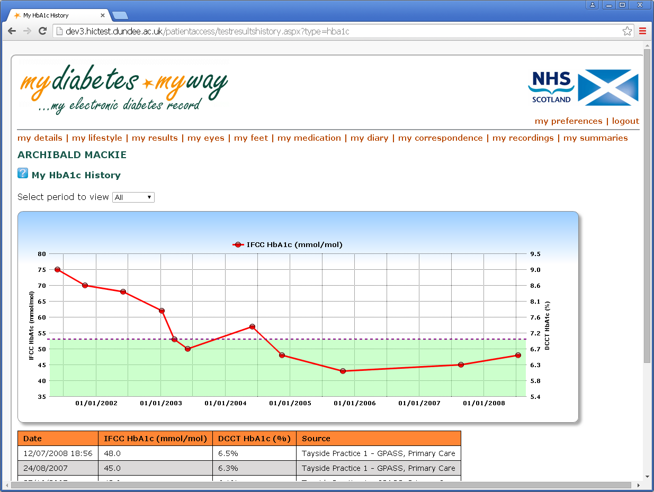

Slide 12
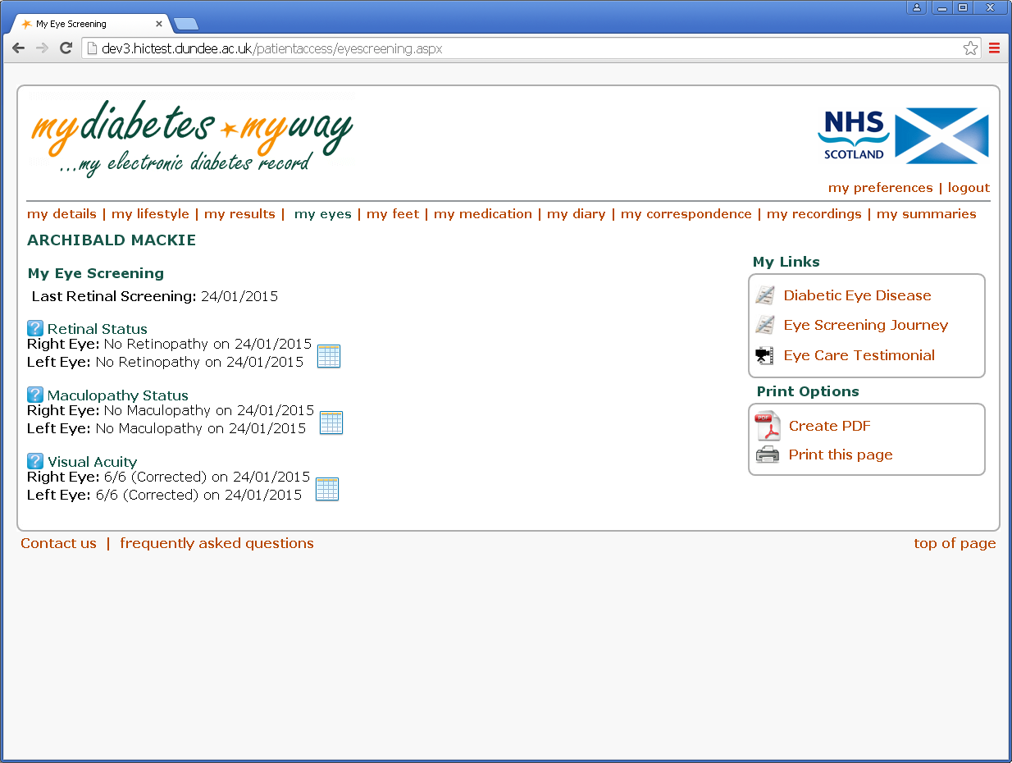

Slide 13
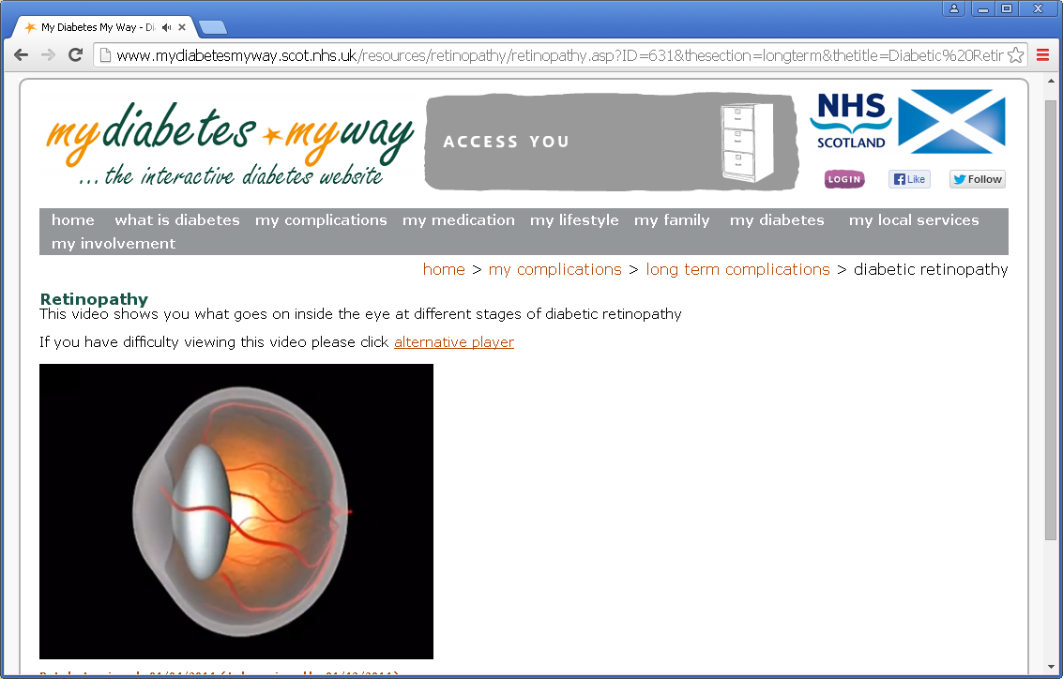
www.mydiabetesmyway.scot.nhs.uk

Slide 14
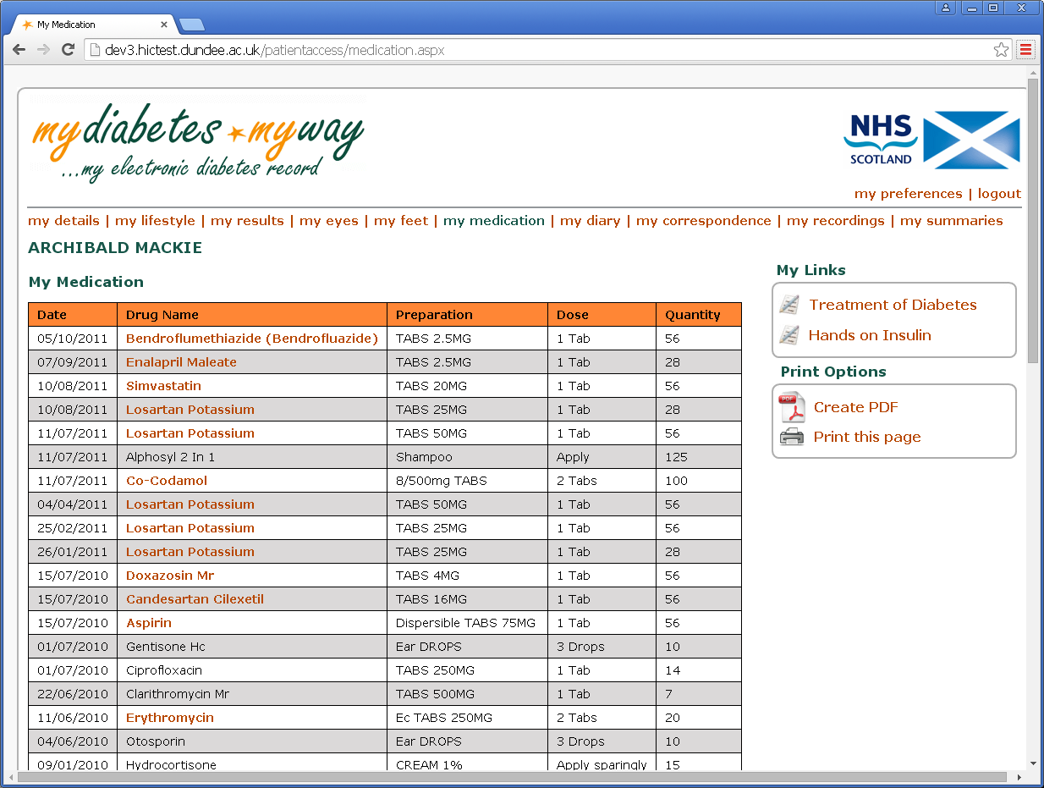
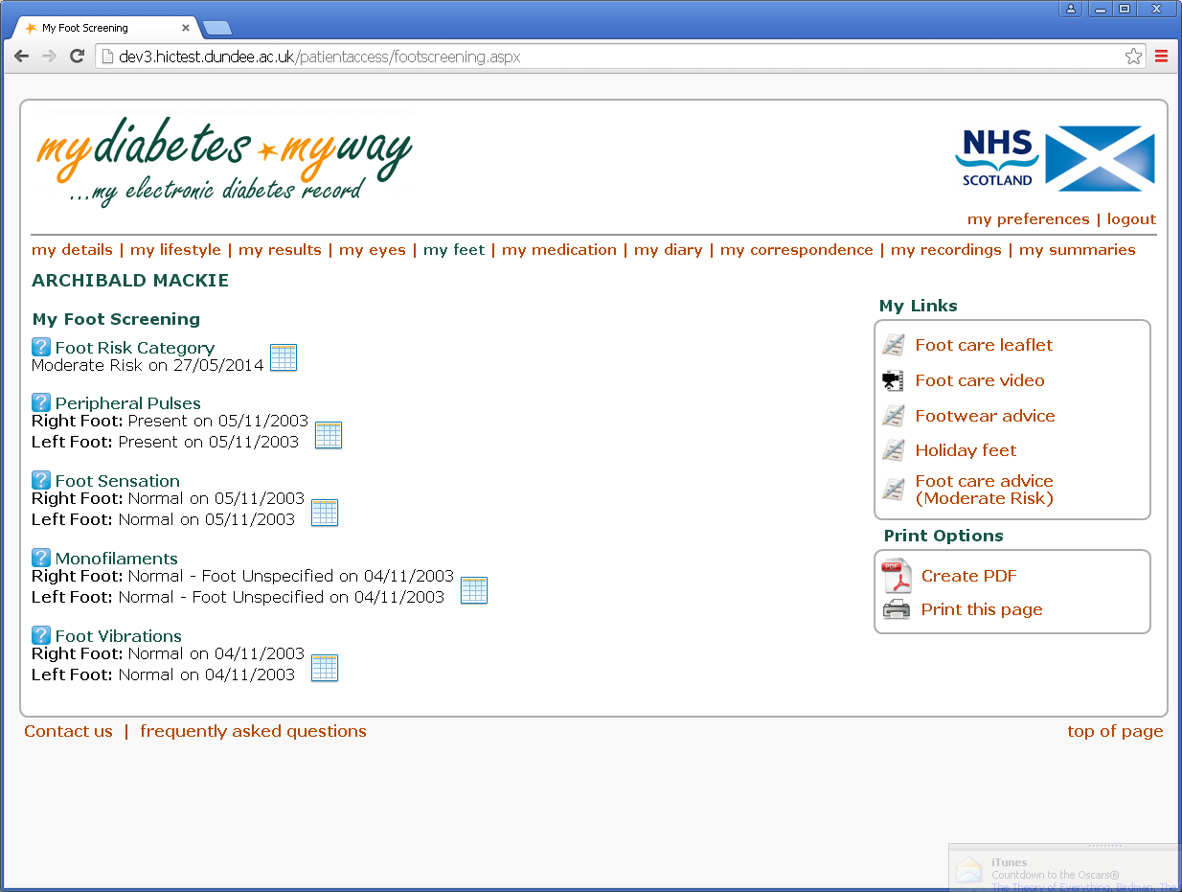
Tailored Education Links on each page-
dependant on the personal data

Slide 15
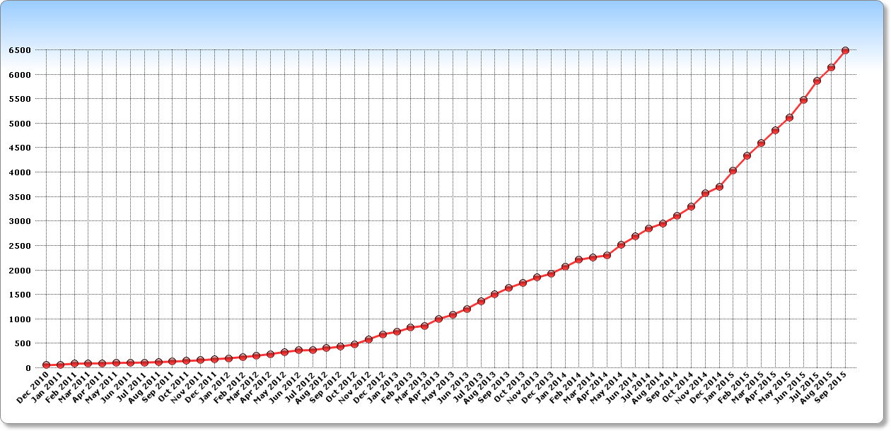
Patient Data Access Sign Up
Currently –18,450 registrants, 8,000 active users

Slide 16
Self reported Patient Outcomes (>1000 participants)
89.6% felt it helped them make better use of their consultation
88.2% felt it helped them manage their diabetes better
90.3% felt it improved their knowledge
89.3% felt it improved their motivation
Clinical Outcomes
Pre and post MDMW use comparison show modest
improvements in HbA1C, BP, cholesterol, weight (p<0.01)

Slide 17
Questionnaire related to web-based systems/Apps /MDMW
-Questions were supplied by Scott Cunningham at the University of Dundee and adapted at East and North Herts NHS Trust
-10 patients independently answered several questions
-All have Type 1 Diabetes and attend a Lister Diabetes Clinic
-N=10; 5M ; 5F

Slide 18
The web
Do you own a smart phone?
Do you have internet at home?
I am aware that there are web-based portals that could allow me to access my diabetic health records
YES 90% NO 10%
YES 100% NO 0%
YES 40% NO 60%

Slide 19
Apps
If there was a portal system available as a smartphone app I would be interested in hearing about it?
Would you use a smartphone app that allowed you to view your diabetic heath records?
YES 100% NO 0%
YES 100% NO 0%

