Slide 1
A New Integrated Diabetes Service Dr Nicola Cowap – Diabetes Clinical Lead Gemma Thomas– Head of Planned Care

Slide 2
Your Care, Your Future
Nationally – 6% of population have Diabetes growing at about 5% per year. About 10% of people with diagnosed diabetes have type 1 and 90% have type 2 diabetes
Herts Valleys – 2014/15 5.3% of population had diabetes (24,974) growing at about 0.3% per year
Your Care, Your Future – Has identified as a priority Long Term Condition area .
Key themes identified by patients – prevention, joined up care, care closer to home, ongoing education, psychological support.

Slide 3
Diabetes – Case for Change
Workforce/operational issues in HCT
Low levels of GP education
Low up take of structure education sessions,
Long waits for both services
Unnecessary duplication of care
Delay in patients seeing the right clinician at the right time.
Foot = ‘burning platform’, not meeting NICE standards, poor outcomes NB amputation compared with other similar CCGs.

Slide 4
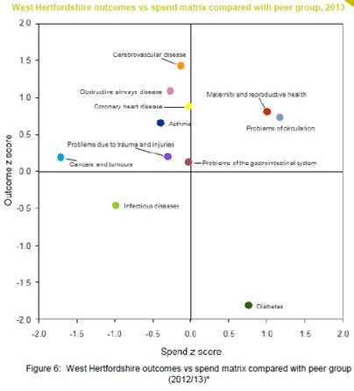
Diabetes – Case for Change
Outcomes for diabetes although improving have been identified as poor:
2014 Spend and Outcome Tool produced by Public Health England, and tabled above.

Slide 5
Development of the Model
Notes:
Not all the 9 key care standards are incentivised through QoF.

Slide 7
Diabetes New Service
Patient
Clinics in the community
Max. of 6 weeks wait for appt. incl. education
Minimal Duplication of Appts.
GP/Practice Nurse can access specialist support to enable me to be treated at practice
Supported Transition from Paediatric Service
Psychological needs assessed and supported
Patient Centred Care Plan
On-going education and information available

Slide 8
Diabetes New Service
GP/Practice Nurse
Joint clinics with DSN if needed
Virtual Clinics with Consultant
Access to specilaist support via telephone or email
On-going education and information available for patients
Service to support patients with pre-Diabetes
Psychological needs assessed and not referred back to GP
Patient Centered Care Planning

Slide 9
Children’s Services
Together agree Children not to be included due to the best practice already being followed in Children’s
Developed transition process to ensure robust patient centred service during the move from children’s to adult services

Slide 10
Mental Health & LD
Development of HPFT CQUIN for diabetes
3 tiers of service:
WBS – diabetic patients needing mental health support.
Psychiatric support for complex patients e.g brittle type 1s.
Multi-disciplinary team approach to patients with SMI, LD and diabetes or at high metabolic risk.
Ongoing mutual education.

Slide 11
Next Steps & Implementation
Implementation of the new model through:
Assurance Framework for most capable provider (incumbent providers) input from all directorates across CCG involved in this process
Task and finish groups as part of Diabetes Clinical forum to work on the following stages of the pathway :
1. Primary care up-skilling and education of the multi-disciplinary team.
2. Structured patient education and care planning
3. Medicines optimisation & IT

Slide 12
A Skilled Clinical Workforce

Slide 13
Less ‘Ping-Pong’ Care

Slide 14
More Collaborative Care

Slide 15
Less of this

Slide 16
More of that

Slide 17
Less Waiting

Slide 19
Better outcomes

