Slide 1
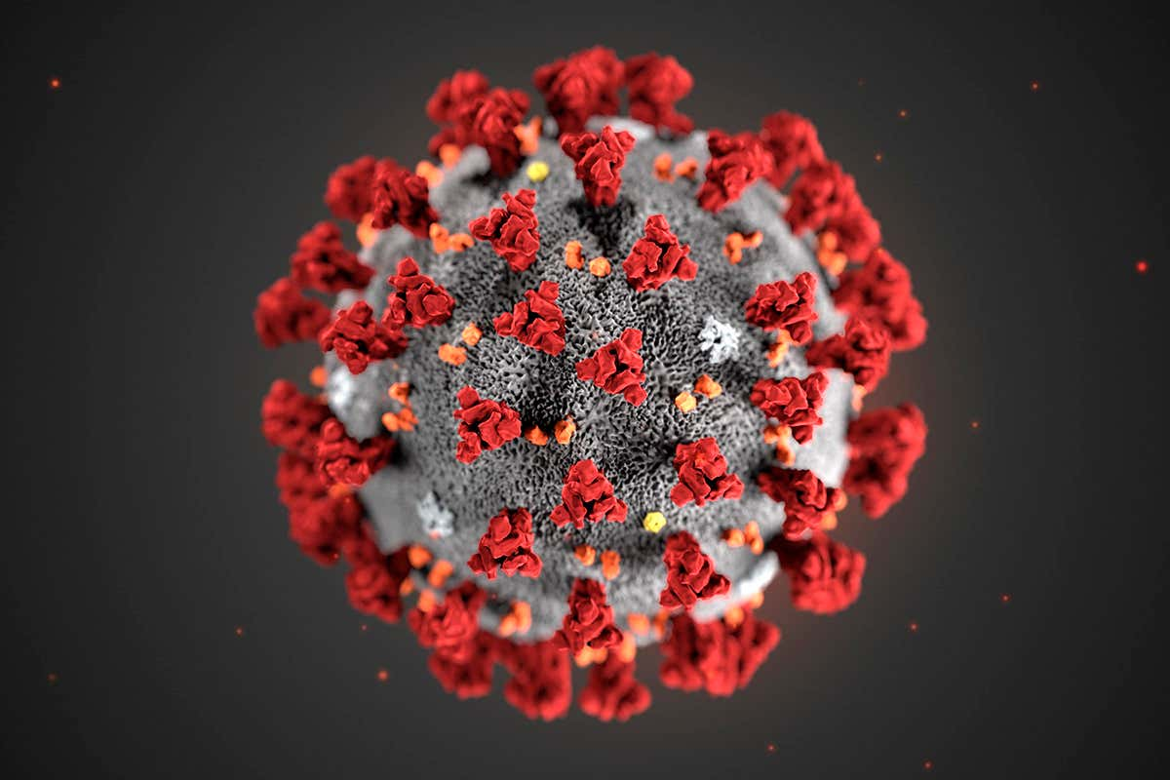
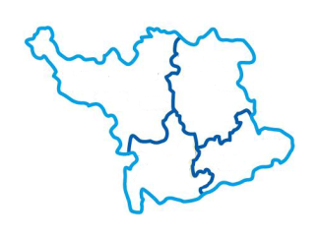
HIDS during COVID-19
Herts Valley Integrated
Diabetes Service
(HIDS)
28th May 2020

Slide 2
Challenges
Herts Valley Integrated
Diabetes Service
(HIDS)
Rapidly changing clinical landscape
Local / National guidance
Redeployment
Acute
Community
Shielding by members of staff
Sickness

Slide 3
Short-term changes
Herts Valley Integrated
Diabetes Service
(HIDS)
Community Treatment Unit (SACH)
Urgent face to face reviews for e.g. new Type 1 diabetes, hyperglycaemia etc.
Virtual review roll-out
Libre application process simplified
Contingency planning doc circulated
Including:
Key contacts
Admission avoidance advice

Slide 4
Acute tier
Herts Valley Integrated
Diabetes Service
(HIDS)
Telephone clinics instead of face to face clinics
Young adult clinics/CSII prioritised by Consultant team
Virtual support by DMHLT
Podiatry
MDT Foot clinics (HHGH) Mon/Weds/Fri
Twice weekly diabetic foot WRs
MDT meetings now restarted
Weekly Combined Ante-natal clinics with Obstetrics
Adoption of RCOG criteria for diagnosis of GDM
In-patient specialist review
Emergency patient helpline
Use of HHGH and SACH as ‘cold / non-COVID’ sites

Slide 5
Community Diabetes Nursing
Herts Valley Integrated
Diabetes Service
(HIDS)
All face-to- face clinics converted into telephone clinics
Including MDTs
Daily virtual Consultant support
Nursing reviews continue
Holding details of and addressing caseload waits (Doctor)
Video-conferencing
Insulin starts
GLP-1 RA starts
Freestyle Libre start
Teaching of BG monitoring
Face to face reviews
Insulin starts
Urgent housebound reviews
CTU reviews to avoid admission

Slide 6
Diabetic Podiatry
Herts Valley Integrated
Diabetes Service
(HIDS)
Review of all high risk feet in clinics
Admission avoidance key
National guidance to only treat patients with active diabetic foot ulcer
MDT Foot clinics (HHGH) Mon/Weds/Fri
MDTF WR (WGH) x2 /week
Clinician of the day retained
Home visits
Future plans:
Close attention to national guidance and social distancing measures (has to be face to face reviews)
Increase no. of MDFT clinics
June – start step-up/step-down clinics (Avenue, Marlowe’s, St. Alban’s Civic Centre)

Slide 7
Diabetes Dietetics
Herts Valley Integrated
Diabetes Service
(HIDS)
Continued to receive referrals and tried to support remotely
Type 1 DM Education:
DAFNE paused - On-line course being developed, July course planned
Individual support
BERTIE programme (on-line)
Type 2 DM
Offer of digital options (MyDESMOND and OVIVA)
Starting Insulin Together – support provided via videoconferencing
Carb awareness suspended

Slide 8
Diabetes and COVID-19
Herts Valley Integrated
Diabetes Service
(HIDS)
2 recent papers (NHSE):
Population study - T1 and T2 DM related mortality in England
Multivariate logistic analysis (adjusted for demography and co-morbidities)
T1 DM: RR 2.86 ; T2 DM: RR 1.81
Established as an independent risk factor for in-patient hospital death
Cohort study – T1 and T2 DM related mortality (T1 DM deaths = 418)
HbA1c >86 mmol/mol and 48-53mmol/mol
T1 DM: HR 2.19; T2 DM: HR 1.62
BMI >40 vs. 25-29.9
T1 DM: HR 2.15; T2 DM: HR 1.46
U shaped relationship
BAME
HR 1.68 – 1.79
Age

Slide 9
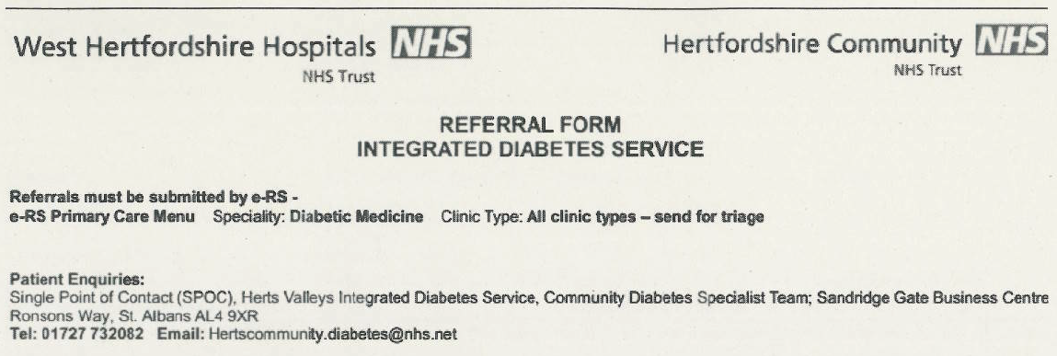
Polite request
Herts Valley Integrated
Diabetes Service
(HIDS)

Slide 10
Key contacts
Herts Valley Integrated
Diabetes Service
(HIDS)
Diabetes Nurse Duty Senior:
(07584) 703989
DSN Office:
(01727) 732082
Diabetes Admin Office:
(07900) 913021
WHHT Patient Advice Line:
(01923) 217553
Podiatry Clinician of the Day:
(01727) 732004

