Slide 1

Erectile dysfunction, cardiovascular disease & diabetes
Living with Diabetes in the 21st Century
By Dr Patricia Schartau
3rd December 2019
GP in Hampstead, London
Academic Clinical Lecturer in Primary Care at UCL
NHS Entrepreneur

Slide 2

No disclosures

Slide 3

Case: Rudolf
48y, train driver, husband and father
2 years of increasing tiredness, low mood, reduced sex drive and ED
No sign PMHx, non-smoker, alcohol 6 IU/week, OTC Vitamins
BMI: 27 ; waist circumference 97.7cm, normal BP and PR
Seen GP two years ago: Dx with T2DM and depression
ED not addressed, lifestyle measures advocated
Notes:
Saw my colleague
Had not changed lifestyle as too low in mood and feeling of inadequacy re ED
ADAM (Androgen Decifiency in Aging Male), Dx with hypogonadism, TRT and ED Tx, lifestyle changes as overall mood and zest for life improved

Slide 4
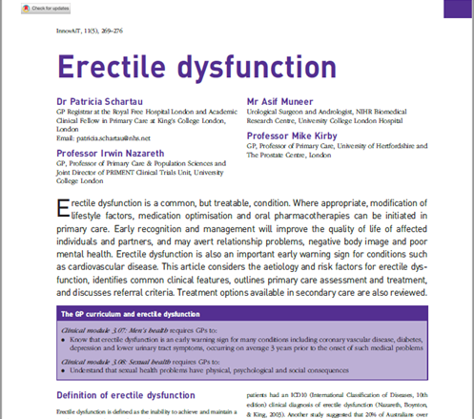

What are the barriers to ED assessment?
Notes:
Newspapers: GUM clinics closure, who treats STIs and Sexual Dysfunction?
InnovAit paper: Answer: Us GPs. Pivotal role in assessment, Dx and Mx of sexual dysfunction

Slide 5
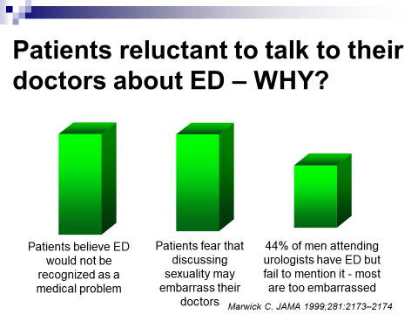

Slide 6

Doctors equally hesitant to discuss ED with their patients:
Feel not equipped to address the problem
Waiting for patient to raise the problem
Time pressures
GPs attitudes towards sexuality in older life
80% of men with ED would like to talk about it but only if GP raises the subject!
Gott, M. & Hincliff, S. (203). Family practice, 20, 690-5.

Slide 7
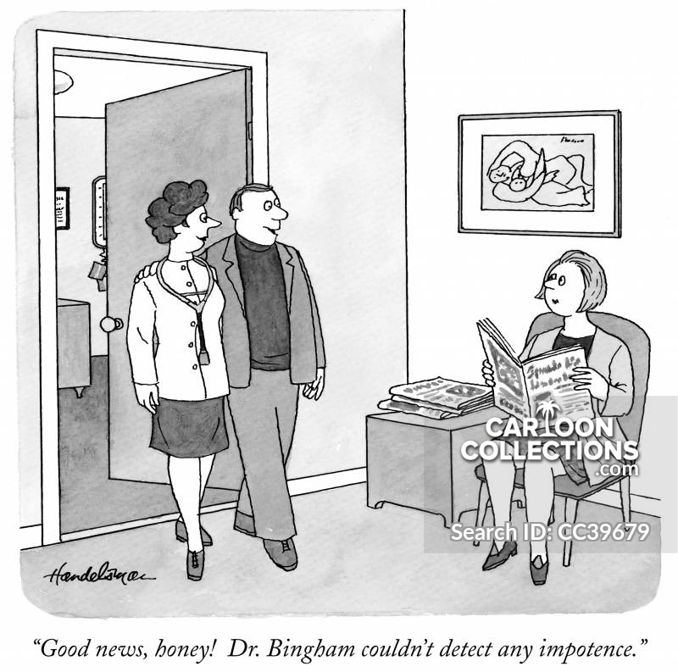
Why should we ask about ED?

Slide 8
Quality of Life: Most men & women report sex is important to their relationship
Age : 60 years +
N = 1300
79%
66%
Percentage Reporting Sex Is Important to Their Relationship
Srvey of 1300 men and women.
Women
The National Council on Aging. National Council on Aging Website. Available at: http://www.ncoa.org/content.cfm?sectionID=105&detail=128¹⁰
Notes:
random survey of 1300 60+ y Americans by The National Council on Aging
Participants were questioned on their views on and mature experience with sex.
Among respondents who were sexually active (engage in sexual activity at least once per month), 79% and 66% reported that maintaining an active sex life is an important aspect of their relationship
The survey suggests that sexual activity continues to play an important role in relationships among older men and women
Speaking from a GP perspective, we often neglect the discussion of sex in the elderly due to co-morbidities management (typical patient w/ IHD, HF, COPD, CKD or even chest drain) → goes to Mike to say : all I want from life is still being able to have sex.
Among 60- to 70-year-olds with partners, 46 percent of men and 38 percent of women have sex at least once a week

Slide 9
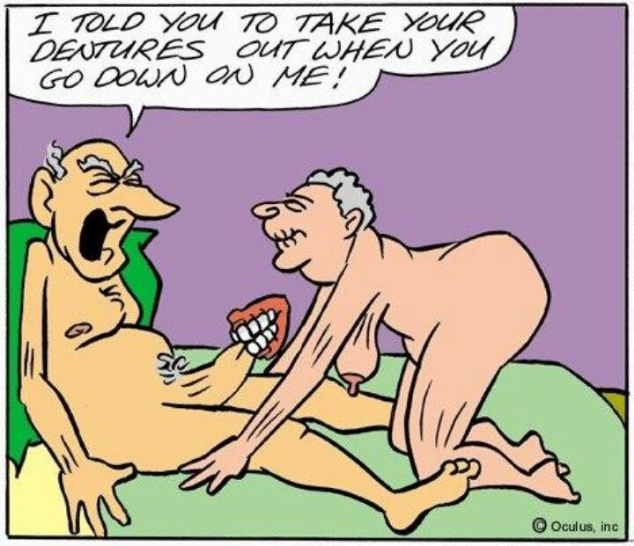
Physical health
The Duke Longitudinal Study of Ageing (1982)
  Frequency of intercourse a significant
  predictor of longevity in men
Swedish Study (1981)
  Early cessation of sex associated with premature death
Caerphilly Cohort Study (BMJ 1997)
  50% reduction in cardiac death with more than two orgasms per week
Notes:
Psychological: feelings of inadequacy and shame→ unnecessary as Tx available

Slide 10

Physical health
ED is a risk factor for CVD → Qrisk 3
“…equivalent to a current moderate level of smoking. ED confers a 1.46 increased risk for cardiovascular disease^{”1}
In a younger man, it is associated with a marked increase in the risk of future cardiac events²
Pro-active management of ED to address other cardiovascular risk factors”¹
Hackett G et al. (2017), ‘British Society for Sexual Medicine Guidelines on the Management of Erectile Dysfunction’, accessed from http://www.bssm.org.uk/downloads/default.asp
Inman BA et al Mayo Clin Proc. 2009;84(2):108-113
Notes:
-

Slide 11
Artery Size and Atherothrombosis
Artery | Size (mm) | Clinical event
Penile` | 1-2 | ED
Coronary | 3-4 | CAD
Carotid | 5-7 | TIA/Stroke
Femoral | 6-8 | Claudication
Montorsi et al. (2003). Eur Urol, 44, 352-54
Notes:
ED precedes CAD/future CV events by 3-5 years
Window of opportunity for lifestyle measures and pharmacological Mx

Slide 12
Prevalence of ED in men with co-morbidities
Rosen R et al CMRO 2004; 20 (5): 607 – 617

Slide 13
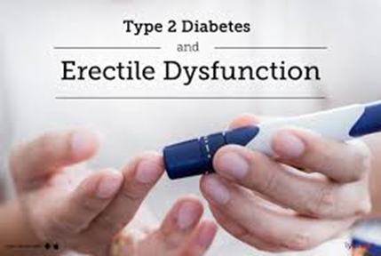
T2DM, ED & TD

Slide 14
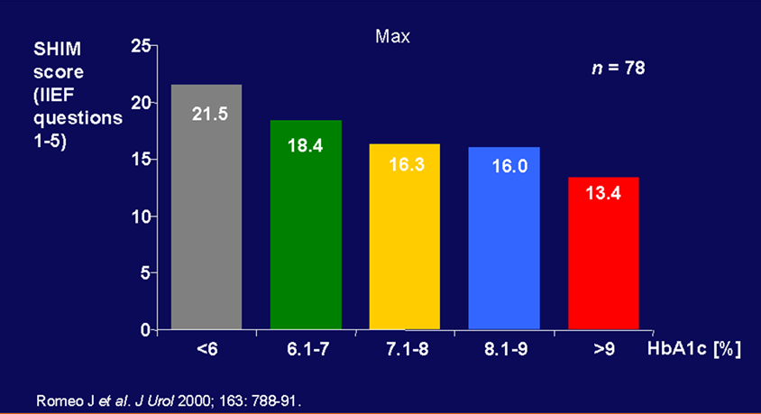
Correlation between ED and glycaemic control

Slide 15
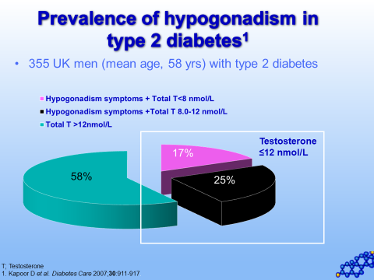
T2DM on the rise: >3 million with DM diagnosis in the UK, 90% T2DM
Prevalence of ED in men with T2DM:
Range of 32 – 90%¹
ED pathophysiology: Micro and macrovascular, endocrine and neuropathic disease²
ED is an early marker and independent risk factor for CVD³ and a predictor of T2DM⁴
Notes:
-T2DM patients are one of the biggest chronic disease patient groups cared for by GPs and comprise one of the largest groups of patients suffering from ED (Hackett et al., 2016)
-Prevalence: Range due to different methodologies (and how ED question is asked e.g. IIEF vs single question by nurse) & populations
ED & CVD: Link amplified when T2DM throw into the equation as they have additional risk factors eg obesity, HTN, hyperlipidaemias
ED is a predictor of T2DM (4), and T2DM one of the most common organic causes of ED
- 40% T2DM pts have low testosterone: of these 15% TT < 8 nmol/L
- Mortality prediction via increased adiposy, insulin resistance, poor glycaemic control and dyslipidaemias

Slide 16
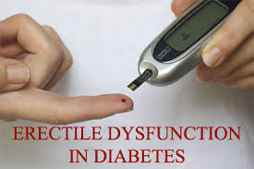
ED is 3-4 times more common in men with T2DM^{5,6}
Severity correlates with diabetic control
40% of T2DM patients have low total testosterone (TD)
independently predicts mortality in T2DM; treatment-resistant ED^{5,6}
1. Kamenov, Z.A. (2015). Exp Clin Endocrinol Diabetes, 123, 141-58.
2. Hackett, G., Heald, A.H., Sinclair, A. et al. (2016a). Clin Pract, 70, 244-53.
3. Kirby, M. & Hackett, G. (2017). International Journal of Clinical Practice, 72:e13054. doi.org/10.1111
4. Mazzilli, R.J., Elia, M., Delfino, F. et al. (2015). Clin Ther, 166, e317-20
5. Chiles, K.A. (2016). Transl Androl Urol, 5, 195-200
6. Hackett, G. (2016). British Journal of Diabetes, 16, 52-57. doi:10.15277/bjd.2016.076
Notes:
-T2DM patients are one of the biggest chronic disease patient groups cared for by GPs and comprise one of the largest groups of patients suffering from ED (Hackett et al., 2016)
-Prevalence: Range due to different methodologies (and how ED question is asked e.g. IIEF vs single question by nurse) & populations
ED & CVD: Link amplified when T2DM throw into the equation as they have additional risk factors eg obesity, HTN, hyperlipidaemias
ED is a predictor of T2DM (4), and T2DM one of the most common organic causes of ED
- 40% T2DM pts have low testosterone: of these 15% TT < 8 nmol/L
- Mortality prediction via increased adiposy, insulin resistance, poor glycaemic control and dyslipidaemias

Slide 17
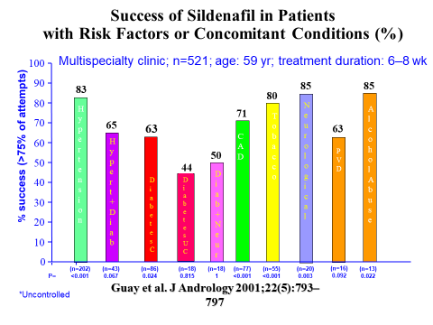

Slide 18
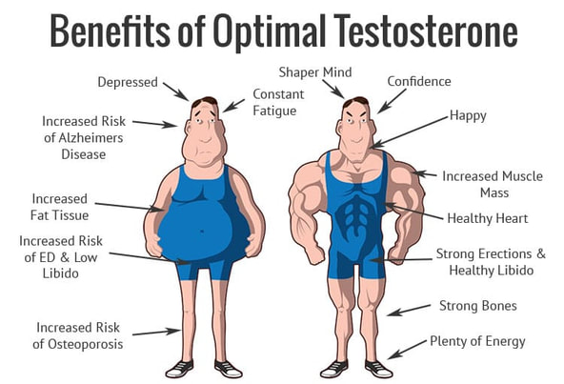
Notes:
TD associated w. frailty, co-morbidities and mortality

Slide 19
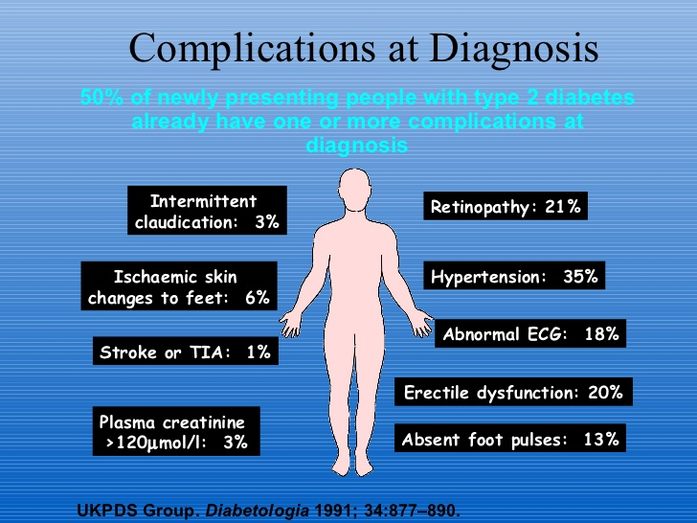
Complications at diagnosis of T2DM
Notes:
ED is right up there and in 20% of pts the first symptom of T2DM

Slide 20
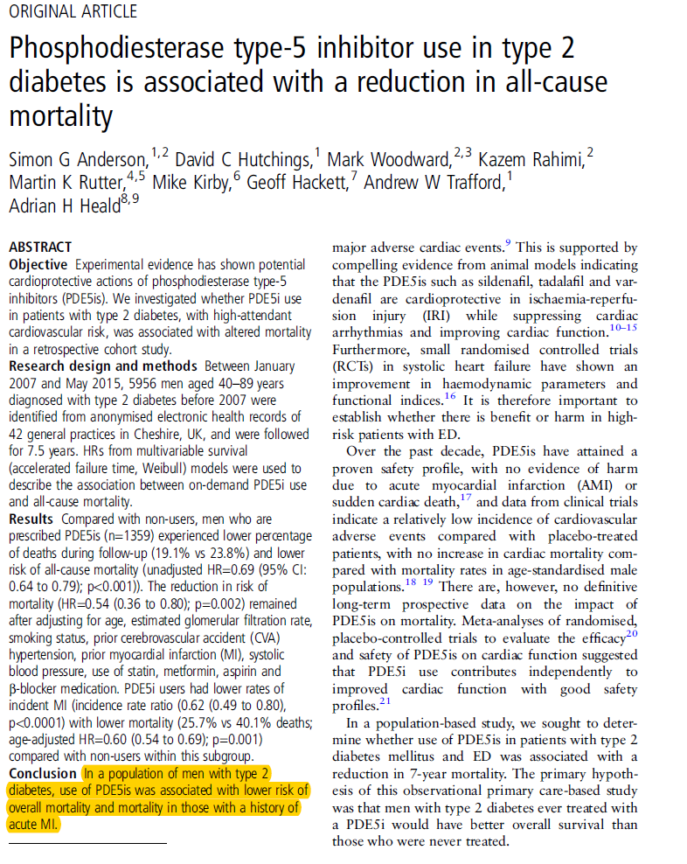
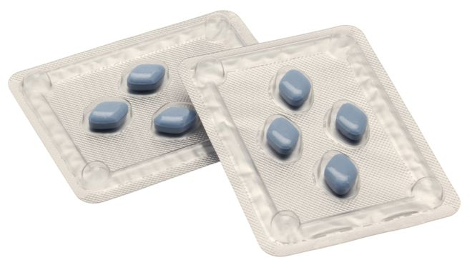
Notes:
I don’t have sufficient time to go into detail of Tx. But we discussed why ED case finding is important: Diagnosis may facilitate early detection of underlying CVD, dyslipidaemia etc which can be addressed. Management improves QoL and physical health by modification of risk factors and managing co-morbidities. (CV and metabolic). But the Tx itself is beneficial and has cardioprotective effects.
This was a landmark retrospective cohort study of almost 6000 men which uncovered potential cardioprotective effects of PDE5is in T2DM pts
The authors concluded…..
Also lower rate of incident MIs for pts on PDE5is and if they did experience one, it was less deadly
- They reported a 31% reduction in all-cause mortality and 26% reduction in incident MI in men with T2DM prescribed PDE5I

Slide 21
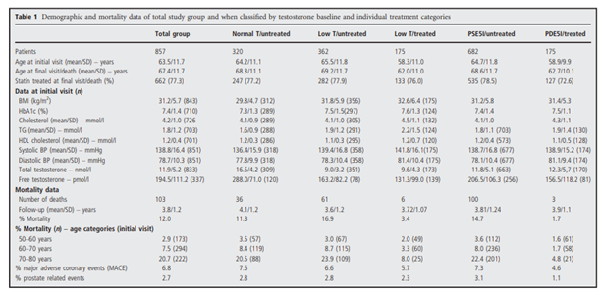
Mortality data of men with Type 2 Diabetes mellitus receiving PDE5 Inhibitors followed for approximately 4 years (N= 175)
HR: 0.21, CI: 0.066–0.68
Hackett G et al. Int J Clin Pract 70(3): 244-253 (2016) ¹¹
Notes:
Prospective longitudinal study of 857 men with T2DM followed up for 4 years stratified into normal TT….
- Used regression model with PDE5i as confounding factor showing that PDE5is (and TRT) were independently associated with increased survival in men with T2DM
- In T2DM, hypogonadism is associated with increased mortality compared to eugonadal men. Importantly TRT
abolished this increase in mortality
- Baseline body weight, body mass index, lipids, glycaemic control and hypertension were not associated with mortality
Important: The red and the yellow bars. Left (y-axis): All-cause mortality. X-axis age. Greatest benefits in older men
-PDE5is have an effect in terms of mortality in the elderly → when we often don’t prescribe or one a week

Slide 22

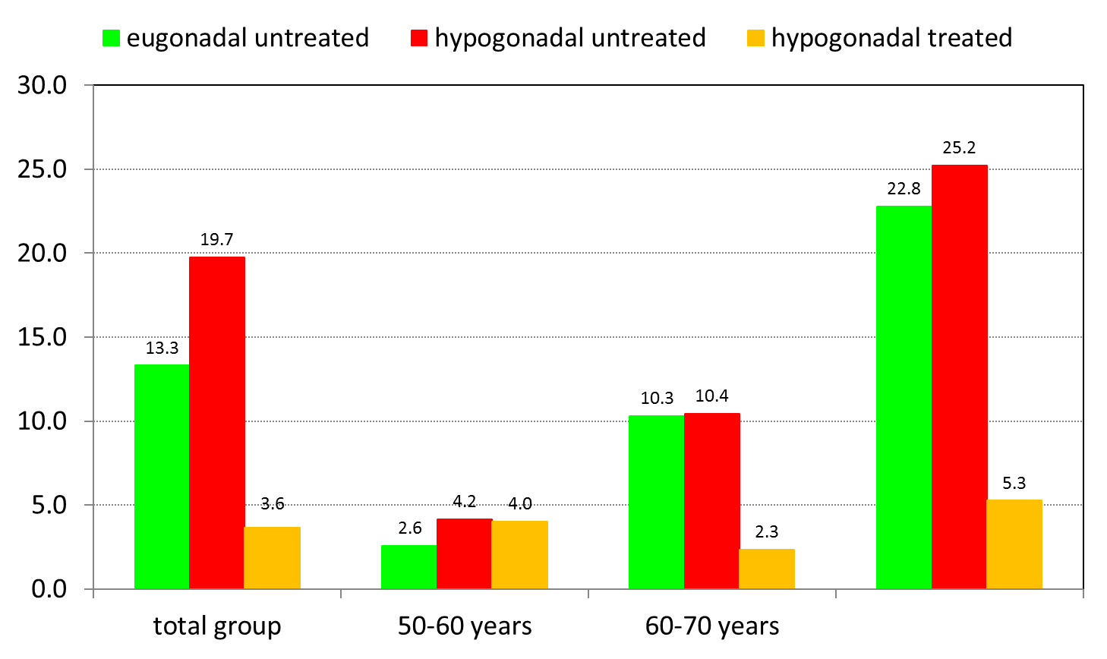
Mortality data of men with Type 2 Diabetes mellitus not receiving PDE5 Inhibitors followed for approximately 4 years (N= 682)
HR: 0.38, CI: 0.16–0.90
Hackett G et al. Int J Clin Pract 70(3): 244-253 (2016) ¹¹
Notes:
Prospective longitudinal study of 857 men showing that PDE5is (and TRT) were independently associated with increased survival in men with T2DM
Lower HR for LT/treated compared to LT/untreated (reference population)
- In T2DM, hypogonadism is associated with increased mortality compared to eugonadal men. Importantly TRT
abolished this increase in mortality
- Baseline body weight, body mass index, lipids, glycaemic control and hypertension were not significantly associated with mortality
Important: The red and the yellow bars. Left (y-axis): All-cause mortality. X-axis age. Greatest benefits TRT in older men
-PDE5is have an effect in terms of mortality in the elderly → when we often don’t prescribe or one a week

Slide 23
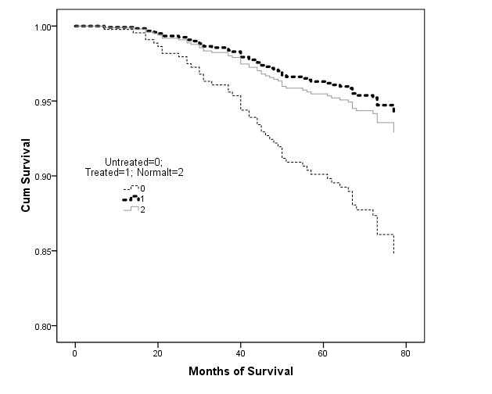
Effect of TRT on 6 year mortality in men with T2DM
Treated
Normal
Untreated
HR 2.3
p<0.005
Muralheedharan V et al. Endocrine Abst 2011 25:P163
Notes:
-TRT treated pts w. T2DM don’t die! (Kaplan-meier plot)
- Prospective study of 581 men with type 2 diabetes who had testosterone levels performed between 2002 and 2005 were followed up for a mean period of 5.81.3 S.D. years
-mortality rates were compared between total testosterone 10.4nmol/l (300ng/dl; n=343) and testosterone 10.4nmol/l (n=238). the effect of TRT (as per normal clinical practise: 85.9% testosterone gel and 14.1% intramuscular testosterone undecanoate) was assessed retrospectively within the low testosterone group
Mortality was increased in the low testosterone group (17.2%) compared with the normal testosterone group (9%; P=0.003) when controlled for covariates
TRT (mean duration 41.6±20.7 months; n=64) was associated with a reduced mortality of 8.4% compared with 19.2% (P=0.002) in the untreated group (n=174)
The multivariate-adjusted HR for decreased survival in the untreated group was 2.3 (95% CI 1.3-3.9, P=0.004).

Slide 24




T2DM, ED, Hypogonadism
Guidance T2DM: ED & TD
National & international: All men with T2DM should be asked annually about ED, investigated and treated accordingly, and have their serum testosterone levels measured
Opportunity to screen for (and treat) metabolic and cardiovascular health
Financial incentive (QOF) to assess and diagnose ED in UK primary care (2013/14)
Notes:
-NICE 2015, (European Urology Association), ISSM, (International Society for the Study of the Ageing Male) BSSM (British Society for Sexual Medicine) and Endocrine society guidelines
Metabolic health & cardiovascular health: TRT → Improved QoL, sexual dysfunction, glycaemic control, cognition, muscle mass and reduced visceral adiposity (Saad et al., 2011)
QOF: Quality and outcomes framework, world’s largest pay-for-performance health care scheme
- Revitalise audit: N = 3185 pts with T2DM from 13 UK GP practices
Recorded data on incidence of ED, testosterone testing and levels, TRT

Slide 25
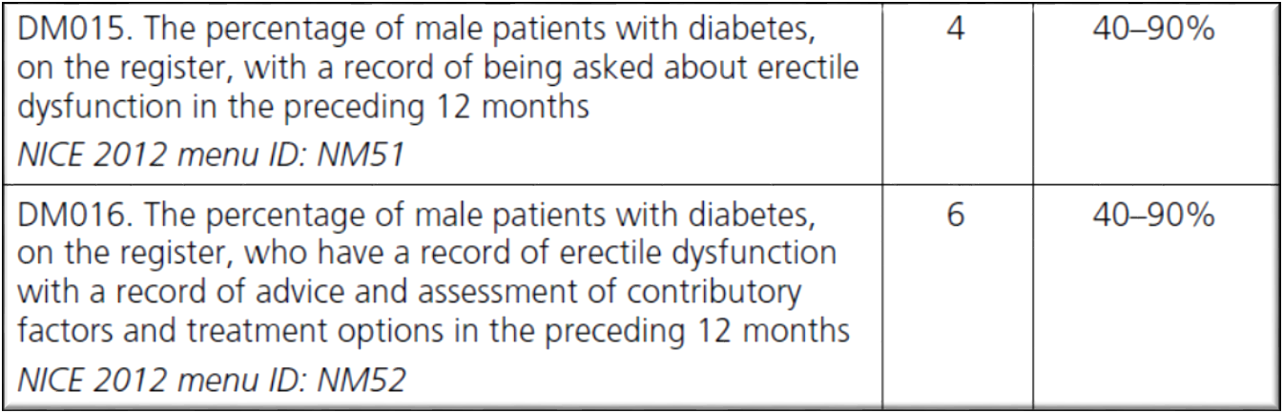
QOF 2013/14: ED in T2DM

Slide 26
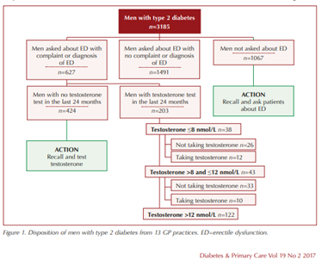
Revitalise audit
David, J. et al. (2017)
13 GP practices across the UK
N = 3185
Notes:
Recorded data on incidence of ED assessment and testing, testosterone testing and levels, TRT

Slide 27
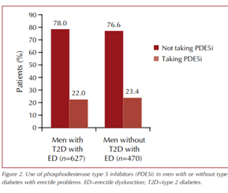
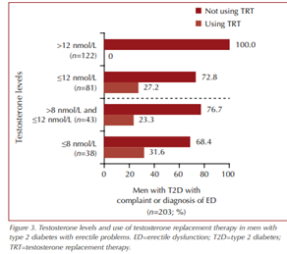
Revitalise audit
Results:
Conclusion: Need for improvement of clinical Mx in men with and without T2DM at risk of ED/TD
Notes:
Small proportion of men with ED taking PDE5is- differs from my study results
Majority of pts with TT < 8 nmol/l not on TRT (almost 70%)- similar to my results

Slide 28
What are the barriers to TD assessment and management?

Slide 29

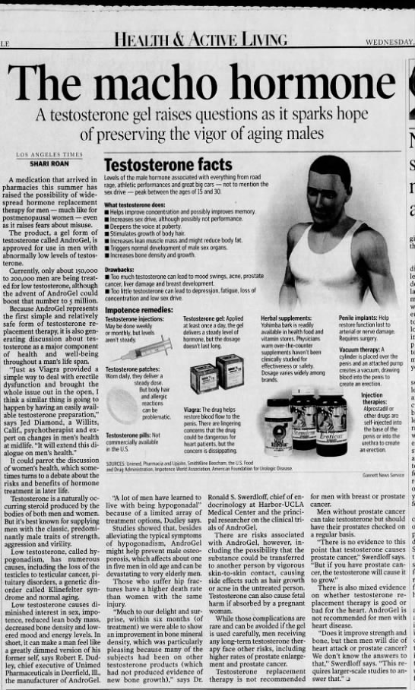
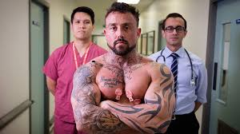
Feel not equipped to address or manage the problem
Time pressures
?GPs attitudes towards TRT?
Notes:
Scaremongering

Slide 30

Title: Recent trends in incidence of recorded erectile dysfunction, hypogonadism, phosphodiesterase type 5 inhibitor prescriptions and testosterone replacement therapy in patients with Type 2 diabetes in a primary care setting

Slide 31

Aims & Methodology
Aim: Explore the effects of QOF on ED/TD assessment, diagnoses & management in T2DM patients
Data source: The health improvement network (THIN) UK primary care database
Study design: Retrospective cohort study
Study population: Cohort of males (aged ≥ 18y) diagnosed with T2DM and contributing to UK primary care electronic health records between 1999-2016
Analysis: STATA15: Adjusted incident ratios (IRRs) using multivariate Poisson regression

Slide 32
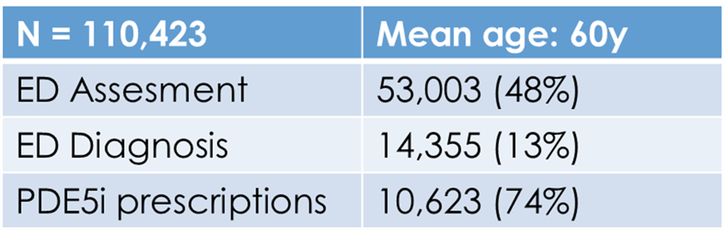
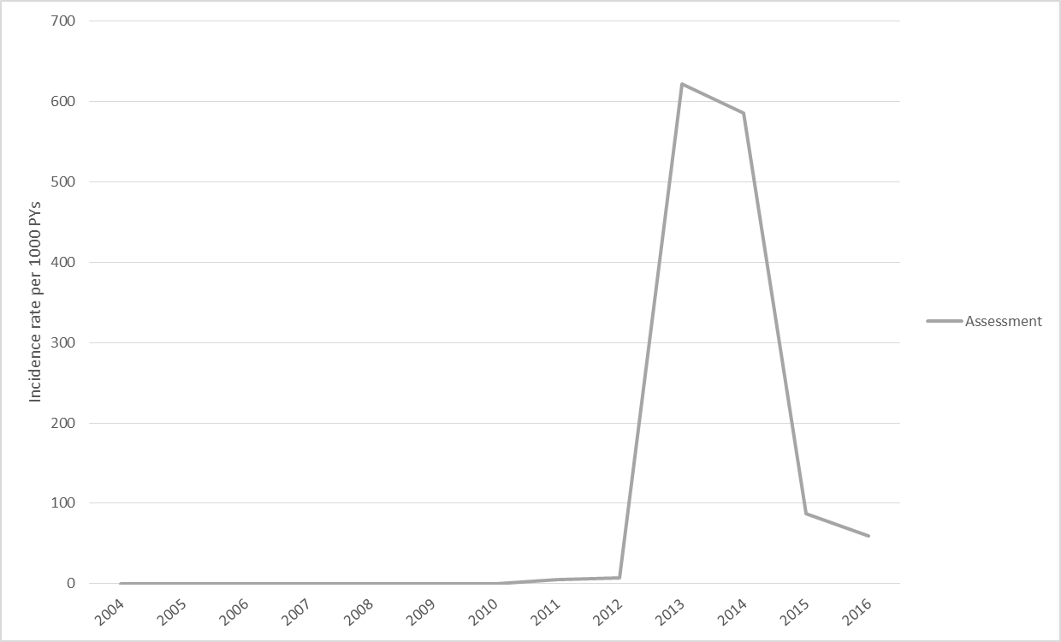
Analysis (1)
Figure 1. Time trends for ED assessment.
Notes:
- Assessment graph: 4 ED READ codes prior to QOF, from 2013 there are 7 (including specific DMT2 ED ones). Spike expected, flat before less.

Slide 33
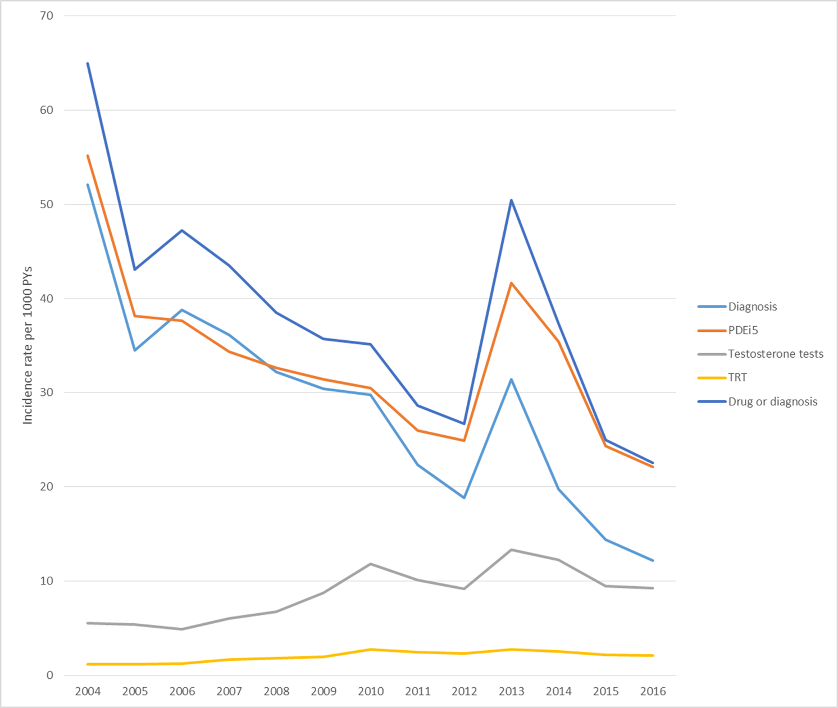

Analysis (2)
ED assessment: Adj Incident rate (IR) ↑ from 7.6 to 620 per 1000 PYAR from 2012 to 2013 (95% CI: 7.0- 8.3)
↓ to 54 per 1000 PYAR in 2015
ED diagnoses: IR doubled from 2012 to 13 (IRR 2.0; CI: 1.8 – 2.1)
Notes:
-QOF worked. Also (although less) for testosterone testing and TRT (increased by 1/3 from 2008-13)
- Post QOF worse performance vs back log cleared. See next 5 years

Slide 34

Analysis (3)- Cross-sectional and multi-variate
Testosterone:
Of 1187 men with T2DM and newly diagnosed ED in 2015, 213 (18%) had at least one testosterone measurement, 45 (21%) of these had a serum testosterone ≤ 8nmol/L, of which 9 (20%) received TRT
Significant effect of age on ED assessment, diagnosis and PDE5i prescriptions (p < 0.001) with most assessments, diagnoses and PDE5is prescriptions done in the 55-60y old age group
Notes:
- Cohort: Not possible → cohort entry date (ED Dx) is exit date in most cases (PDE5i prescription); also problem with numerator & denominator (PDE5is prescription in both if Dx not just READ code); messy 2013/14 as QOF starts April
-GP prescriptions PDE5is 2015-16: Regression model for age (mostly prescribed 45-55) and social deprivation ( not significant, trend is < prescriptions in more deprived)
-Age: ? Later in life more occupied with managing various chronic diseases? Patients less sexually active or/and reduced libido?

Slide 35

Discussion & Conclusions
Prevalence of recorded ED (13%) lower than reported in the literature
↓ PDE5i prescription rate
Testosterone testing not common practice; ↓ TRT prescription rate
Triad between ED, TD & CVD in pts with T2DM → early screening & treatment
Notes:
PDE5i prescription rate: Unlikely cost related; patient choice vs not offered
Testosterone testing and TRT not common practice- in line with article by Stedman et al to be published in Int Journal of Clin Practice: Hypogonadism not sufficiently recognised by 99% of practices

Slide 36

The GP and Sexual Problems – Just a matter of time?
Overall, we are doing ok
Time may be a factor, but not the only one
To improve diagnosis/management of ED/TD in T2DM pts:
incorporation of guidelines into GP framework
financial incentives
solid GP education
Notes:
…and thus QoL and cardiovascular health:

Slide 37
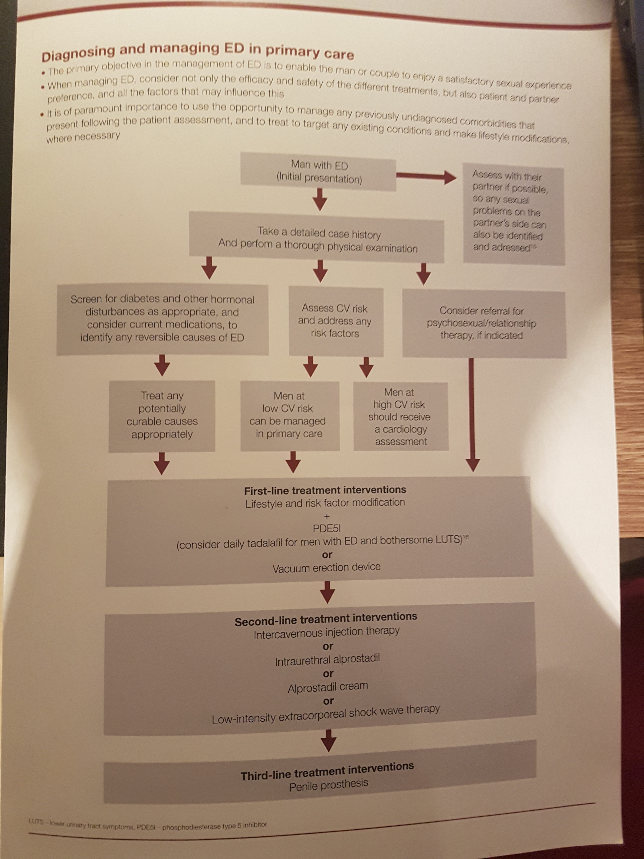
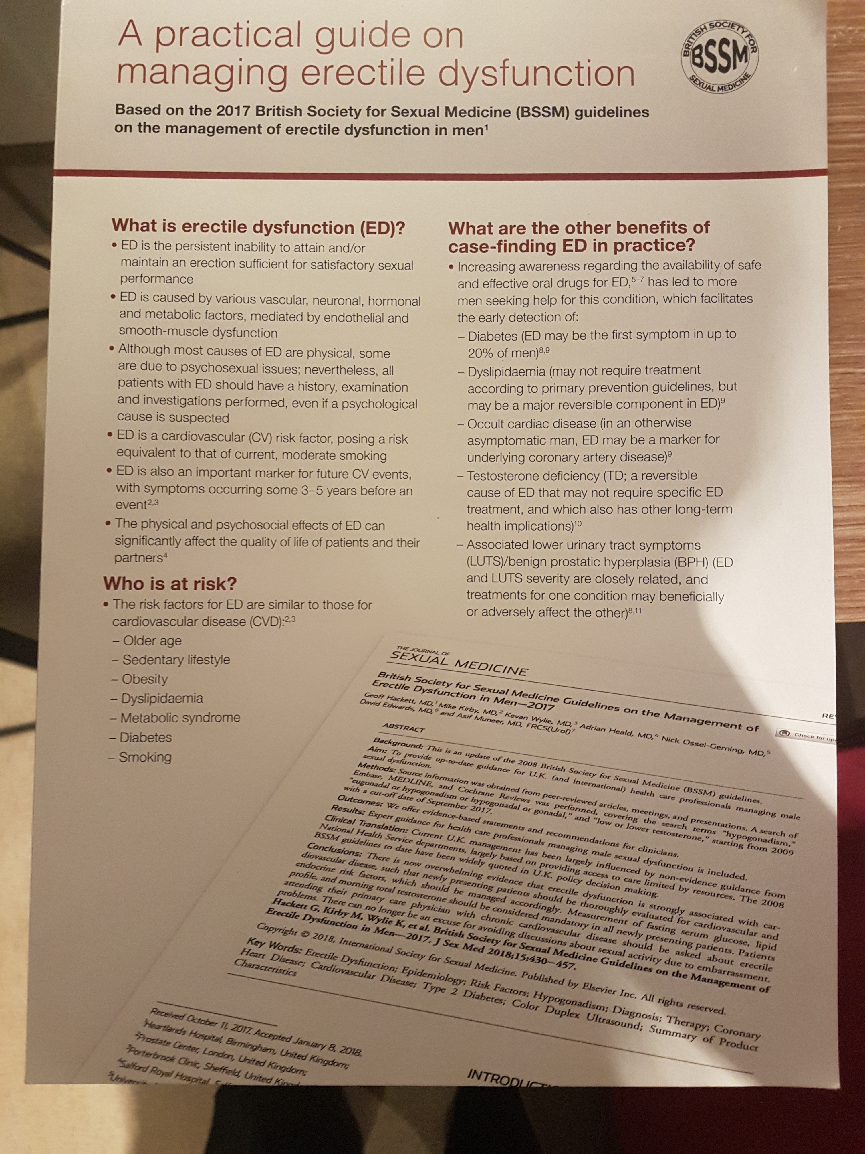
ED Mx:

Slide 38
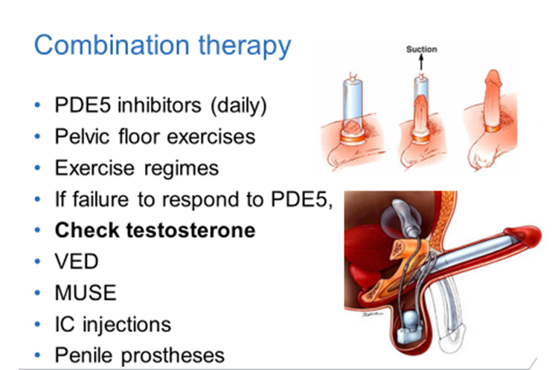
ED Mx:

Slide 39
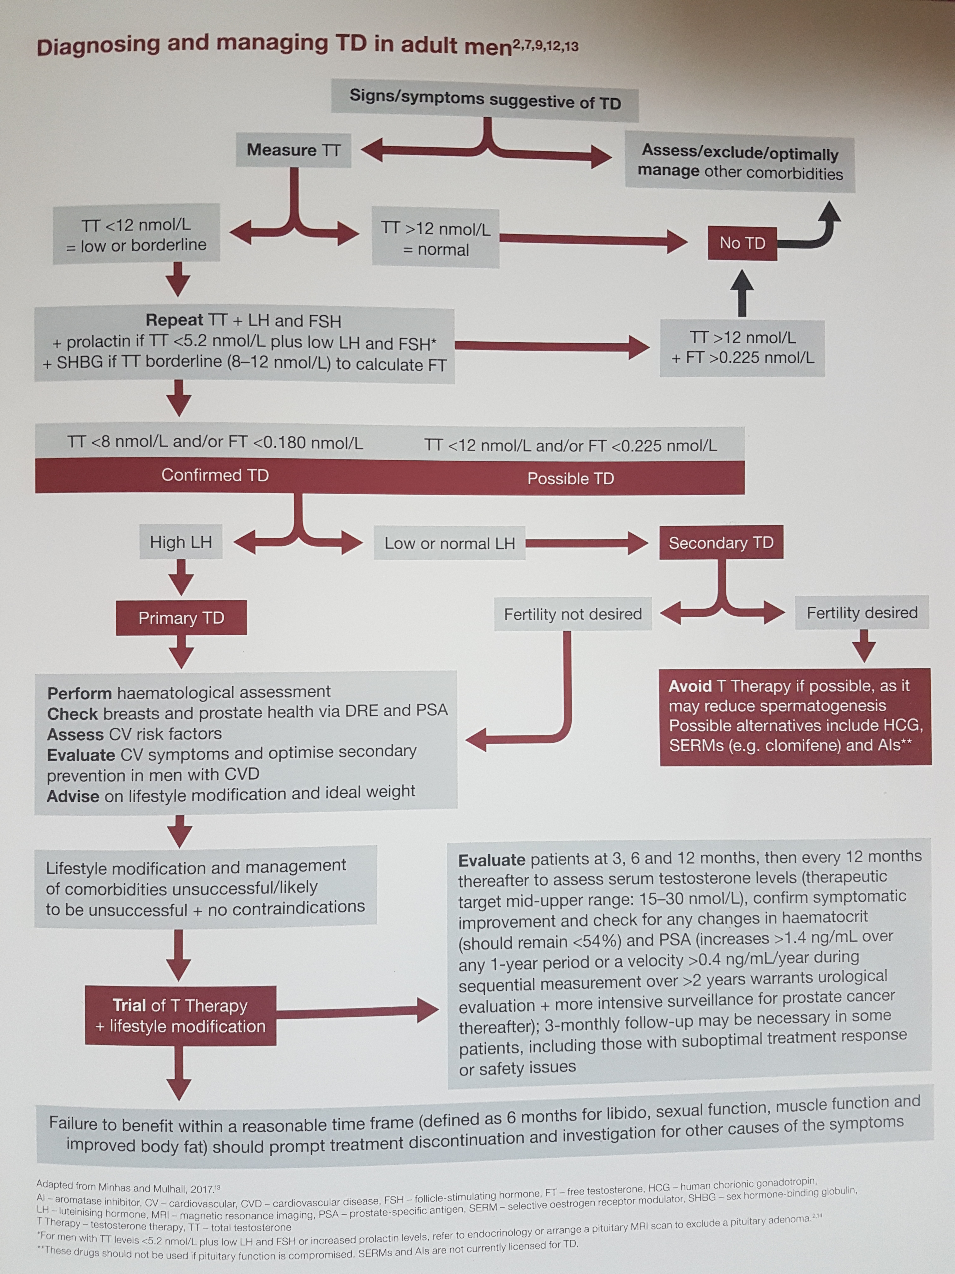
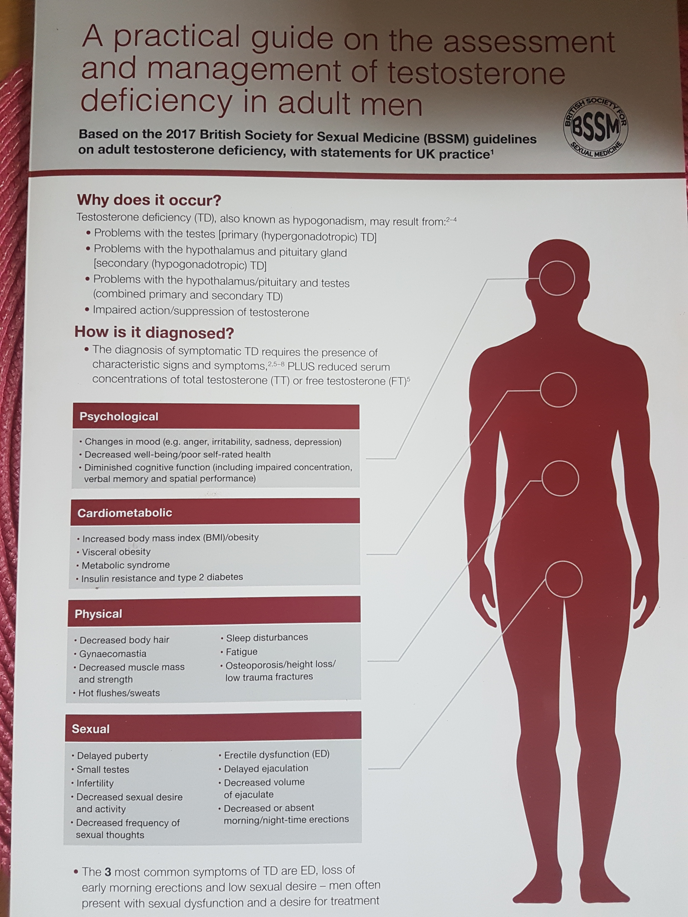
TD Mx:

Slide 40


Smart SAA: https://sexualadviceassociation.co.uk/app/

Slide 41

Take home message:
ED assessment, diagnosis & management is important in relation to QoL, underlying physical health, and risk factor management
ED is independent risk factor for cardiovascular events, risk amplified in DM
TD is common in DM → independently predicts mortality and treatment resistant ED
BSSM Primary Care Guidelines: For ED/TD
Various additional options to treat ED in secondary care

Slide 42

Thank you!

