Slide 1



‘Social Prescribing’
Connecting People
for Health
Tim Anfilogoff
Head of Community Resilience, HVCCG
NHSE Social Prescribing Facilitator (EoE)

Slide 2

Not Rocket Science

Slide 3
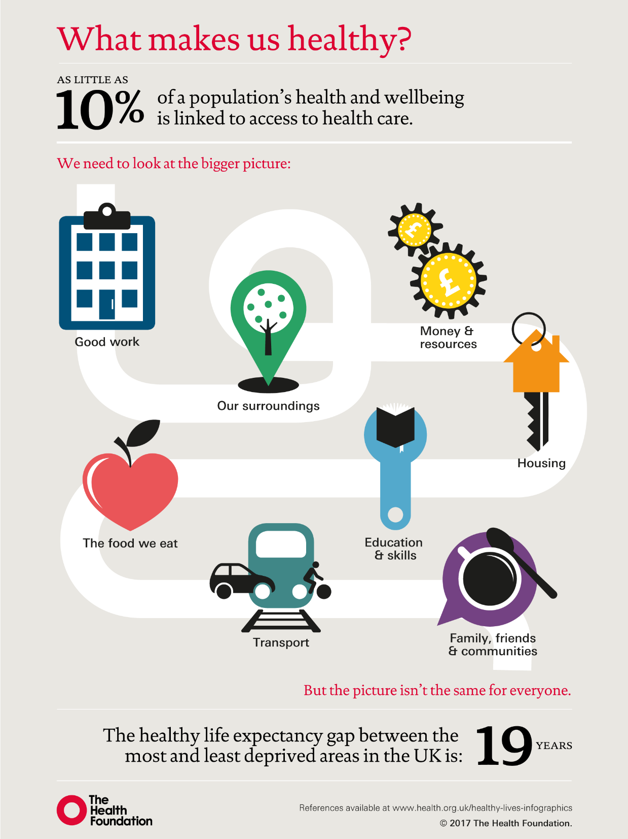

Slide 4
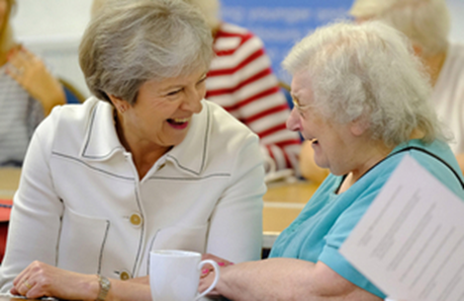
Loneliness Strategy:
A Connected Society
…‘social prescribing’ will allow GPs to direct patients to… tailored support to help people improve their health and wellbeing, instead of defaulting to medicine
…funding will be provided to connect patients to a variety of activities…reducing demand on the NHS and improving patients’ quality of life

Slide 5

http://westminsterresearch.wmin.ac.uk/19629/

Slide 6
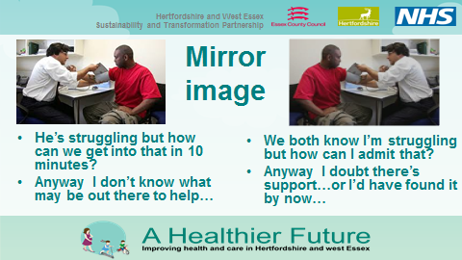
Patient and Doctor In Same Boat?

Slide 7

Social Prescribing Models
1. Referral to a commissioned ‘one-stop connector service’
2. Collaborative Practices: GP surgeries as community ‘hubs’, invite citizens in to work collaboratively, as ‘health champions’.
3. In-house ‘community link workers/ navigators’ – employed by GP practices or federations of GP practices.
4. Active Signposting: ‘Care Navigators’ in GP practices, having different conversations with patients, signposting them to community support, as well as pharmacy, physiotherapists and care providers.
Referral Agency: GP, Integrated Care team, Library staff, self referral
Social Prescribing Connector Scheme; hosted in the VCSE sector, employs link workers
Prescription: Community Groups - gardening, singing, dance, peer support – funded

Slide 8
Asset-based community development
Our aim: to enable all GPs across England to refer to a link worker service, connecting people to community support.
This only works where the voluntary, community and social enterprise groups are nurtured and supported.
We need to fund VCSE groups to receive referrals, not just the connectors.

Slide 9

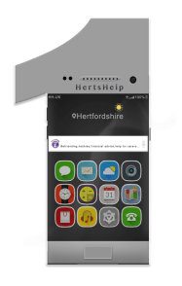




Access to thousands of community groups in Herts
  Web – Hertshelp.net
  Text – HertsHelp to 81025
  Email – info@hertshelp.net
  Skype - HertsHelp
  Minicom on 0300 456 2364
  Fax 0300 456 2365
  Telephone 0300 1234 044 or Text HertsHelp to 81025
  Face to Face advice – arrange on 0300 1234 044
  Advocacy – via professional referral
  Communication Toolkit - BSL, Makaton, Braille Service
0300 1234 044

Slide 10

How does it work in Herts?
Health referral – GP, nurse, consultant, physio etc (usually electronic) – but also social care, housing etc
Triaged by HertsHelp
Community Navigator – ‘co-producing’ support plan
The prescription: service/s and connections in community
Key social prescribing service in West Herts = Community Navigator Service
For people who don’t need face to face
support HertsHelp provides the help

Slide 11
Scaling social prescribing with support of local GP-practice-based volunteers
Complex
cases
Community Navigator
Less straightforward cases – Volunteer social prescribing
Straightforward cases –
HertsHelp/Active Sign-posting direct to volsec

Slide 12
Starts with the person – not the condition
‘’I had a lady that was invited to a breast screening, who refused to go. So I offered to go with her, and waited with her in the waiting room. Now I know, that next time she is invited she’ll go because she’ll know what to expect, because it’s not the frightening thing that she thought it was”.

Slide 13

University of Hull/
Hull York Medical School Survey
3,000 people with type 2 diabetes
Loneliness, stigma, embarrassment, blame, guilt
Feel they’re seen as burden on NHS
‘If you have type 2 people think it is your fault, that you haven’t looked after yourself properly.”
‘At Christmas or going out for a friend’s birthday it isn’t easy to cope with not being able to eat the same food, the same birthday cake as everyone else. So instead – you just don’t go out.”

Slide 14
What matters to the patient
(My Care and Wellbeing form)
“Meeting other people who are in similar situations and the incredible warmth and supportiveness of all the "staff" who made it so much more possible to be positive and optimistic about the future.”
“…I have never had the chance [before] to discuss myself holistically; to really stop and consider all my needs, physically, mental and spiritual. THANK YOU FROM THE BOTTOM OF MY HEART.”
“The most important aspect is the change in the way I think about myself and the compassionate caring I had - I couldn't have made these changes without support and I found the group work especially valuable.”
Fig. 5 Examples of ‘What has been most important for you?’ (MYCaW form)
http://www.pennybrohn.org.uk/wp-content/uploads/2014/08/Polley_et_al_200770a9.pdf

Slide 15
Preliminary results on the use of a “Facilitated Social Prescription” to improve the health outcomes for those with Type 2 Diabetes and those at risk of Diabetes
April 2015

Slide 16
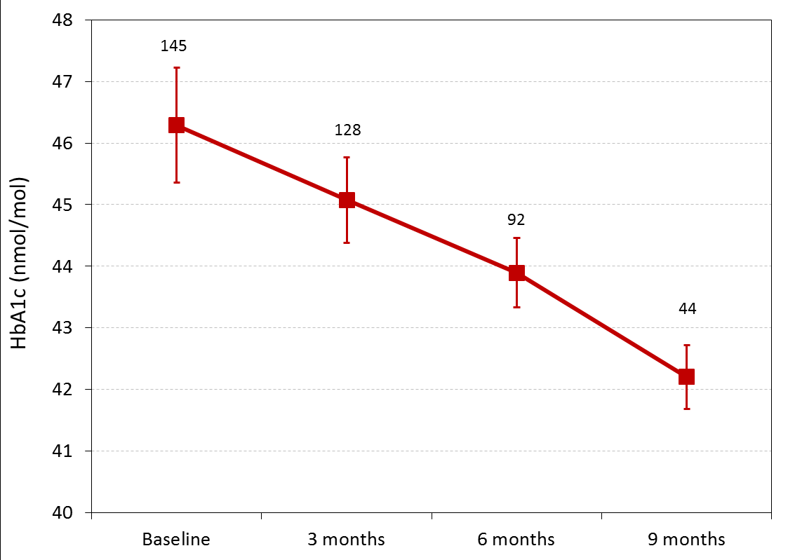
Average (+/-SE) HbA1c levels over time

Slide 17
Weight change over time
(average +/-SE)
Significant reduction relative to baseline (p≤0.05), 6 + 9 m data not complete

Slide 18
Waist circumference over time (average +/-SE)

Slide 19
Average (+/-SE) Quality of Life Score (EQ5D)

Slide 20

Medicine in its proper place: part of the solution…
https://www.diabetes.org.uk/research/research-round-up/research-spotlight/research-spotlight-low-calorie-liquid-diet

Slide 21

Thanks for listening
tim.anfilogoff@nhs.net
07900 161673
p.o'hare@nhs.net
0300 1234 044

