Slide 1
Mental Health Issues in Diabetic Patients
Reducing admissions through effective Case Identification
Presented by The Wellbeing Service
Notes:
Title slide.
Personal introductions.

Slide 2
Workshop Aims
Gain an understanding of Wellbeing and our Diabetes Pathway
Identify the common forms of psychological distress in patients with Diabetes
Understand how effective case identification can reduce admissions
How to refer
Notes:
Our objective today is to help you decide whether any of your diabetes patients might benefit from a Wellbeing Team intervention.
We’ll talk about what we do, and our specialist service for diabetes patients.
Then we’ll talk about the sorts of psychological difficulties we commonly see in this group and how you can begin to identify them.
There are many benefits to incorporating psychological interventions into your work – and we’ll explain what those are.
Finally we’ll explain how you can refer these patients onto our service.

Slide 3
IAPT and the Wellbeing Service
IAPT - Improving Access to Psychological Therapies
Government NHS initiative implemented in 2006 to improve access to psychological therapies of working age adults.
The Wellbeing Service is the local (Herts) name for IAPT
Staffed by therapists qualified in cognitive behavioural therapy (CBT)
The Wellbeing Service offers free and confidential short-term psychological, emotional and practical support.
Those seeking help need to be registered with a GP in Hertfordshire and be over the age of 16 years.
Notes:
Run through this basic info about the service.

Slide 4
Who do we work with?
Those experiencing common mental health problems’. Typically anxiety and depression in a Primary care setting.
Core group is adults over 16
Active outreach with some groups:
People with long term conditions (diabetes, COPD, chronic pain, MUS etc).
Carers
Young people (16-18) and students
Older adults
Notes:
Who is Wellbeing /IAPT for?
1 in 4 of us are likely to experience a common mental health difficulty in any given year – IAPT is for those people.
IAPT is intended to be a large-scale, high-volume, rapid throughput service. It is aimed at adults experiencing a short-term or mild to moderate mental health difficulty. Such people are normally functioning, ie continue to work, attend to family commitments etc.
IAPT has developed ways of working with groups who have specific needs and vulnerabilities. One of our major target groups is people experiencing long term physical conditions.

Slide 5
The Long Term Conditions Expansion project
Hertfordshire one of 22 pilot sites across England
Work commenced January 2017
A dedicated team received specialist training in cognitive behavioural therapy (CBT) for Long-Term-Conditions
Integration of physical and mental health care via community teams and GP Surgeries
Routine screening for everyone with diabetes
Notes:
The expansion project is a national undertaking within IAPT, funded by NHS England for an initial two years.
Hertfordshire was selected to be one of 22 pilot sites.
The funding covered specialist staff training, ensuring we could offer a tailored service to diabetic patients.
The project supports and drives forward the NHS’ intention to integrate physical and mental healthcare more closely, offering significant benefits to patients.
It encourages and enables routine screening of all diabetic patients for symptoms of mental health difficulties.

Slide 6
Working towards Integrated care
Psychological
Physical
Social
Mental health difficulties impact on successful self-care in Diabetes
Notes:
One of the fundamental drivers of this project is the need to integrate physical and mental healthcare more closely.
The idea is that effective healthcare management means looking at all aspects of a person’s life.
This includes.. physical, psychological and social circumstances. It paints a fuller picture of the factors affecting an individual’s health and helps us understand how services can pull together to meet the holistic needs of each person.

Slide 7
The Wider Context
30% of population suffer from a Long Term Condition (LTC)
20% of population
suffer Mental Health problems
Comorbid mental ill-health and LTC – here we see the greatest suffering in approx 15% total population
Notes:
These figures give some indication of the scale of the problem.
The prevalence of LTCs and MH difficulties is such that a significant proportion of the population experiences both.
This represents a large number of patients experiencing significant difficulties with no resource intended to address these needs.

Slide 8
The impact of a comorbid MH problem
Long Term Condition (eg diabetes)
Depression, anxiety
Compromised self-management
Higher cost to the NHS
Exacerbation of illness/ increased disability and distress
Notes:
The impact of the two can also be represented here.
The problem works both ways - people with diabetes are on average 3 times more likely to develop anxiety and /or depression.
And similarly people with anxiety and /or depression are more likely to develop Diabetes Type 2.

Slide 9
Case Identification
“How do I know which of my diabetic patients might benefit from a Wellbeing intervention?”
Notes:
Ok, a large part of your patient group is diabetic patients, so you probably already realise that mental health difficulties are quite common amongst this population.
We’re going to talk about how you can move towards Wellbeing case identification – what to look for and how to think about the kind of things patients say, do and experience which might indicate they could benefit from some psychological support.

Slide 10
What to look for
Unhelpful emotions
Feelings, expressed as a single word
Unhelpful thinking patterns
Beliefs and ideas, expressed as sentences
Unhelpful behaviours
Actions and activities – what people do
Uncomfortable sensations
Physical symptoms
Notes:
When talking to your patient, it can be helpful to ask questions around a range of their experiences.
According to our way of working, mental health difficulties are expressed via the things people feel, believe and do – this is quite a wide range of things!
We use the word ‘unhelpful’ (or uncomfortable) to separate out the feelings, behaviours and thoughts which appear negative, unrealistic, counterproductive, or otherwise harmful to a patient’s wellbeing.
It’s important not to describe these experiences as ‘wrong’ or ‘bad’ – most people behave the way they do for (what they see as) good reasons.

Slide 11
What emotions might your diabetes patients experience?
Depression
Anxiety
Anger
Grief
Guilt
Shame
Frustration
Failure
Worry
Notes:
First of all, let’s start by thinking about the kind of feelings or emotions diabetic patients might experience.
What emotions do patients name in your consultations?
[ask audience to call out their experiences /observations – sliding words]
If it helps, emotions are usually expressed as a single word.

Slide 12
What thoughts /beliefs might a patient express?
“I feel hopeless about managing blood sugars”
“I’m sick and need to take it easy”
“Its all my fault”
“I’ll be to blame if I get complications”
“I am worried about my sugars, and terrified of hypos”
“I’ll never cope with the injections”
“No matter what I do I will die from complications of diabetes”
Notes:
Now, let’s consider the thoughts and beliefs diabetic patients might have.
What beliefs do patients express in your consultations?
[ask audience to call out their experiences /observations – sliding words]
If it helps, thoughts are usually expressed as sentences.
Here are some examples.

Slide 13
What behaviours might your patients exhibit?
Excessive or infrequent GP Practice visits
Missing medications
Sporadic blood tests or no testing at all
Reduced general activity
Using junk food and alcohol to manage emotions
Self harm
Poor sleep pattern
Days off work
Lack of general motivation
Notes:
Now, let’s consider the behaviours diabetic patients might exhibit.
What behaviours do patients describe in your consultations?
[ask audience to call out their experiences /observations – sliding words]
Here are some examples. Behaviours can be small and simple (occasionally missing medication) or big and complex (quitting a job or withdrawing from a relationship).
Behaviours are usually observable by someone else.

Slide 14
What symptoms might your patient experience?
Dry mouth
Dizziness
Palpitations
Aches
Pain
Headaches
Tension
Fatigue
Notes:
What about the symptoms diabetic patients might have?
What symptoms do patients describe in your consultations?
[ask audience to call out their experiences /observations – sliding words]
You’ll notice that common symptoms are very common! And associated with a wide range of conditions, including anxiety.
These kind of symptoms are not definite indicators of a MH issue but they may be. Sometimes this is an opportunity to explore other aspects of distress or discomfort eg thoughts, behaviours etc

Slide 15
Thinking, Behaving, Feeling
BEHAVIOUR
Comfort eating.
Stopped taking dog for daily walks.
THOUGHTS
It’s all my fault.
No matter what I do I will die from diabetes complications
EMOTIONS AND SYMPTOMS Guilty, anxious, dizziness, dry mouth, lower back pain.
Situation: recent diagnosis of type 2 diabetes
Notes:
T: E: B.
The central idea in CBT is that how we feel is a product of the interactions between our thoughts, behaviours, and physical sensations. Here’s an example of typical diabetic patient behaviours expressed within the CBT model.
The wider situation is that a patient has recently been diagnosed with type 2 diabetes.
Their most dominant thought is: “I’m sick….”
….Which influences and provokes an unhelpful behaviour… (avoid activity)….
.…Which influences unhelpful emotion(s) and sensations….
….Which further reinforces the unhelpful behaviour.
The patient enters a downward spiral which becomes self-maintaining, ultimately developing into depression, poorer physical condition and a potential worsening of their diabetes.

Slide 16
Exercise
Small groups.
Read your case study. Identify examples of the three areas and write these in the appropriate part of the model diagram.
Think about the way these are connected.
15 minutes.
Notes:
In small groups, review the case studies in front of you.
See if you can identify examples of unhelpful thoughts, behaviours, emotions and symptoms.
Writ e them in the appropriate boxes.
Think about the way they are connected and perhaps influence each other.

Slide 17
Review of exercise
What do maintenance cycles look like? – share
How helpful was it to identify thoughts /feelings /behaviours?
Were you able to see how these items influence one another?
How would you feel about referring this person to Wellbeing?
Notes:
How did you find this exercise? Are some sections easier to complete than others?
Any other comments or observations?

Slide 18
Another way in: the 6q tool
The 6q Screening Tool
Identify key symptoms of depression, anxiety and social avoidance with only 6 items
Quick and easy to administer
Provides an early indication that referral to Wellbeing may be indicated
Notes:
This questionnaire is a useful tool for opening up the conversation about mental health.
It only takes a minute or two to administer.
It identifies key symptoms of depression and anxiety.
There is no minimum score or clinical cutoff – any score other than zero on any question is an opportunity to discuss mental health concerns.

Slide 19
Patient declines a referral
Suitable patients may sometimes decline to be referred
Time /logistical concerns
Stigma, and other unhelpful beliefs about therapy
Explore reasons for declining when appropriate.
Respect their choice, revisit if concerns persist
Notes:
In some cases patients may decline a referral even if their symptoms are marked.
Respect this, but review at intervals.
Use the same sorts of questions and observations to explore reasons for declining.

Slide 20
Yes – suitable and consenting
Also for ‘no concerns’ patients requesting a referral anyway
Concerns difficult to articulate
May not wish to disclose
Referral to Wellbeing
www.talkwellbeing.co.uk
Professional referral form
Notes:
If a patient is suitable and agrees to the referral, the easiest way forward is to direct them to our website.
If you aren’t concerned but they request a referral anyway, please go ahead and make a referral. There may be reasons they don’t want to, or can’t easily, disclose.
You can always use our professional referral form.

Slide 21
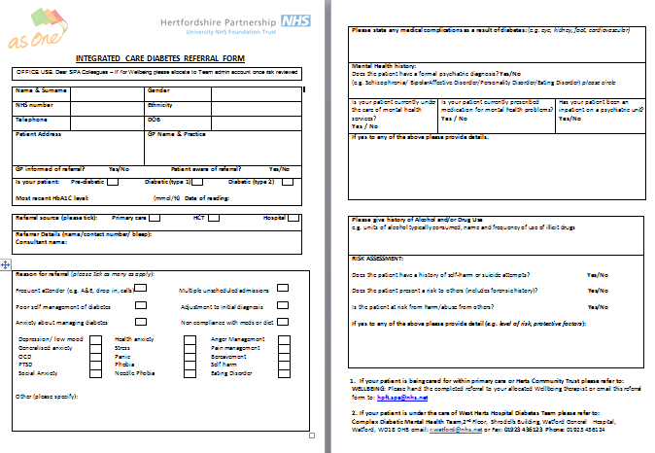
Professionals referral form available on DXS
Notes:
For our GP practices this referral can be found on DXS.

Slide 22
Typical referrals
Difficulty adjusting to new diagnosis (stress, anxiety, sense of loss)
Needlephobia
Low motivation to adhere to self management (including attending Desmond /Dafne)
Hopelessness or low mood related to chronicity
Common mental health problems unrelated to diabetes.
Notes:
As a further clue to suitability, these are some typical referrals we’ve received in the past year or so.
These are common difficulties we’re happy to deal with.
Be aware we also treat patients whose anxiety and depression is nothing to do with their having diabetes!

Slide 23
Does effective case identification reduce admissions?
Notes:
Based on our pilot outcomes, the answer is Yes!
Measured by CSRI at IA, end of tx, and 3 month FU. And this can work either way as positive nhs utilisation e.g..

Slide 25
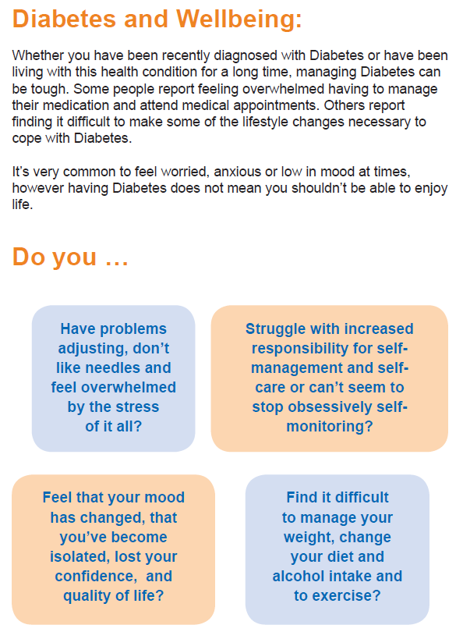
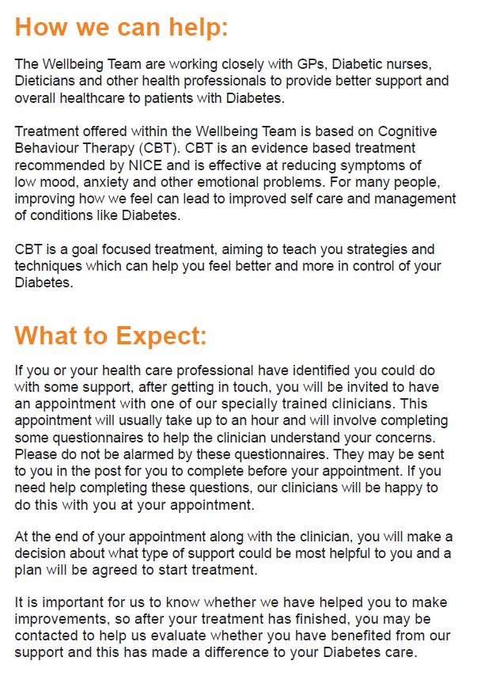

Slide 26
Questions?
Professional referral form - download via:
http://www.hpft.nhs.uk/wellbeing-service
talkwellbeing.co.uk
Single Point of Access: 0300 777 0707
Hertfordshire Wellbeing Service
@HPFT_Wellbeing
Notes:
For all other referrals

