Slide 1
Hertfordshire Conference 2018 How to avoid admission of older people with diabetes
Diabetes Specialist Nurses

Slide 2
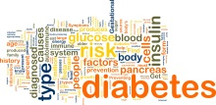
Considerations to prevent admission of an older person with diabetes
Feet
Hypoglycaemia
Hyperglycaemia
Medications
Are they coping with their diabetes?

Slide 3
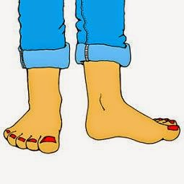
Who is at risk of feet problems?
Anyone with Type 1 or Type 2 diabetes, whether controlled with diet, tablets or insulin, regardless of duration of diabetes and regardless of age.
Is the person with diabetes checking their feet regularly?
If not, is there a carer or relative that can check feet?
Regular checks and education might prevent an admission
If you find a foot problem refer to podiatry/acute care as appropriate

Slide 4
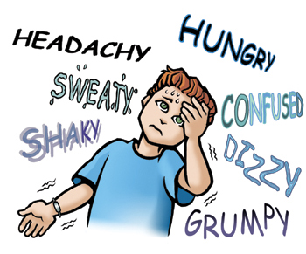
Hypoglycaemia – some considerations in the elderly
Is the person coping at home? Are they able to provide meals/food for themselves?
History of confusion or falls
Low/very good HbA1c may suggest unrecognised/asymptomatic hypoglycaemia
Remember, not just insulin can cause hypos, some oral agents can too e.g. gliclazide, especially if renal function has deteriorated
Preventing hypos could prevent admission

Slide 5
Hypoglycaemia – some more considerations in the elderly
If the person is on insulin/certain oral agents, do they know how to treat hypo?
If patient has had admissions with hypos does the person know how to treat hypos?
If not, ask the DSN/ practice nurse/ district nurse to teach the patient and relatives/carers

Slide 7
Hyperglycaemia – some considerations in the elderly
Any BGL >15mmol/l – test for ketones if on insulin
Identify cause – Diet / Sepsis / Steroids
Modify diet if appropriate – refer dietitian?
Review regular medication – does it need titrating/is patient taking it?
Review who administers medication – does patient need additional support e.g. district nurses/family

Slide 8
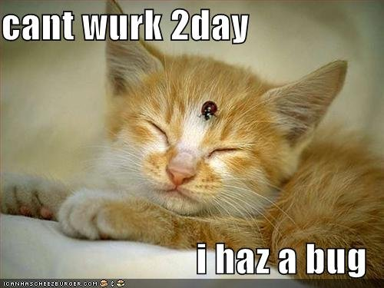
Hyperglycaemia - some more considerations in the elderly
Does the patient understand sick day rules?
Have they been given literature and individual advice about dose titration/ correction doses/what to do with OHAs?
If not refer to DSN
or practice nurse for
further education

Slide 9
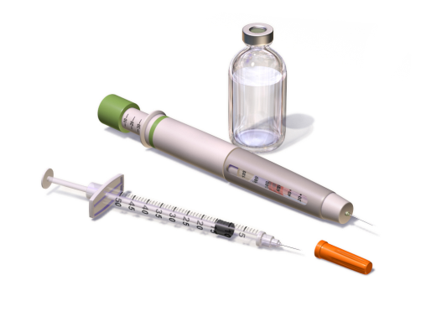
Injectable Medications e.g. Insulin or GLP 1
Do they inject themselves?
If new to insulin or GLP 1, have they been seen by a DSN/ practice nurse and taught how to inject?
Do they have insulin pen and needles/ sharps box?
What length pen needle are they using?
Are they testing their BGLs appropriately?
If not able to inject, have you set up district nurse or taught relative/carer?

Slide 10
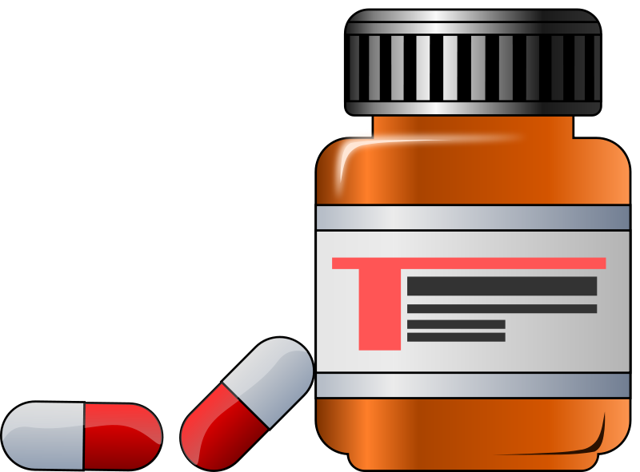
Oral Medications
Do they self-administer tablets?
Is their memory reliable?
Do they need a Dossett box?
Have you involved the community pharmacist for help if you have concerns?

Slide 11
Scenarios What do you see? What would you do?

Slide 12
Doris – 85 years old.
On BD Humulin M3 (Luxura pen)
Sight deteriorating
Erratic blood glucose levels over last 2 months –
5-17mmols/l
Patient keen to maintain independence
Admitted with recurrent UTI’s

Slide 13
What factors could be affecting her glycaemic control?
Infection
Sight: Correct dosage / Injection technique
Dexterity: Administering full dose
Injection Sites: Lipodystrophy / Site rotation / Needle length
Diet
Equipment: Faulty / Too complicated

Slide 14
What should be done to help overcome these problems/prevent further admissions?
Treat Infection
HBA1c
Insulin Adjustment with support from GP/PN/DSN
Safety first! Aim BGL 6-12 mmol/l
Refer to DSN:
Assess use of device and safety - ?Kwikpen ?DN
Check sites
QC meter and change if needed
Refer to dietitian: check diet appropriate

Slide 15
Mr. Singh 79 yrs old
On Once daily Glargine 18 units for 3 years
BMI – 18
HBA1c 11.5%
(102 mmol/mol)
DNs giving insulin
Blood Glucose today is 27.5 mmols/l at 11.00
Usually runs blood glucose 7-9mmol/l pre breakfast – tested by daughter

Slide 16
What would you do about his hyperglycaemia today?
Check urine or blood for ketones
Check dietary intake
Assess patient – is he well? Does he feel any different from usual. Can this be managed or does he need admission?
Review medication ?? Stat insulin – CAUTION!

Slide 17
What does his HBA1c indicate?
Extremely poor glycaemic control. Most blood
glucose levels running >15 mmols/l
Weight Loss / Osmotic symptoms
Current insulin not adequate
What needs to be done longer term?
BD insulin e.g. Humulin M3, Novomix 30.
Refer to DSN/PN for education of daughter
Liaison with District Nurse and GP/PN/DSN for
dose titration
Dietetic review and monitor weight

Slide 18
Betty – 73 years old
On Humalog Mix 25 BD and Metformin
HBA1c 7.5 %
Erratic control – Blood glucose running 2.1 – 18.7 mmols/l
2 ambulance call-outs/ admissions in last 6/12 due to hypoglycaemia
Intermittent confusion reported by husband but denied by patient

Slide 19
What is the priority with this lady?
Hypoglycaemia / Confusion
What could be causing the hyperglycaemia?
?Hypoglycaemia Over –treatment
?Omission of insulin post hypo treatment- Rebound high
What should be done?
Assess cause of hypoglycaemia
e.g. insulin timing and doses, food intake, exercise,
alcohol intake
Reduce Insulin
Refer to DSN/PN to check sites and educate re:
correct treatment of hypoglycaemia

Slide 20
Any questions?

