Slide 1
Tight Glycaemic Control Does More Harm Than Good?
Proposed by
Dr. Nicola Cowap

Slide 2
Does tight glycaemic control reduce diabetic complications?
DCCT (type 1) ‘93
UKPDS (type 2) ‘98.
Non-significant reductions in cardiovascular risk

Slide 3
What Happens with an Increased Event Rate? Part One.
EDIC (type 1) 2005
42% CVD risk reduction
UKPDS 10 year follow-up (type 2) 2008
15% risk reduction in MI in SU-insulin group
33% in metformin group
Despite attenuation in A1c between intensively and conventionally treated groups.

Slide 4
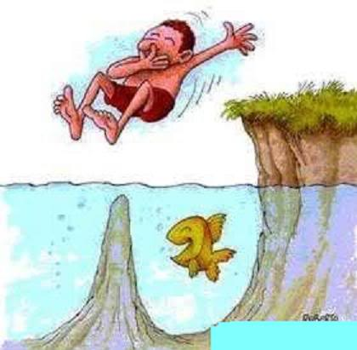
Intensive Glycaemic Control
The Hidden Dangers!

Slide 5
What Happens with an Increased Event Rate? – Part Two
Type 2 trials.
- PROACTIVE (2005)
- VADT (2009)
- ADVANCE (2008)
No significant reduction in CV mortality
- ACCORD (2008)
Mean age ~62yrs. Stopped after an average of 3.5yrs due to 22% increase in mortality in intensively treated group.

Slide 6
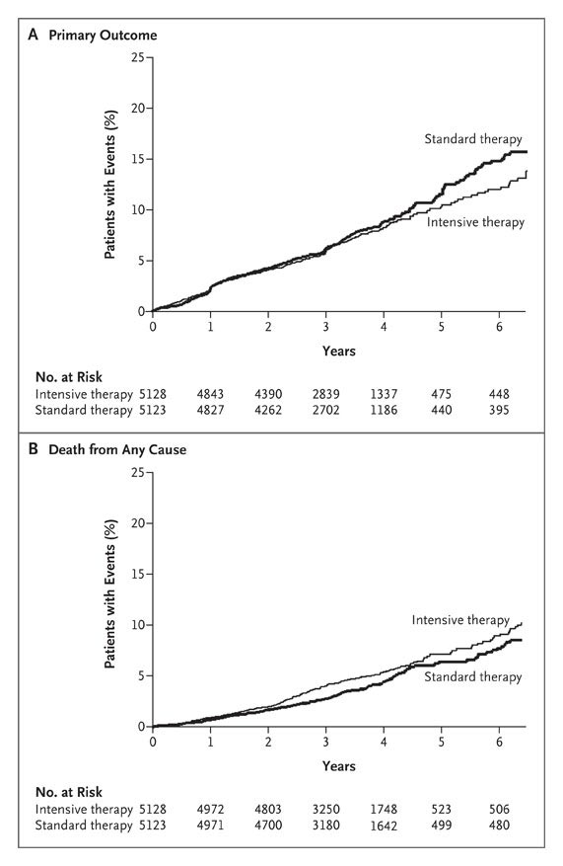

Slide 8
Any other Evidence?
Hemmingsen Cochrane Review, meta-analyses (2011, 2013) in 2DM no reduction in total or CV mortality, MI, stroke or ERF and 30% inc in severe hypoglycaemia.
Kahler et al (2014) Systematic review and meta-analyses – No trend towards improving all-cause or CV mortality in intensively controlled type 1 patients.
Kunti (2015) Retrospective cohort study – Inc. risk of CV events in insulin Rxd 2DM & 1DM patients who had hypos.

Slide 9
Any other Evidence?
Leuven Studies (2001) – RCTs of surgical & medical ICU patients. Intensively treated had reductions in in-hospital morbidity & mortality.
NICE-SUGAR (2009) - Increased mortality in the intensively treated group (27.5%vs. 24.9%) and more hypos. ( 6.8% vs. 0.5%).

Slide 12
Especially Bad News
For:-
People who drive for a living
Elderly
Children and adolescents
NB. Some at higher risk of hypoglycaemia i.e elderly, children, poor renal or liver function, alcohol misuse.

Slide 13
Elderly
More at risk of hypoglycaemia (and hypo. unawareness):
- co-morbidity,
- polypharmacy,
- impaired counter-regulatory hormone mechanisms
More at risk from hypoglycamia:
- falls
- ?increased risk of dementia
Limited life expectancy

Slide 14
Children and Adolescents
Poor glycaemic Control
Hypos.

Slide 15
The ‘Sweet Spot?’
Currie et al (2010) –Retrospective cohort study of type 2 diabetics >50yrs from UK General Practice research database examining all-cause mortality according to decile of HbA1c.
U-shaped curve with lowest mortality at an HbA1c of 7.5%

Slide 16
Take Home Messages
Tight glycaemic control is not ideal for all diabetics. Focus on those patients who are most likely to benefit and least likely to be harmed.
Good diabetic control is not always the same as good glycaemic control.
Any reduction in HbA1c is worthwhile in terms of reducing risk.

Slide 17
References
Diabetes Control and Complications TG. The effect of the intensive treatment of diabetes on the development and progression of long-term complications in insulin-dependent diabetes mellitus. N Engl J Med. 1993;329:977-86.
UKPDS G. Intensive blood-glucose control with sulphonylureas or insulin compared with conventional treatment and risk of complications in patients with type 2 diabetes (UKPDS 33). The Lancet. 1998;352(9131):837-53.
DCCT/EDIC SRG. Intensive Diabetes Treatment and Cardiovascular Disease in Patients with Type 1 Diabetes. The New England Journal of Medicine. 2005;353(25):2643-53.
Holman R, Paul S, Bethel A. 10 year follow-up of intensive glucose control in type 2 diabetes mellitus. N Engl J Med. 2008;359:1577-89.
Dormandy JA, Charbonnel B, Eckland DJA, Erdmann E, Massi-Benedetti M, Moules IK, et al. Secondary prevention of macrovascular events in patients with type 2 diabetes in the PROactive Study (PROspective pioglitAzone Clinical Trial In macroVascular Events): a randomised controlled trial. The Lancet. 2005 2005/10/14/;366(9493):1279-89.
Duckworth W AC, Moritz T; et al, VADT Investigators. . Glucose control and vascular complications in veterans with type 2 diabetes. N Engl J Med. 2009;360(2):129-39.
ADVANCE Collaborative Group, Patel A MS, Chalmers J, Neal B, Billot L, Woodward M, Marre M, Cooper M, Glasziou P, Grobbee D, Hamet P, Harrap S, Heller S, Liu L, Mancia G, Mogensen CE, Pan C, Poulter N, Rodgers A, Williams B, Bompoint S, de Galan BE, Joshi R, Travert F. Intensive blood glucose control and vascular outcomes in type 2 diabetes. N Engl J Med. 2008;358(24):2560-72.
Action to Control Cardiovascular Risk in Diabetes Study Group, Gerstein HC MM, Byington RP, Goff DC Jr, Bigger JT, Buse JB, Cushman WC, Genuth S, Ismail-Beigi F, Grimm RH Jr, Probstfield JL, Simons-Morton DG, Friedewald WT. . Effects of Intensive glucose lowering in type 2 diabetes. N Engl J Med. 2008;358(24):2545-59.
Hemmingsen B, Lund SrS, Gluud C, Vaag A, Almdal T, Hemmingsen C, et al. Intensive glycaemic control for patients with type 2 diabetes: systematic review with meta-analysis and trial sequential analysis of randomised clinical trials. 2011.

Slide 18
References
Hemmingsen B1 LS, Gluud C, Vaag A, Almdal TP, Hemmingsen C, Wetterslev J. Targeting intensive glycaemic control versus targeting conventional glycaemic control for type 2 diabetes mellitus. Cochrane Database Systematic Review. 2013, Nov 11
Kahler P, Grevstad B, Almdal T, Gluud C, Wetterslev Jr, Vaag A, et al. Targeting intensive versus conventional glycaemic control for type 1 diabetes mellitus: a systematic review with meta-analyses and trial sequential analyses of randomised clinical trials. BMJ Open. 2011 August 1, 2014;4(8).
Khunti K, Davies M, Majeed A, Thorsted BL, Wolden ML, Paul SK. Hypoglycemia and Risk of Cardiovascular Disease and All-Cause Mortality in Insulin-Treated People With Type 1 and Type 2 Diabetes: A Cohort Study. Diabetes Care. 2015 February 1, 2015;38(2):316-22.
Van den Berghe G, Wouters P, Weekers F, Verwaest C, Bruyninckx F, Schetz M, et al. Intensive insulin therapy in critically ill patients. New England Journal of Medicine. [Article]. 2001 Nov;345(19):1359-67.
NICE SUGAR Si. Intensive versus Conventional Glucose Control in Critically Ill Patients. New England Journal of Medicine. 2009;360(13):1283-97.
Clarke W, Jones T, Rewers A, Dunger D, Klingensmith GJ. Assessment and management of hypoglycemia in children and adolescents with diabetes. Pediatric Diabetes. 2009;10:134-45.
Patton SR, Dolan LM, Henry R, Powers SW. Fear of hypoglycemia in parents of young children with type 1 diabetes mellitus. Journal of Clinical Psychology in Medical Settings. 2008;15:252 – 9
Skrivarhaug T, Bangstad HJ, Stene L, Sandvik L, Hanssen K, Joner G. Long-term mortality in a nationwide cohort of childhood-onset type 1 diabetic patients in Norway. Diabetologia. 2006;49(2):298-305.
Bryden KS, Dunger DB, Mayou RA, Peveler RC, Neil HA. Poor prognosis of young adults with type 1 diabetes: a longitudinal study. Diabetes Care. 2003;26(4):1052 - 7.
D.C.C.T SG. Effect of intensive diabetes treatment on the development and progression of long-term complications in adolescents with insulin-dependent diabetes mellitus: Diabetes Control and Complications Trial. The Journal of Pediatrics. 1994;125(2):177-88
Currie CJ, Peters JR, Tynan A, Evans M, Heine RJ, Bracco OL, et al. Survival as a function of HbA1c in people with type 2 diabetes: a retrospective cohort study. The Lancet. 2010;375(9713):481-9.

Slide 19
