Slide 2
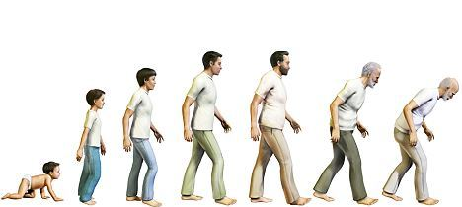
The Seven Ages of Man
1. Infancy

Slide 3
The Seven Ages of Man
2. Childhood

Slide 4
The Seven Ages of Man
3. Adolescence

Slide 5
The Seven Ages of Man
4. Young adult

Slide 6
The Seven Ages of Man
5. Adulthood

Slide 7
The Seven Ages of Man
6. Early old age

Slide 8
The Seven Ages of Man
7. Later old age

Slide 9
Diabetes from Cradle to Grave
Dr. Thomas Galliford
Consultant Endocrinologist
West Herts Hospitals NHS Trust

Slide 10
Hertfordshire Diabetes Conference

Slide 11
Childhood

Slide 12
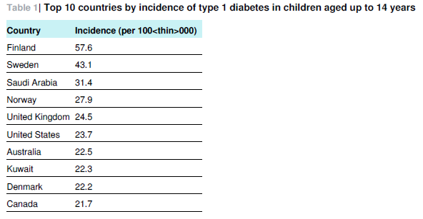
Incidence of diabetes in children
^{1.}
¹Iacobucci. BMJ 2013; 346

Slide 13
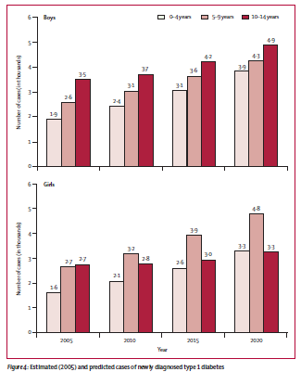
Incidence trends for type 1 diabetes in Europe¹
EURODIAB registers (17 countries)
Oxford, Bristol, Leeds, N. Ireland
¹Patterson et al. Lancet 2009; 373:2027-33

Slide 14
Challenges with young children with type 1 diabetes
Physiological
Increased insulin sensitivity
Susceptibility to hypoglycaemia/failure to reliably detect
Hyperglycaemia (glycaemic variability) leading to decreased grey matter volume
Nutritional
Glycaemic index of foods
Food preferences and food refusal
Greater negative child mealtime behaviours /mealtime misbehaviour and worse diet
Physical Activity
Unpredictable
Avoidance (hypoglycaemia)
Psychosocial
Considerations of management pervade nearly all ADLs (e.g. play, meals, sleep, sibling/peer relationships, school/daytime interactions)
Adherance to treatment regime feels like punishment
Neuropsychological effects from difficulties in achieving treatment targets
Reduced QoL
Parental (more known about psychological stresses in parents)
Fear/worry about acute and chronic complications including hypoglycaemia (e.g. seizure)
Social isolation/negative effects on job performance or advancement
Self-doubt
Increased prevalence and risk of PTSD/depression/anxiety symptoms
Sleep disturbance
The younger the child the greater the impact
70-80% of burden of care on mothers (very young children)
difficult to predict insulin volume and dosage
Less activity overall

Slide 15
Young children with type 1 diabetes
Interventions
Limited trial data, small studies
e.g. parent mentors, phone-calls, coping skills training
Streisand et al¹:
134 parents of children 1-6yrs (parent support vs. diabetes education support)
Parent support = phone sessions, online message board, group teleconferences
Interventional strategies = parental emotional functioning, support of parenting behaviours
Preliminary results:
Improvements in mealtime distress
Higher satisfaction
0.5% reduction in HbA1c from baseline at 1 year
More studies needed!
¹Streisand and Monaghan. Curr Diab Rep. 2014, 14(9)

Slide 16
Target HbA1c < 58mmol/mol (7.5%)
Published Aug 2015, updated Nov 2016
Target HbA1c < 48mmol/mol (6.5%)

Slide 17
All 173 PDUs
24,439 children <24yrs
27,115 (96%) Type 1 diabetes
Prevalence 195.4/100,000
Incidence 25.9/100,000
♂ > ♀
Mean HbA1c 67.8mmol/mol (8.35%)
3.2mmol/mol improvement from 2014-2015
23.5% HbA1c < 58mmol/mol
Complications:
9.7% microalbuminuria
13.8% retinopathy
26.3% hypertension
30% referred to psychology or CAMHS

Slide 18
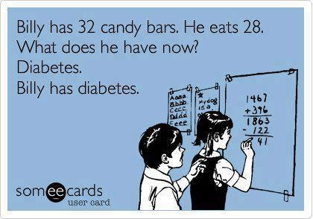
621 (2.2%) Type 2 diabetes

Slide 19
621 (2.2%) Type 2 diabetes
♀:♂ = 2:1
78.5% obese, 7.3% overweight
Black and asian backgrounds greater representation (52.3%)
Most children lived in deprived areas
Mean HbA1c 59.7mmol/mol (7.6%)
Complications:
14.5% microalbuminuria
5.4% retinopathy
40% hypertension
33.8% referred to psychology or CAMHS

Slide 20
Adolescence

Slide 21
Type 1 diabetes in adolescence
Decline in metabolic control
Rates of DKA increase
Less likely to attend OP
Increased drop out of medical system

Slide 22
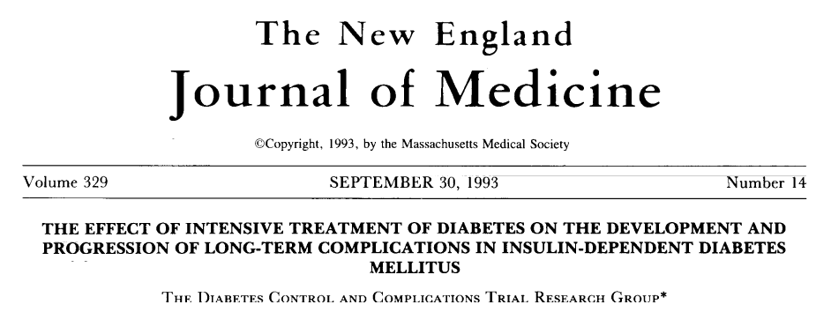
1441 patients with type 1 diabetes
Intensive therapy vs. conventional treatment
Mean follow-up 6.5 years
Results:
HbA1c 7.4% vs. 9.1%
76% reduction in risk for development of retinopathy
54% reduction in progression of retinopathy
47% reduction in proliferative or severe non-proliferative retinopathy
39% reduction in occurrence of microalbuminuria
54% reduction in occurrence of albuminuria
60% reduction in development of clinical neuropathy
41% reduction in major CV and PVD events
2-3x increase in severe hypoglycaemia
NEJM 1993; 329(14): 977-85

Slide 23
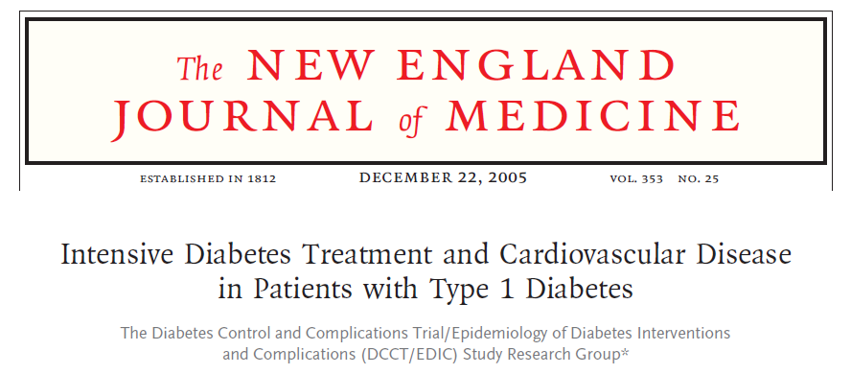
93% followed for 17 years
Assessment of long-term incidence of CV disease (non-fatal MI, stroke, death from CV disease, angina, need for PTCA)
Results: (intensive vs. conventional treatment)
HbA1c 7.9% vs. 7.8%
42% reduction in risk of CV event
57% reduction in non-fatal MI, stroke, death from CV disease
Differences between groups remained significant after adjusting for microalbuminuria and albuminuria
NEJM 2005; 353(25): 2643-53

Slide 24
DCCT in adolescents
DCCT cohort differences adolescant vs. adult¹
195 young subjects (13 – 17yrs)
At enrollment HbA1c INT 9.6% vs. 9.0%, CON 9.5% vs. 8.9%
At completion HbA1c INT 8.1% vs. 7.2%, CON 9.7% vs. 8.9%
Risk reduction of having DR 53% (p = 0.048)
Risk reduction of progression of DR 70% (p = 0.042)
DCCT/EDIC
156 adolescents²
No difference in retinopathy progression 10yrs after the end of DCCT
Significantly higher risk of retinopathy progression INT adolescants vs. INT adults – adjusted hazard ratio 1.7
¹DCCT Research Group. J Pediatr. 1994, 125(2): 177-88
²White et al. Diabetes 2010, 59: 1244-1253

Slide 25
Adulthood

Slide 26
NDA 2015-16: cardiovascular complications - hospital admissions
People with diabetes comprise about 5% of the adult population yet account for 25-30% of admissions for cardiovascular complications.
Complicationª | Non-Emergency Admissions |  |  | Emergency Admissions
 | Number of all non emergency admissions | Number of non emergency admissions for NDA population | Percentage of non emergency admissions for NDA population | Number of all emergency admissions | Number of emergency admissions for NDA population | Percentage of emergency admissions for NDA population
Angina | 224,091 | 63,501 | 28.3 | 256,250 | 78,151 | 30.5
Myocardial Infarction | 16,732 | 4,079 | 24.4 | 87,849 | 21,399 | 24.4
Heart Failure | 107,820 | 32,802 | 30.4 | 356,081 | 115,695 | 32.5
Stroke | 31,670 | 7,286 | 23.0 | 126,590 | 29,392 | 23.2
Number of hospital admissions and NDA related hospital admissions for cardiovascular complications, 2015-2016 HES/PEDW

Slide 27
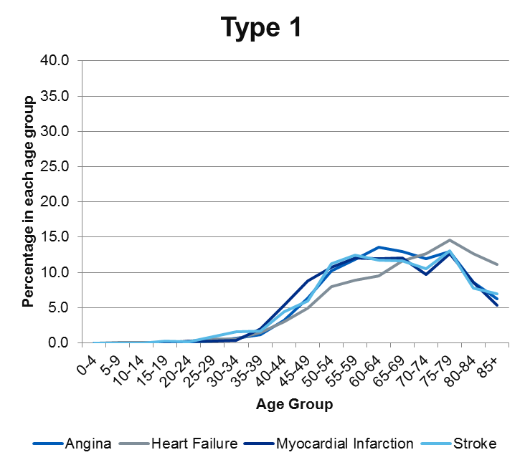
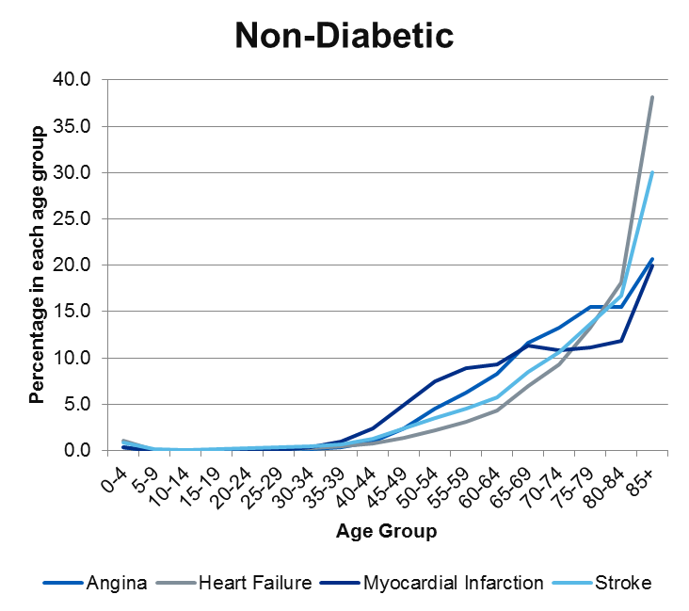
NDA 2014-15: cardiovascular complications - age at hospital admission, type 1 DM
People with type 1 diabetes admitted to hospital with cardiovascular complications are younger than those without diabetes.
Age distribution of people admitted to hospital with cardiovascular complications, by those with type 1 diabetes and those without diabetes, 2014-15 audit

Slide 28
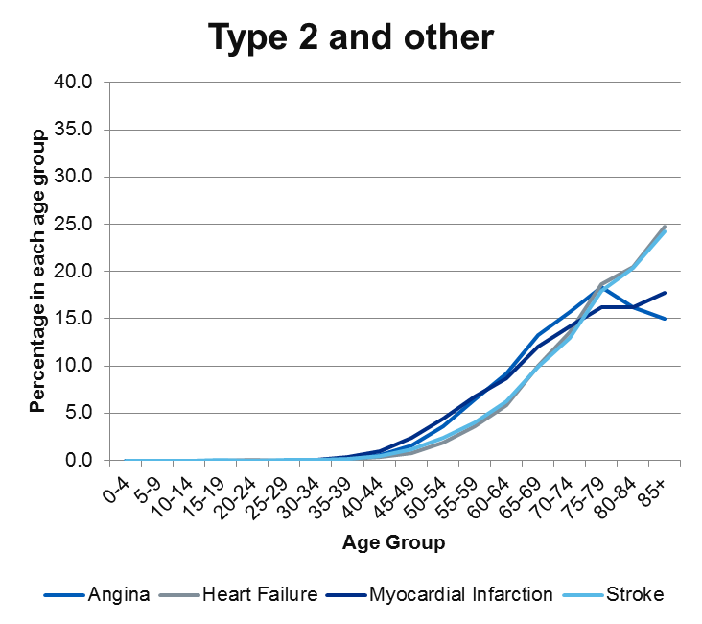
NDA 2014-15: cardiovascular complications - age at hospital admission, type 2 DM
People with type 2 diabetes admitted to hospital with cardiovascular complications are of similar age to those without diabetes.
Age distribution of people admitted to hospital with cardiovascular complications, by those with type 2 diabetes and those without diabetes, 2014-15 audit

Slide 29
NDA 2014-15: amputation prevalence in people with all types of diabetes by age
The absolute numbers of amputations in people with diabetes are relatively small but they represent around half of all admissions to hospital for amputation
Duration of diabetes since diagnosis supersedes age as the dominant risk factor for major and minor amputations
Complicationª | Age Range (years) | Number of People with Diabetes | Number of People with Diabetes Experiencing Amputation | Prevalence Percentage
Major Amputation | 0-64 | 935,957 | 623 | 0.07
 | 65-79 | 739,868 | 681 | 0.09
 | 80+ | 292,981 | 211 | 0.07
Minor Amputation | 0-64 | 935,957 | 1,593 | 0.17
 | 65-79 | 739,868 | 1,345 | 0.18
 | 80+ | 292,981 | 503 | 0.17
One year diabetes related amputation prevalence, by age, 2014-15 audit

Slide 30
NDA 2014-15: diabetes specific hospital admission characteristics (RRT)
People with diabetes requiring RRT are younger than those without diabetes (especially type 1)
Age distribution of people with and without diabetes admitted for RRT, 2014-15 audit

Slide 31
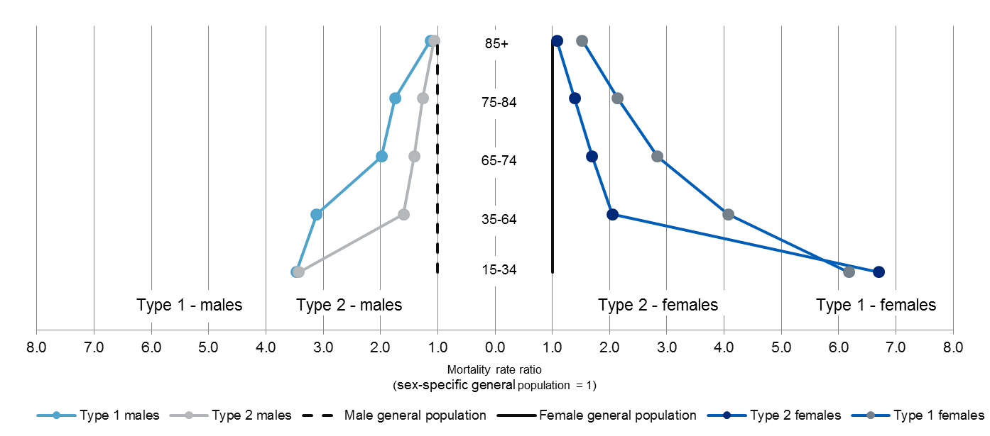
NDA: age specific mortality rate ratios
The relative risk of death is increased at all ages, in both men and women, in younger people more than older people.
Age specific mortality rate ratios by type of diabetes and sex, 2013-14 audit, deaths in 2015

Slide 32
NDA: mortality and care processes – subgroup analysis
Analysis of two cohorts of people with diabetes
aged 20 years and over and alive as at 31st March 2013
Tracked over 7 years between 2006-7
Looked at x3 NICE specified diabetes care processes (HbA1c, BP and cholesterol)
follow up period was used to identify if the patient died during 2013-14 or 2014-15
All 21 checks, ‘Complete’
12 checks or less (significantly reduced care process completion) ‘Incomplete’
 | Type 1 | Type 2 and Other
Complete Care Processes | 23,928 | 242,829
Incomplete Care Processes | 16,823 | 79,924
Care process completion cohort sizes for mortality

Slide 33
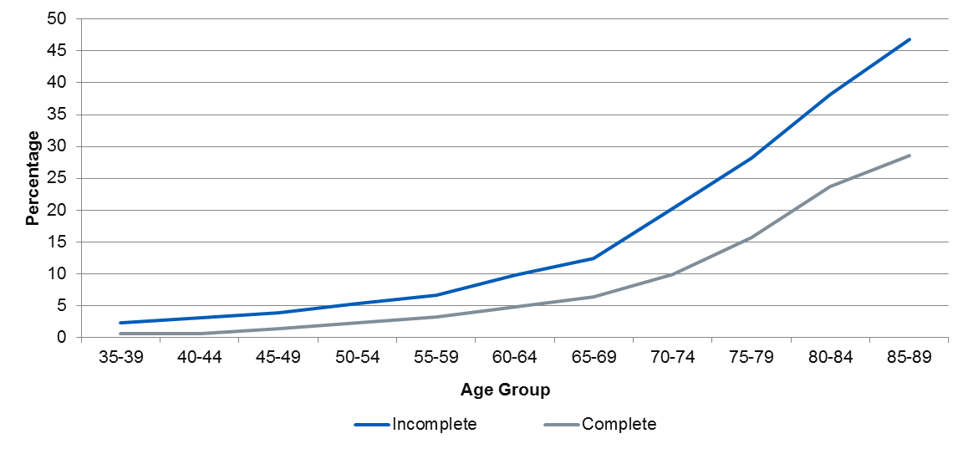
NDA: mortality and care processes - rates by age (type 1 DM)
For all age groups, the death rate during the follow up period was higher for the group whose care process completion during the preceding seven years was incomplete – twice as high for most age groups.
This suggests that regular healthcare contacts in people with type 1 diabetes are associated with reduced additional mortality
Percentage of people with Type 1 diabetes who died during the follow up period, by age

Slide 34
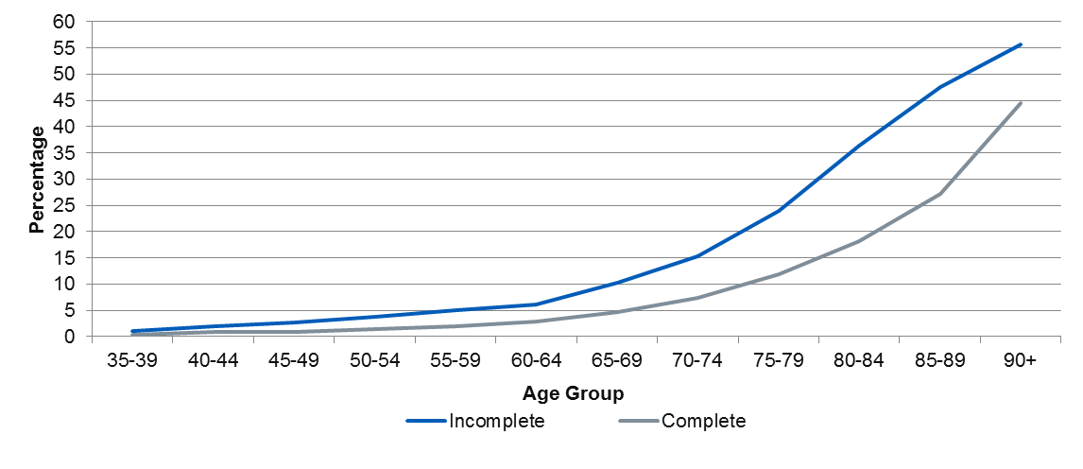
NDA: mortality and care processes - rates by age (type 2 DM)
For all age groups, the death rate during the follow up period was higher for the group whose care process completion during the preceding seven years was incomplete – twice as high for most age groups.
This suggests that regular healthcare contacts in people with type 2 diabetes are associated with reduced additional mortality
Percentage of people with Type 2 and other diabetes who died during the follow up period, by age

Slide 35
Old Age

Slide 36
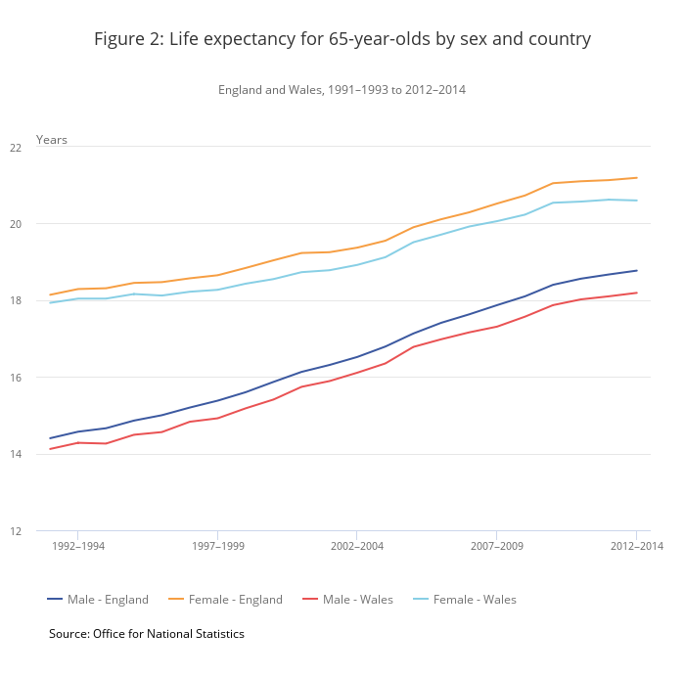
Life expectancy for 65-yr olds by sex and country (England and Wales 2012-14)

Slide 37
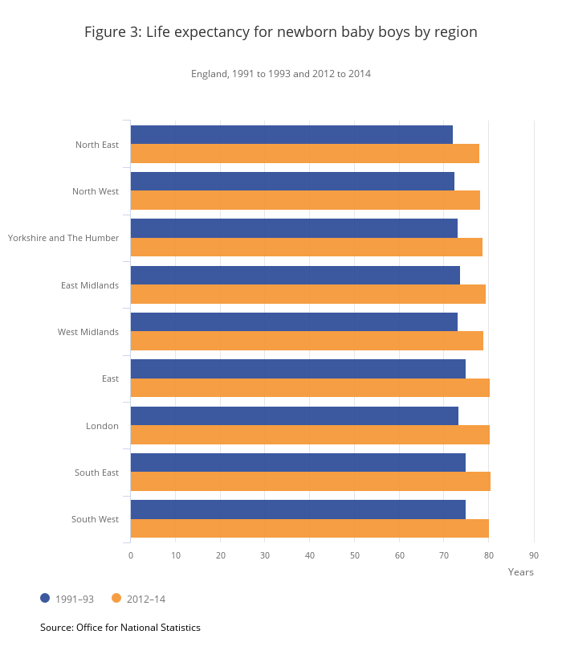
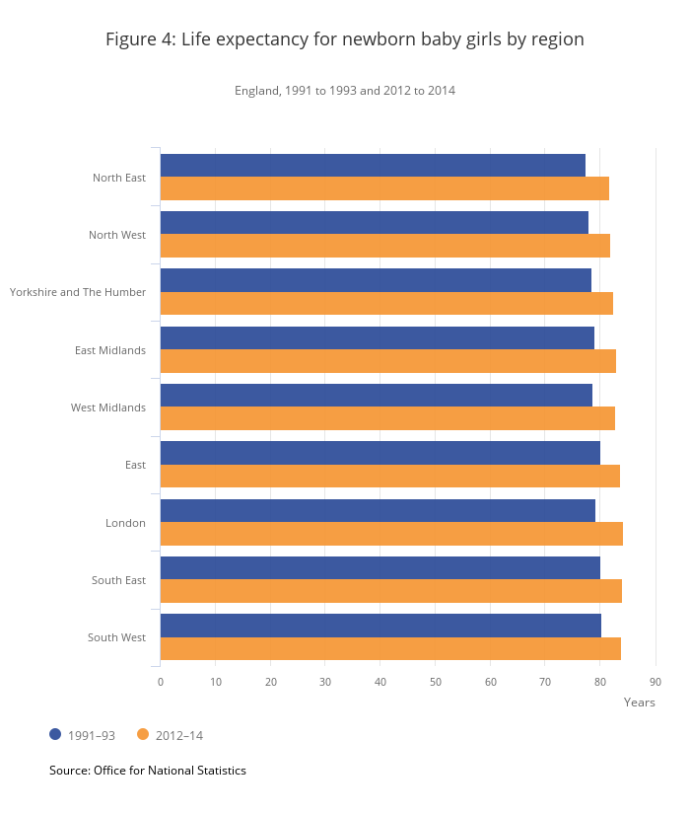
Life expectancy
Newborn baby boys by region
1991-93 and 2012-14
Newborn baby girls by region
1991-93 and 2012-14

Slide 38
Clinical guidelines for diabetes in older age
Individualized care, considering the factors of age, life expectancy and co-morbidity when considering glycaemic targets
Little qualifying detail
European Diabetes Working Group
→ HbA1c target 53-58mmol/mol (7-7.5%) in fit older people;
59-69mmol/mol (7.5-8.5%) for the frail
?69mmol/mol may be risky?

Slide 39
Glycaemic control in older age
Thorpe et al Diabetes Care 2015; 38: 588-95
15,880 people aged > 65 yrs
16% (2,541) had dementia
24% (3,811) had dementia if age > 75 yrs
52% (8,258) had HbA1c < 53mmol/mol / 7%
→ 75% (6,193) treated with insulin, SUs or both
Hambling et al Diabet. Med. 2017; 34: 1219-27
ECLIPSE data extraction in Norfolk and Suffolk for patients from Nov 2013 – May 2015
24,661 patients > 70 yrs; 15.7% (3862) coded for T2 DM
→ 35.7% (1379) prescribed SUs and/or insulin therapies
→ Median HbA1c = 58mmol/mol / 7.5%
719 people HbA1c < 58mmol/mol c.f. QoF
400 people HbA1c < 53mmol/mol
162 people HbA1c < 48mmol/mol
644 people had eGFR <60 ml/min/1.73m²
60 people coded for dementia
⅓ overtreated

Slide 40
Vulnerabilities for hypoglycaemia
Advanced age
Diabetes duration
Polypharmacy
Co-morbidities e.g. renal, cognitive impairment
Frailty (unintended weight loss)
→ Zaccardi et al Lancet Diabetes Endocrinol 2016; 4: 677-85
Year on year increase in hospital admissions for hypoglycaemia in England 2005-2014
over 10yrs absolute nos. = 39% (HES data)

Slide 41
Sequelae of hypoglycaemia
Emergency call outs (GP, Ambulance)
Admission (prolonged)
Fractures
Head injury
CV event
Psychological harm
Increased cognitive decline

Slide 42
Focus on old age - summary
Prevalence of diabetes peaks at 75-79 yrs (19.7% of men, 14.2% of women having diabetes)¹
Insulin and oral hypoglycaemic agents are second only to warfarin and anti-platelet agents as iatrogenic causes of hospital admission
Evidence for tight glycaemic control lacking
Individualized care paramount
Aim to avoid hypoglycaemia and symptomatic hyperglycaemia
Diabetes UK. Good clinical practice guidelines for care home residents with diabetes. 2010
¹Holt. Diabet. Med 2017, 34: 1183-84

Slide 43
The Seven Ages of Man
2. Childhood
4. Young adult
6. Early old age
1. Infancy
3. Adolescence
5. Adulthood
7. Later old age

Slide 44
Sir David Brailsford
"The whole principle came from the idea
that if you broke down everything you
could think of that goes into riding a bike,
and then improved it by 1%, you will get a
significant increase when you put them all
together.”

Slide 45
Marginal gains
Newer Insulins
Ultrafast acting insulins
Better basal insulins
Glucose-responsive insulins
Buccal insulin
Inhaled insulin
Newer oral agents
Reduced hypoglycaemia risk
New combinations
Technology
Greater use of CSII in particular groups
Flash glucose monitoring
RT-CGMS
Closed-loop systems
Education and knowledge

