Slide 1

Clinical Effectiveness within ICT’s
HCAs Administration of Insulin
September 2017

Slide 2
HCA Training Plan
One Day University Course
Injection Technique Training
Carbs Awareness session
6 Steps to Insulin Safety
Sharps Awareness Course
Each HCA is allocated a Registered Nurse mentor who provides support throughout their training programme together with developing their competencies in practice.
58 HCAs and 28 RN mentors identified have completed their training programme January – June 2017.
HCT have now developed an internal Diabetes Training day which is run by our Diabetes Specialist Service. Our first training sessions were delivered by the team in mid September.

Slide 3
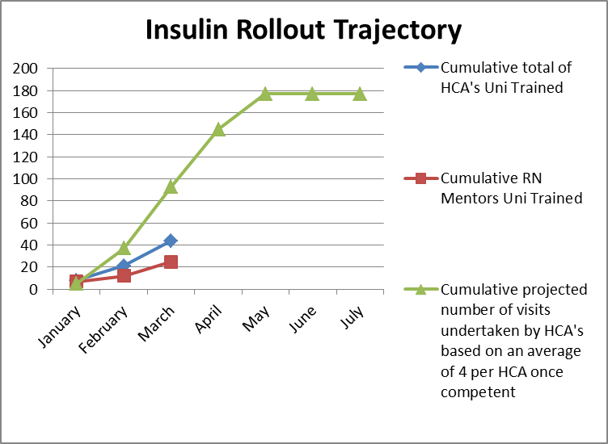
Identifying Suitable Patients
352 patients requiring insulin injections on HCTs combined caseload as at January 2017
168 patients identified as suitable for HCAs to administer insulin in line with Standard Operating Procedures and liaison with locality alined Diabetic Specialist Nurse
January 2017

Slide 4
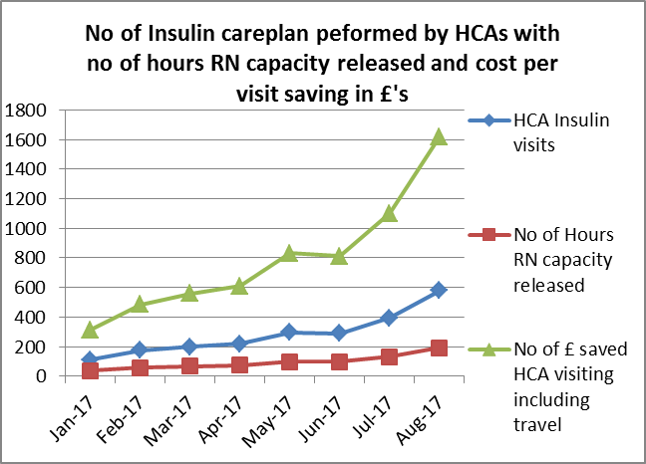
Productivity Outcomes

Slide 5
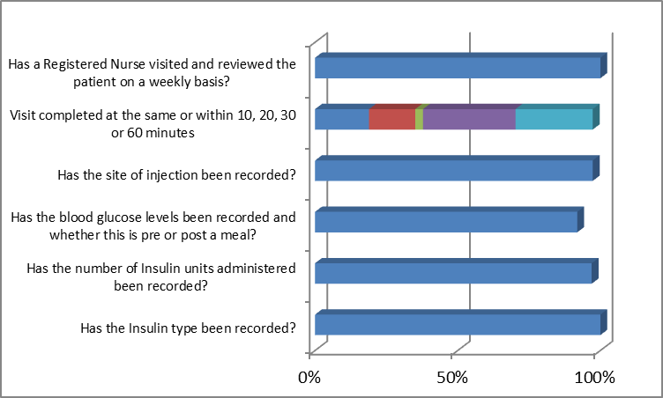
Benefits
Quality Outcomes
Clinical quality assurance record keeping spot checks undertaken by Clinical Quality Leads in September 2017
Clinical Quality Assurance
SAFE – No HCA medicines incidents
EFFECTIVE – treatment delivered at consistent times
EFFICIENT – each visit releases 20 minutes of RN capacity to focus on their more complex patients who require their skills

Slide 6
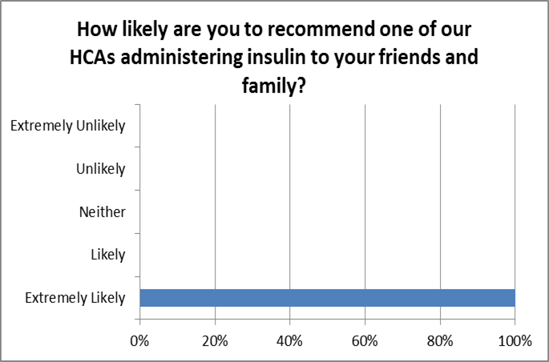
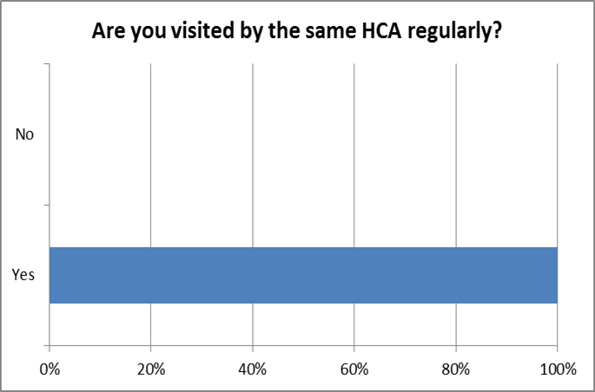
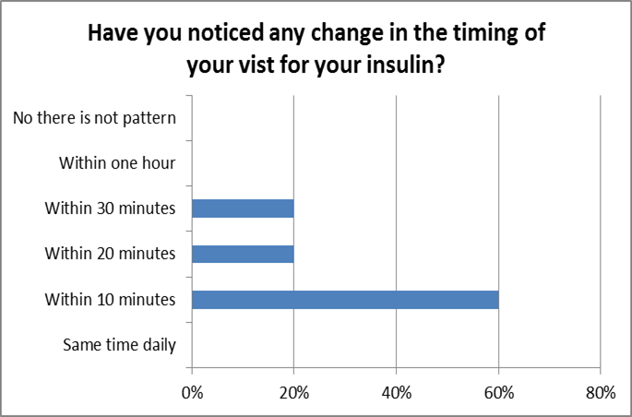
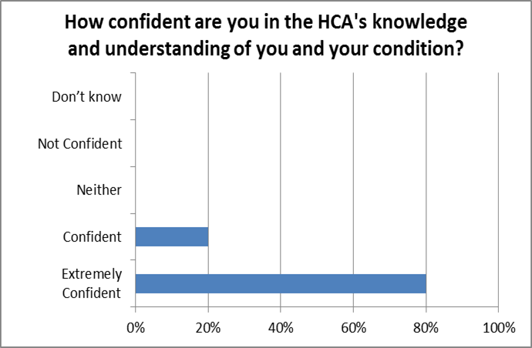
Benefits
Patient Experience

Slide 7

Benefits
Patient Experience
“ The girls always discuss my diabetes with me and even ask me about my diet and my general wellbeing, they seem to be very knowledgeable about my condition”
“Very happy as I feel I
have got to know the girls who always have a smile on their faces and always spend the time to discuss any problems I may be having”
“I have been seen
by the same 2 HCAs for the past few month and I have got to know them. My visit timings are more regular now. I am always made to feel at ease.”
I like having the same nurses visit. She always ringing my bell at the same time every day. She tells me off when I drink fat coke and eat chocolate. I love the banter we have and how the HCA spends time to chat.”
“I used to get
worried about
taking my insulin if people were late to administer it, I now don’t have that worry”
“I have had no problems”
“Great service”

Slide 8
Benefits
HCAs Experience
What worked well

Slide 9
Benefits
HCAs Experience
What were the challenges

Slide 10
Benefits
DN Caseload Manager
SOP
Frame work in place, linked to the code
How has this enabled and supported you to delegate this function to training the HCAs

