Slide 1
Evaluating the process of care for the inpatient management of the acute Diabetic foot. Evidence for the role of a fully integrated inpatient foot MDT?
DCD Hope, H Wang, R Anders, P Villa, C Kong

Slide 2
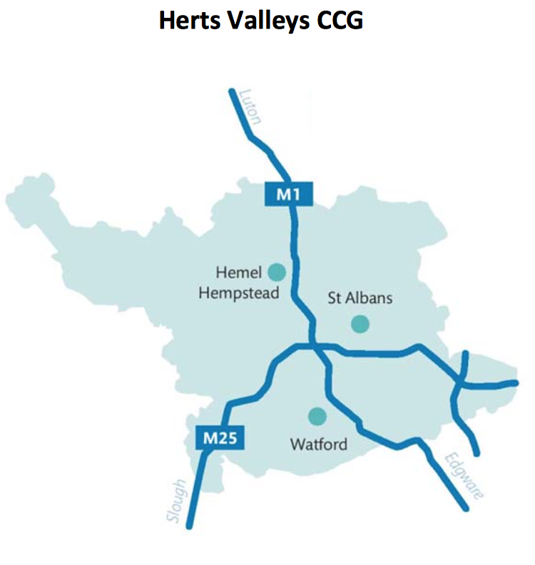
Background
Diabetic foot disease - neuropathy, deformity, ischemia, increased susceptibility to infection
¼ diabetic patients will have a foot complication. More than 60,000 people with diabetes in England are thought to have foot ulcers at any given time
Following amputation mortality is 50-75% at 5 years.
In 2014-15 the annual cost of diabetic foot disease to the NHS in England was estimated at £1 billion.
Foot complications are a significant caseload of diabetes team referrals
NWL STP 2016
Public Health England

Slide 3
Foot care activity profile for HVCCG (Public Health England)
https://www.gov.uk/guidance/cardiovascular-disease-data-and-analysis-a-guide-for-health-professionals

Slide 4
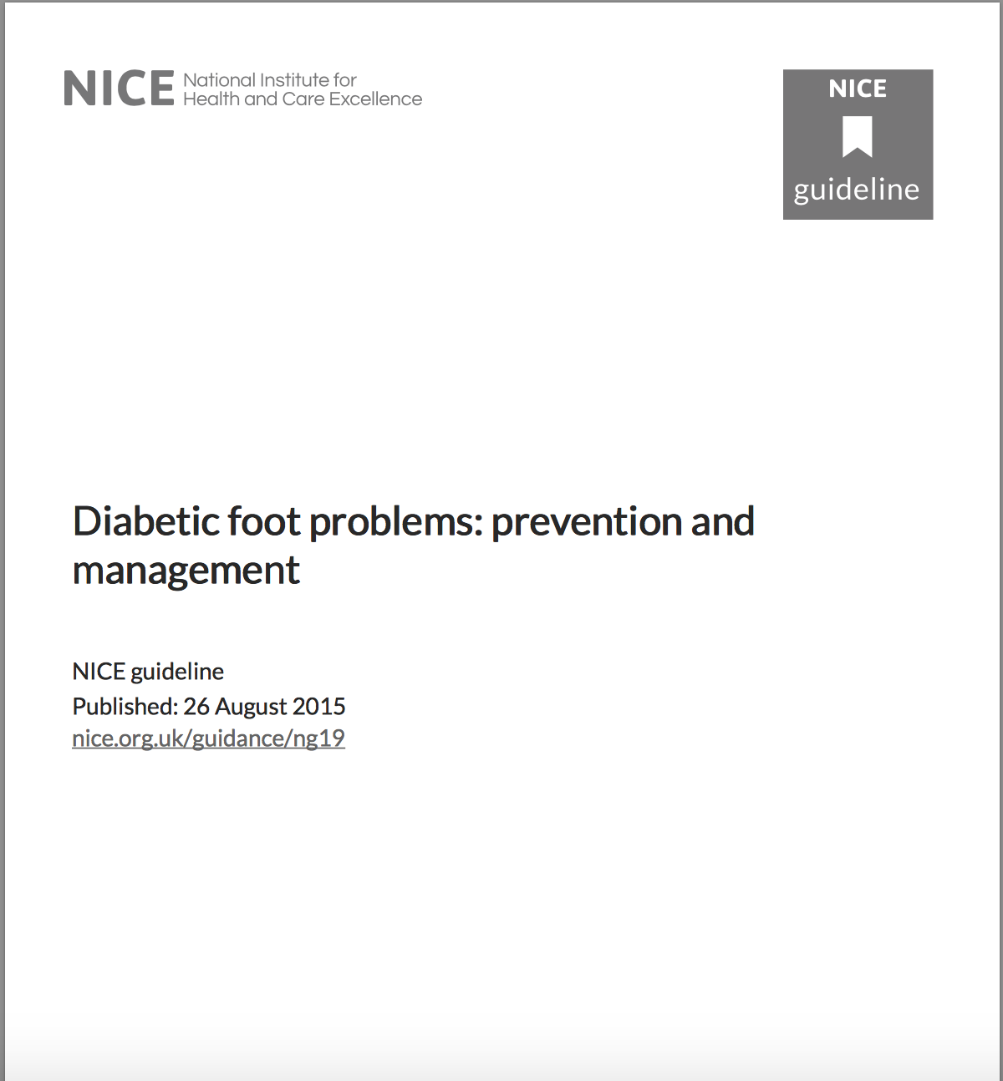
NICE standards of inpatient foot care (2015).
Guidance: Each hospital should have a care pathway for people with diabetic foot problems who need inpatient care.
Guidance: Use a standardised system to document the severity of the foot ulcer, such as the SINBAD (Site, Ischaemia, Neuropathy, Bacterial Infection, Area and Depth) or the University of Texas classification system.
Guidance: Send a wound swab
Guidance: Consider an plain film of the person's affected foot
Guidance: Start antibiotic treatment for suspected diabetic foot infection as soon as possible. Take cultures and sample.
Guidance: Refer the person to the multidisciplinary foot care service (Diabetes and Vascular) within 24 hours of the initial examination of the person's feet.

Slide 5
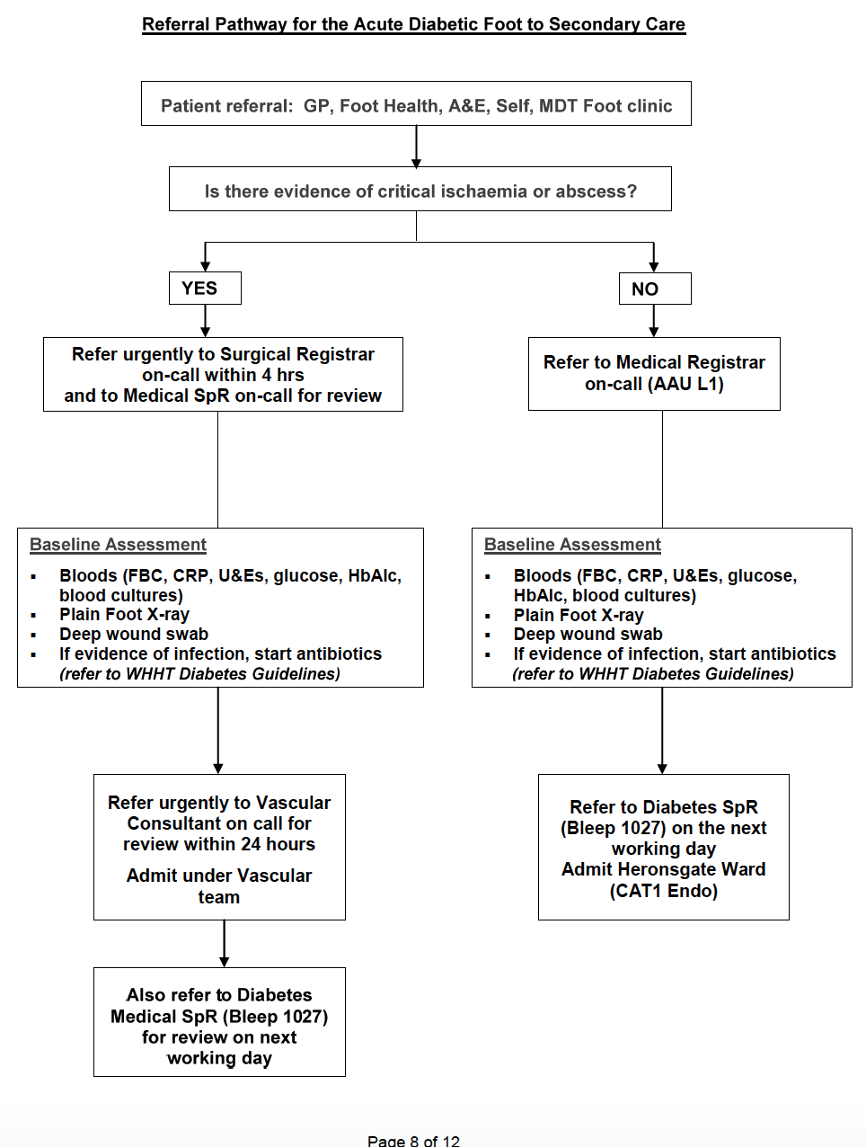
Patient pathway at WGH…
Initial referral to either Surgery or Medicine
Initial inpatient assessment of foot and referral to appropriate team within 24 hours.
Diabetes, Vascular, Microbiology, Orthopaedics, Podiatry, Tissue viability, Radiology, Orthotics
Discharge to appropriate clinics

Slide 6
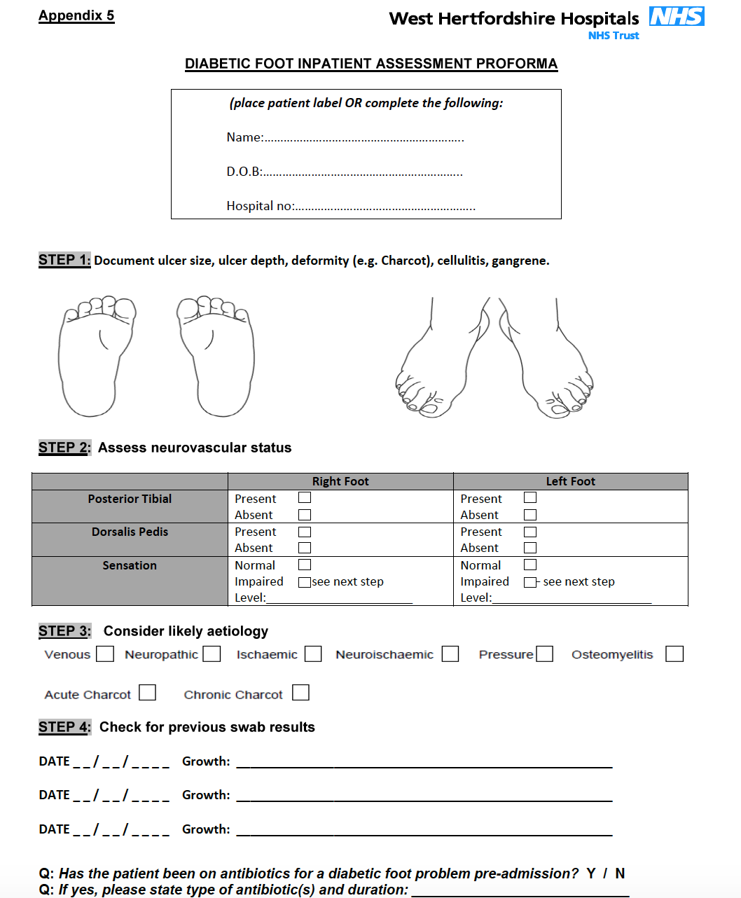
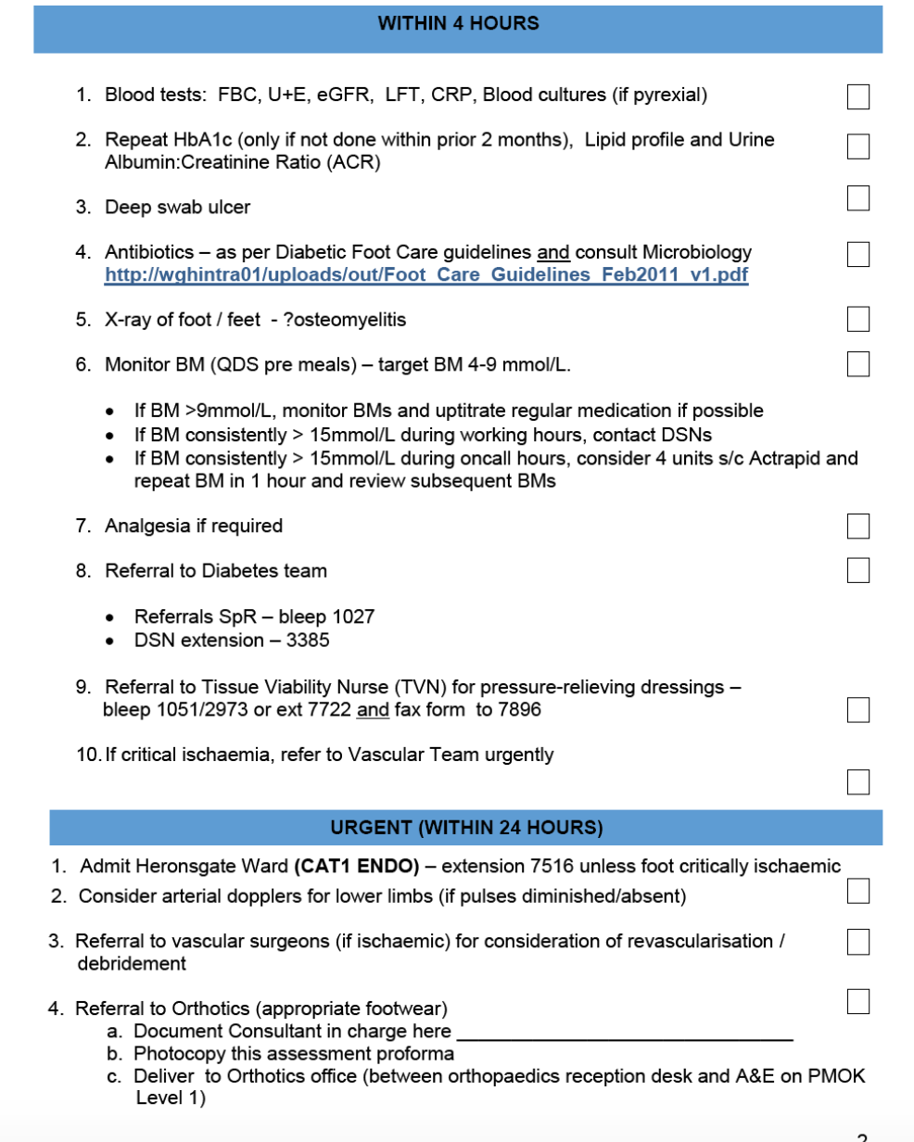
Clerking proforma…

Slide 7
Aims – Audit against NICE guidance
Initial assessment
-Clinical examination
-wound swabs, x-ray imaging and antimicrobial therapy commenced
-referral to Diabetes team within 24 hours (aiming 100%)
-referral to Vascular team within 24 hours (if concern of ischemia)
Primary aim: To audit inpatient initial assessment by Medical team and onward referral (NICE guidance)
Secondary aim: audit key steps of the inpatient care pathway
MDT
-proportion of vascular imaging requested by Vascular team, time to review of imaging
-time to microbiology discussion/advice
Discharge
-Appropriate referral to Diabetes Foot Clinic and community Podiatry on discharge

Slide 8
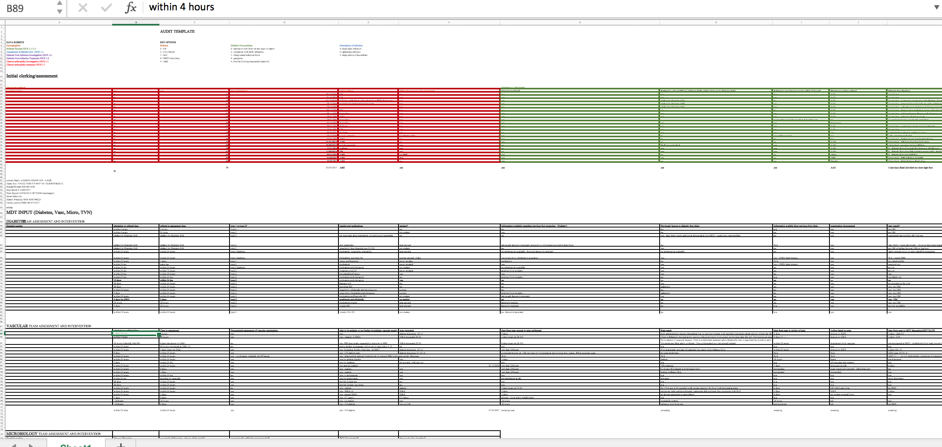
Methods
Patients included with Diabetic Foot Complication referred to Medicine, between October 2016 – March 2017 (identified from SpR Referrals, Home ward admission)
Retrospective analysis of patient’s paper notes.
Retrospective analysis of electronic patient system for investigation requests (ie xray, swab)
Entry of data into comprehensive spreadsheet with separate themes
1) Initial assessment
2) MDT involvement (Vascular team, Microbiology)
3) Referral to clinics on discharge
Intervention/QI based on above audit data

Slide 9
Results – Diabetic foot population represented
19
3
Average age=64

Slide 10
Results – Initial Assessment(1)

Slide 11
Results – Initial Assessment(2)
*Concern of underlying ischemia

Slide 12
Results – MDT - Vascular team

Slide 13
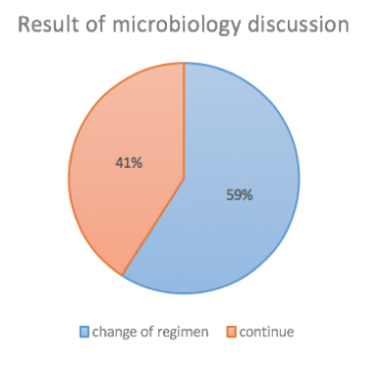
Results – MDT - Microbiology

Slide 14
Results – Discharge Process

Slide 15
What do audit results show?
Initial assessment
-appropriate clinical examination
-wound swabs, x-ray imaging and antimicrobial therapy commenced
-referral to diabetes team within 24 hours
-referral to vascular team within 24 hours
High proportion of patients without adequate assessment of Diabetic foot ulcers – in particular depth (severity) and vascular examination. - ? affects investigation and referral.
Initial investigations, x-ray and swabs identified as a problem.
23% (5/22) not referred to Diabetes team within 24 hours (aiming for 100% referral within 24 hours)
64% (14./22) referred to Vascular team within 24 hours (due to concern of underlying ischemia)
MDT
-proportion of vascular imaging requested by Vascular team, time to review of imaging
-time to microbiology discussion/advice
Time from vascular scan to review of scan variable.; ?due to weekly MDT
Significant time to microbiology discussion? Antibiotic inertia
Discharge
-referral to diabetes foot clinic and community podiatry on discharge
Patients not referred to community podiatry; ?difficult to access intranet referral form.

Slide 16
Interventions suggested?
High proportion of patients without adequate assessment of Diabetic foot ulcers – in particular depth (severity) and vascular examination. - ? affects investigation and referral.
Initial investigations, x-ray and swabs identified as a problem.
23% (5/22) not referred to Diabetes team within 24 hours (aiming for 100% referral within 24 hours)
64% (14./22) referred to Vascular team within 24 hours (due to concern of underlying ischemia)
‘Diabetic foot Proforma’ – make more accessible to clerking team – attaching to standard proforma
Aiming to improve initial examination and investigations, therefore onward referral.
Initial assessment
-appropriate clinical examination
-wound swabs, x-ray imaging and antimicrobial therapy commenced
-referral to diabetes team within 24 hours
-referral to vascular team within 24 hours
MDT
-proportion of vascular imaging requested by Vascular team, time to review of imaging
-time to microbiology discussion/advice
Time from vascular scan to review of scan variable.; ?due to weekly MDT
Significant time to microbiology discussion? Antibiotic inertia
Ongoing work required to establish integrated foot MDT
Discharge
-referral to diabetes foot clinic and community podiatry on discharge
Easier access to community podiatry referral form.
Patients not referred to community podiatry; ?difficult to access intranet referral form.

Slide 17
Re-audit results.. Initial assessment

Slide 18
Re-audit results.. Discharge process

Slide 19
Summary
We looked at process of care of Diabetic Foot management – snapshot of areas of concern within pathway
Identified poor initial examination of the Diabetic foot, in particular depth(severity) and vascular examination
-This directs initial investigations (swab, x-ray) and onward referral to Diabetes and Vascular teams.
Identified suboptimal review time of Vascular imaging and time-to-Microbiology discussion; however reflection on system setup.
Combination of suboptimal initial examination and delay in vascular scan review and microbiology discussion, potentially has significant effect on outcome.
Focused QI on initial assessment of the Diabetic foot as this is the rate limiting step affecting investigation and referral.
Identified issues with discharge process and implemented change. – potential effect on outcome

Slide 20
Conclusions
There is a need for properly commissioned inpatient Specialist Diabetes Foot Service
Dedicated MDT footcare team pivotal to the effective management of the acute diabetic foot from referral to discharge to ongoing community care.
Need dedicated commissioned/frequent timely input from vascular, microbiology & radiology to optimise and streamline patients’ foot management
Inpatient podiatry essential member of the MDFT – foot assessment assessment, wound debridement, tracking of patients beyond discharge

Slide 21
Limitations
-Far reaching audit, therefore less focused…
-Some patients not included (ie direct referrals to Surgery)
-Resulted in low n= .
-not powered to look at outcomes based on our interventions
Strengths
- Identified multiple areas for improvement.
- looked at care pathway from assessment to discharge.
-Identifying issues with initial assessment at rate limiting step, may potentially improve outcomes.
Good news! - March 2017 - successful bid awarded from NHS England from the Diabetes Treatment and Care Programme Transformation Funding to HVCCG/WHHT/HCT for footcare project (expanded multidisciplinary footcare teams) – so watch the space!
Future
- Optimise current MDT approach
- Work towards integrated ward based MDT.
- Show this has positive effect on Diabetic Foot
outcomes
Radiology
Vascular
Diabetes
Podiatry
Orthopaedics
Microbiology
Orthotics
Tissue Viability

Slide 22
Thank you
Acknowledgements:-
-Dr C. Kong
-Diabetes & Endocrinology Department, Watford Hospital
-Audit Department, Watford Hospital
References:
-The Diabetic Foot: The Importance of Coordinated Care. Semin Intervent Radiol. 2014 Dec
-NICE guidance NG19

Slide 23
EXTRA SLIDES

Slide 24
Results – MDT involvement; Diabetes

Slide 25
National priority
£44 million Diabetes transformation fund available via STP’s by CCG’s. Funds available for:-
increasing uptake of structured education
improving achievement of the NICE recommended treatment targets (HbA1c, blood pressure and cholesterol for adults, HbA1c only for children)
reducing the number of amputations by improving access to multi-disciplinary foot care teams
reducing lengths of hospital stays by improving access to specialist inpatient support.

