Slide 1
ENHIDE Young Adult Telehealth Project
Drs Peter Winocour and Andrew Solomon
DSNs Anne Currie and Dawn Hardy
Project Manager Karen Moore-Haines
Young Adult Support Worker Claire Renshaw

Slide 2
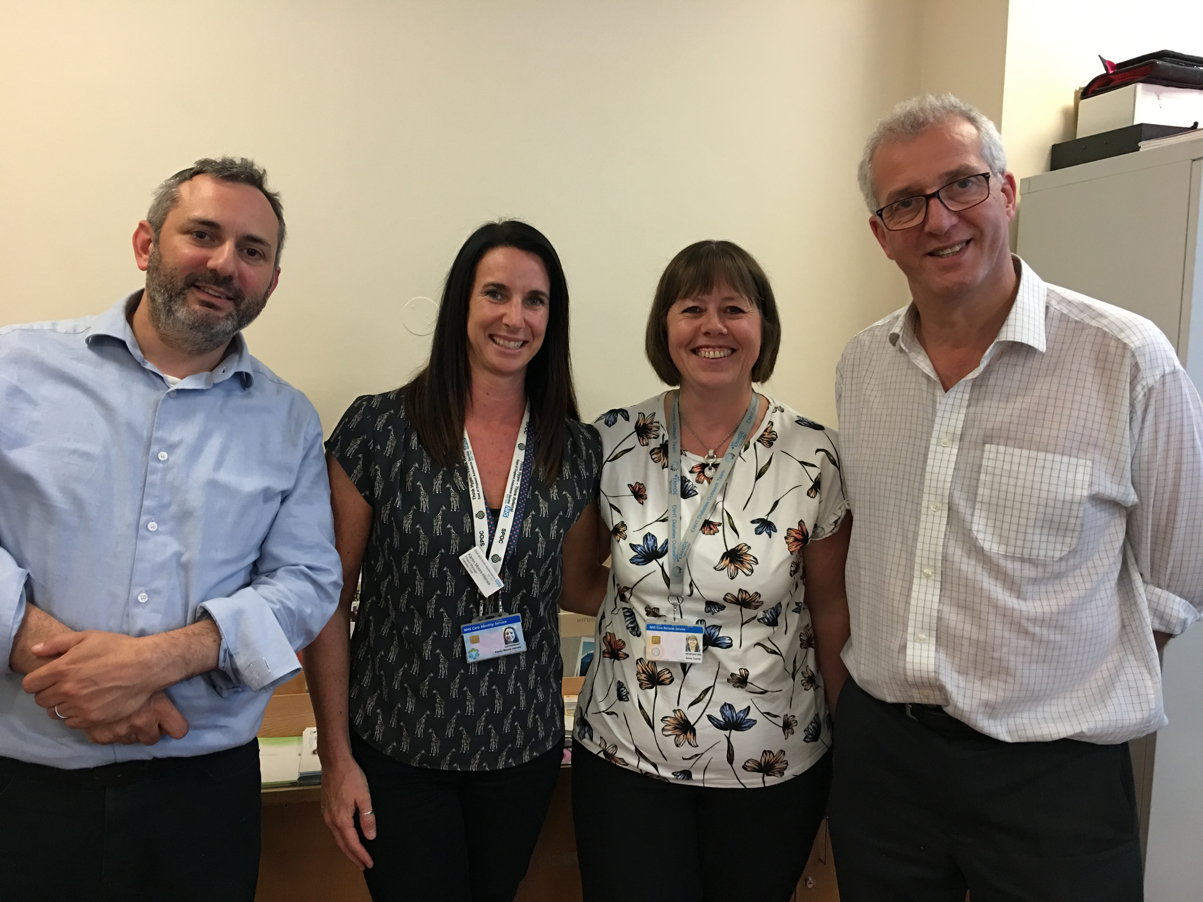
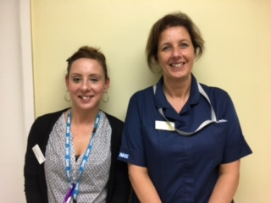
Diabetes Telehealth Team

Slide 3
T1 DM care is challenging
NDA 2014-15 findings in England ( and ENH) :
Completion of 8 care processes 40% (35%)
HbA1c < 58 mmol/mol (< 7.5%) 31% (34%)
Offered structured education 33% (35%)

Slide 4
Why is T1 DM care challenging
(especially in young adults)?
150 standards in NICE T1DM guidelines !!
These include diagnosis, CYP care , pumps , CGMS , education , hypo awareness , other AI screening , psychology , pregnancy , microvascular and macrovascular complications , emergency care , exercise , driving , occupational and higher education issues
Target HbA1c now set at 48 mmol/mol (6.5%)

Slide 5
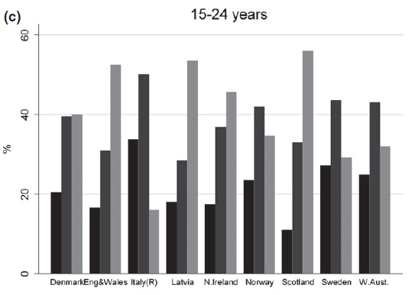
Comparing HbA1c outcomes across Europe
McKnight et al, Diabet Med 2015

Slide 6
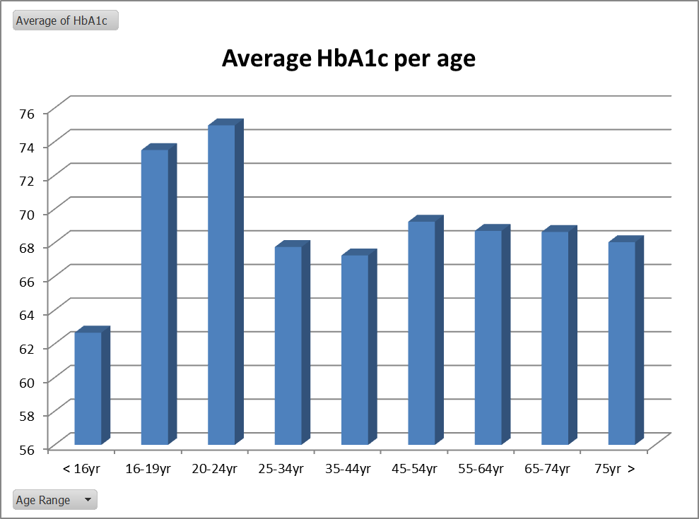

Slide 7
Limitations of structured education using psychological techniques- CASCADE study
In children and adolescents with established T1DM
No impact on HbA1c at 12 and 24 months
Low uptake , high cost
Previous studies of psychological interventions in those with poor control found no impact
Christie et al . BMJ Open , 2016

Slide 8
SDRN 2011-Retinopathy in Young People
Retinal screening DNA rates :
15-30% aged 16-19 and 25-38% aged 20-25
Referable retinopathy after DRS :
4.5% aged 15-25 and 8.2%* aged 25-34
*Highest of all age categories

Slide 9
Beyond Transition – Club 18-30
Higher prevalence in 18-30 than < 18 yrs old
NDA registrations T1DM were 8% < 15 , 6.5% 16-20 and 14% 20-30
Many T1DM diagnosis aged > 18 never under paediatric care
BpT operates till age 19 then .. !

Slide 10
ENHIDE Transfer Audit
Audit of 77 T1DM transferred from transition to adult care in 2006-12
Delays in YAC appointments , high DNA rates
20% lost to follow up at transfer
2016 review – 25 of these 77 cases aged 22-28 years old remain disengaged

Slide 11
What do disengaged young adults with T1DM want ?
For HCP to understand their individual issues that hinder engagement - don’t make assumptions !
Individualised person-centred care planning
Relationship building and needs-based assessment
Problem solve difficulties in self-management
? Peer support – mentoring through transition
Telehealth support and appts, inc out of hours
Proactive information – issues, events, developments
Young adult support worker to navigate through the system
Avoid negative directive consultations and offer gender appropriate care if requested
DUK 2016 Meeting healthcare needs of young people with type 1 diabetes

Slide 12
Type 1 Diabetes in ENH
? Estimated 2600 with T1DM ? 800 aged 16-30
Currently 1342 under acute specialist care of whom 413 (31%) aged 16-30
Potentially 200 (48%) of these were identified from records initially and considered ‘disengaged’

Slide 13
Telehealth Project

Slide 14
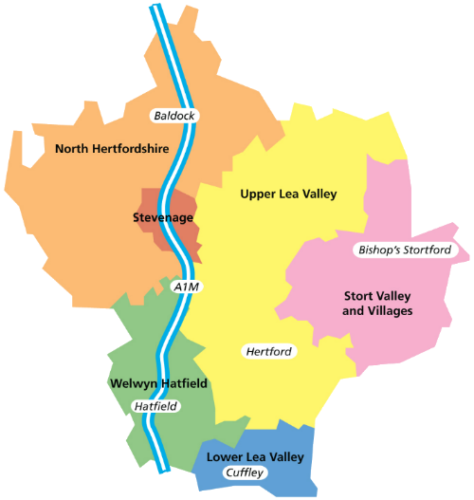
Ashwell
Baldock
Courtenay House
Orford Lodge
Portmill
Regal Chambers
Knebworth & Marymead
Birchwood
Garden City
Nevells Road
Sollershott
Whitwell
East and North Hertfordshire CCG Map
Puckeridge
Buntingford Medical Centre
Orchard
Castlegate
Hanscombe House
Wallace House
Ware Road
Watton Place
Haileybury College
Hailey View
Amwell Street
Park Lane
Church Street
Dolphin House
The Maltings
The Limes
Bedwell Medical Centre
Canterbury Way
Chells Way
King George
Manor House
Shephall Way
St Nicholas Health Centre
Stanmore Medical Group
Symonds Green Health Centre
Church Street
Parsonage
South Street
The Health Centre
Central Surgery
Burvill House
Lister House
Potterells Medical Centre
Wrafton House
Bridge Cottage
The Garden City
Hall Grove
Peartree Lane
Spring House
The Maples
Cromwell and Wormley
High Street
Stockwell Lodge
Warden Lodge
Cuffley and Goffs Oak
Abbey Road
Stanhope

Slide 15
Disengaged - Young Adults
Objective
Contact with a member of the health care team via the Young adult support worker or DSN.
Improved attendance for clinics
Improved attendance for routine blood tests and other screening tests – including retinal screening.
Reduction in hospital admissions with DKA – all DKA admissions reviewed by project consultants.
Improved patient experience.
At least 10% Engagement

Slide 16
Getting Started
Identifying patients for inclusion (initial estimate 250 pts)
Criteria for inclusion
- Admitted with DKA,
- Not attended Retinal Screening,
- No Bloods or Micro albuminuria taken in last 15mths,
- Not attended 2 consecutive appointments,
- Hba1c higher than 75mmol/mol,
- Benefit from a more flexible approach
Contacting the practice for engagement
Practice meetings / discussions for further knowledge on patient history
Invite leaflet sent out to patient (includes process to ‘Opt out’)
Baseline form completed on patient
Wellbeing and DAWN questionnaire completed
6 month follow up form completed
Final 12 month form completed
Notes:
Dawn and Wellbeing questionnaire completed as a baseline assessment of their Psychological needs.

Slide 17
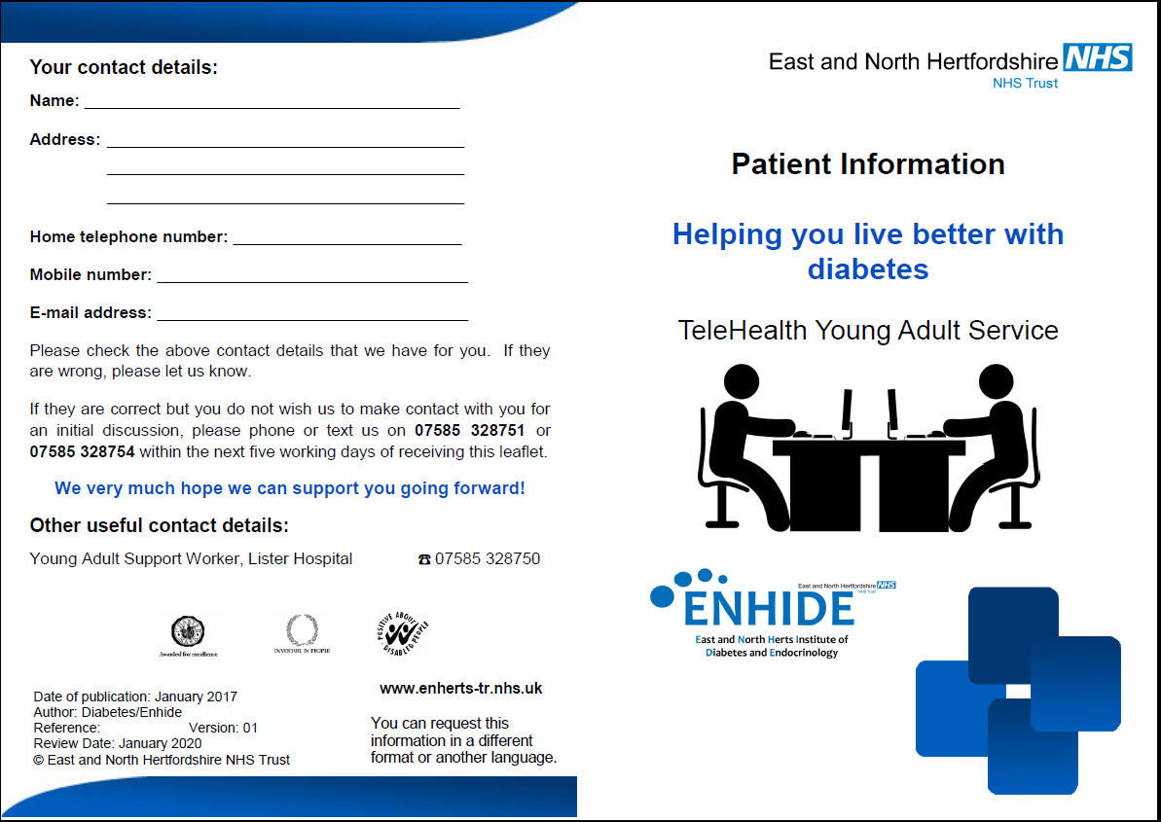

Slide 18
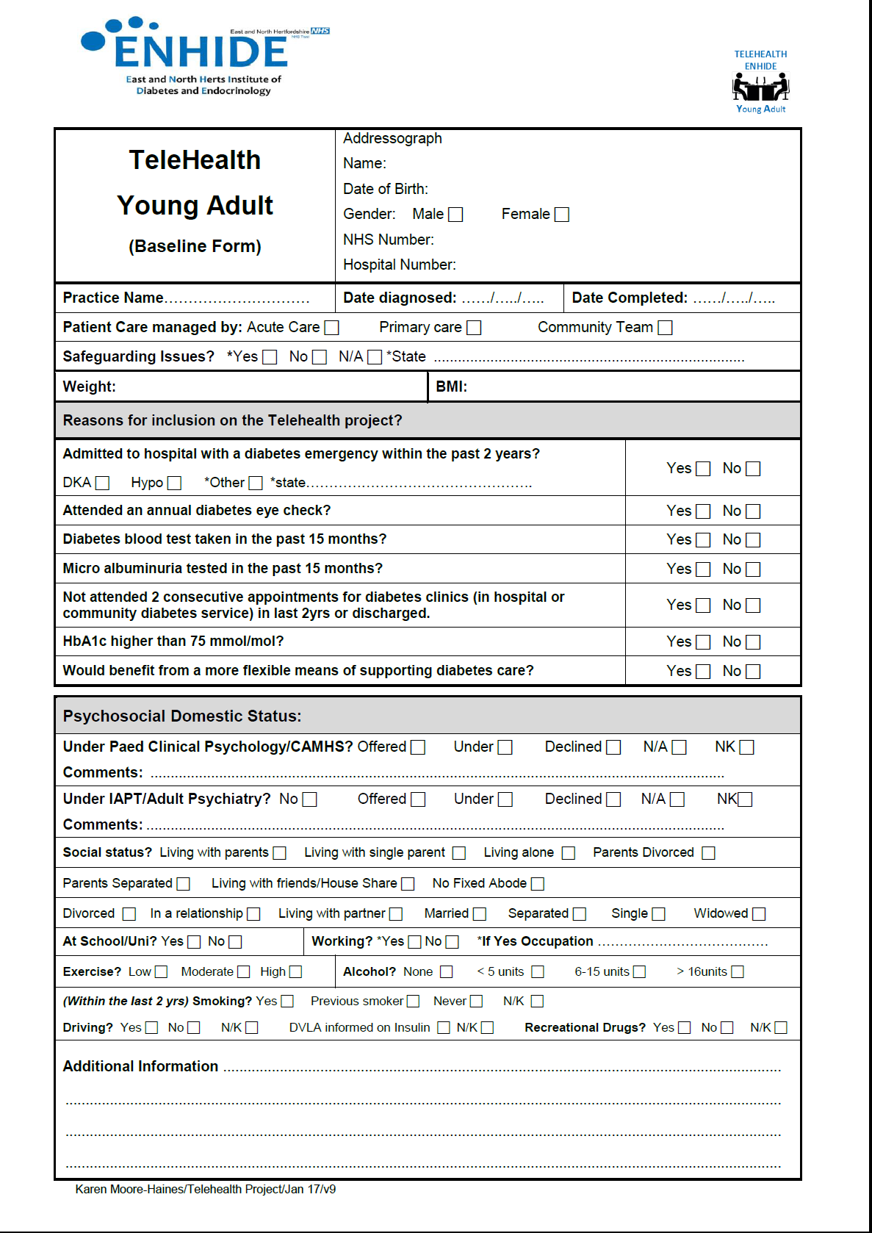
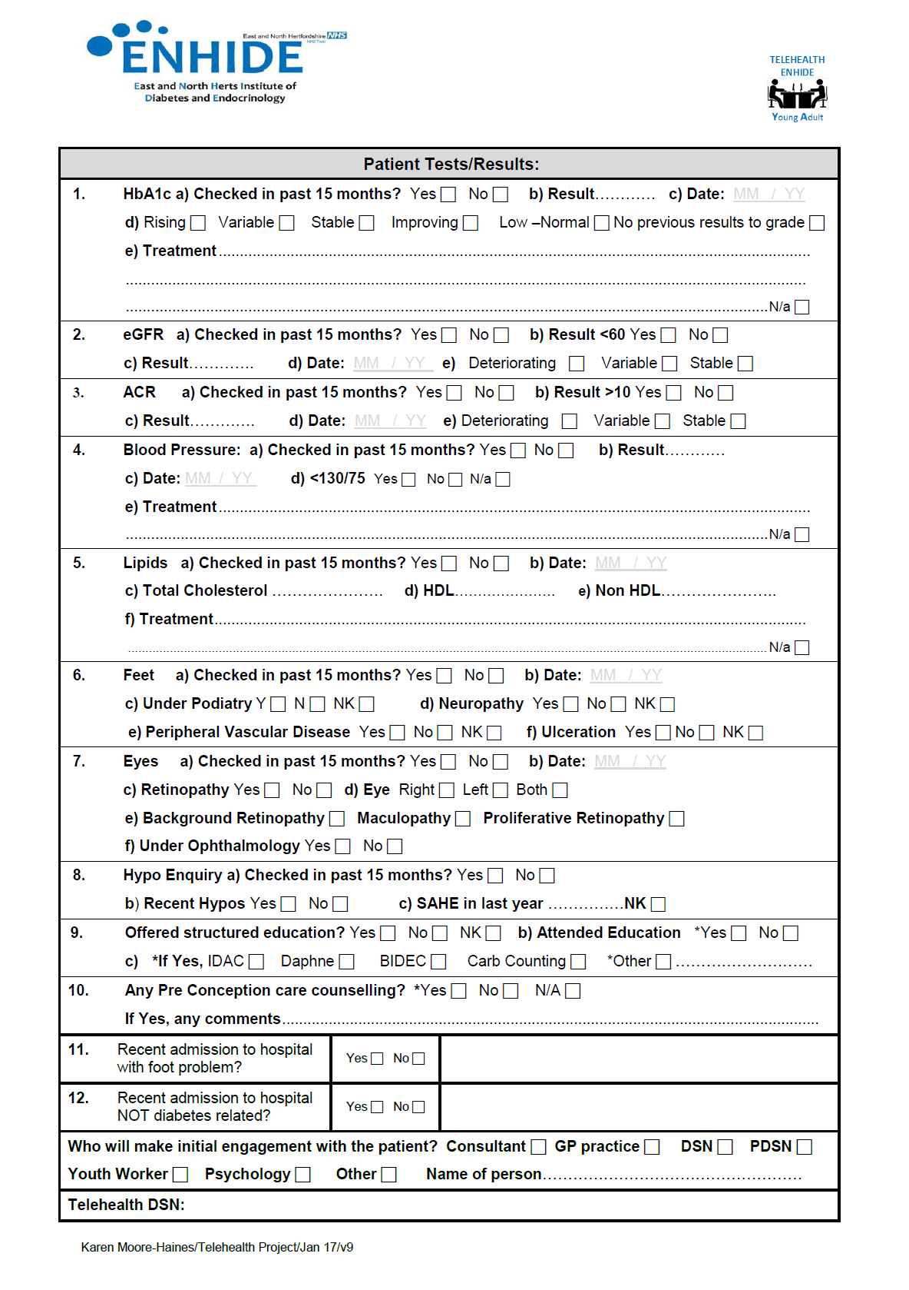

Slide 19
Practice Engagement
Excellent engagement from practices identifying young adults suitable for the project.
Focused initially on the localities closer to the Lister and New QE2 hospital.
Approximately 1-5 patients included in the project, per practice.
Notes:
~50% of practices responded with additional patients for the Telehealth Project in addition to those already identified
Lower Lea Valley and Stort Valleys contacted in the last few months due to cross over of care with PAH, Chase Farm/Barnet hospitals

Slide 20
Figures to date: | Total
Total Number of ‘Young Adults’ reviewed | 341
Reviewed and not included | 160
Currently identified Young Adults for Project | 181
Total number of ‘Young Adults’ sent invite leaflet | 181 (100%)
Patients removed from Telehealth | 16 (9%)
Total number of patients to ‘Opt out’ | 5 (2%)
Total number of patients who have had initial engagement & baseline proformas | 81 (51%)
Notes:
160 Reviewed and not included (144 – Didn’t meet project criteria or engaging back with services, 16 – Out of Area)
Patients removed from Telehealth since project started – Moved Out of Area, Referred back to Acute Services
Patients Declined Project - Too busy, Prefer to engage back with paediatric team,

Slide 21
Gender
Age

Slide 22
Key Messages to date:
Very low number of patients ‘Opting out’ of the project (2%)
Very positive response so far from YA’s who are keen to re-engage.
Increasing uptake in medical technologies and carb counting course, 28 patients out of 81 (35%)
Patients are very keen to communicate via text and phone, a few interested in using Skype or Skype messaging. Some have shown interest in ‘Whats App’ but current Trust policy does not allow this technology.
Notes:
25 patients changed to Degludec or tried using Libre.
8 patients attended 3 CCC course (7 of these patients also changed to Degludec or Libre)

Slide 23
Role of the Telehealth DSN
Offer a flexible approach to patient management
Agree patients priorities
Agree clinical criteria for improvement
Improve engagement with HCP
Use of different methods of communication
Use of apps
3hr carbohydrate awareness course
Access to newer insulins
Offer flash glucose monitoring (Libre) or Dexcom CGMS
Use of Diasend for remote consultation
Notes:
- YA priorities, fitting in with work, getting to the hospital, time of day and disengagement due to confusion around appts
- Clinical Criteria such as avoidance of admissions, A1c, Eye Screening, bloods, Urine
Improve engagement either Face2face or virtually
Skype and text and email

Slide 24
Initial summary of patients needs / requirements
Patients want face to face consultations at times convenient to them
A general feeling of low morale
Diabetes is not top of their agenda
Interested in new technology
Large proportion of patients with mental health needs
High proportion of disengaged patients following transition
Issues with appointments – trust cancellation policy
Wanting a cure for Diabetes!!

Slide 25
Role of the Young Adult Support Worker
To work holistically with young people.
Provide a support service focusing on everyday lifestyles.
Ensure patients are aware of current support aimed at young adults provided by the local county council, NHS Trust such as Diabetes education programs .
Ensure patients are aware of current support aimed at young adults provided by national based support such as Diabetes UK and JDRF.
Assisting with self-help approaches with diet control, glucose monitoring, clinic appointments and emotional support.
Signpost young adults to appropriate services and assists with completing forms and making contact with services on behalf of the young adult, if appropriate.
Communication with the Young Adults to the YA Support Worker will be via phone calls, text messaging, SKYPE, email and face to face contact.

Slide 26
Case Study – Young Adult Support Worker
Pre Telehealth
Diagnosed diabetes in 2013
Single parent
Minimal family support
Poor mental health
Year of diagnoses HbA1c 65mmol
5 months later 95mmol
HbA1c levels between 65 – 118mmol
2014 – 2017 – 15 admissions
Post Telehealth
2017 – 1 admission (January pre telehealth)
Post telehealth 83mmol
No admission & full engagement
Admissions to hospital

Slide 27
Any Questions?

