Slide 1
Diabetes in Children and Young People
Dr Cristina Matei
Consultant Paediatrician
East and North Herts NHS Trust

Slide 2
Scope
Discuss challenges in Diagnosing Diabetes in children and young people (CYP)
Increase awareness of symptoms, especially in very young children
Reduce risk of presentation in Diabetes Ketoacidosis (DKA) at diagnosis

Slide 3
Outline
Data on Type 1 diabetes
Making a diagnosis from primary care perspective
Clinical cases
Future directions
Discussion

Slide 4
National Paediatric Diabetes Audit (NPDA)Data
28,439 CYP with diabetes in the UK
95% Type 1 Diabetes (T1D)
Prevalence T1D 0-15 years ~1:500
Incidence 25.4/100,000/year in general population
Increasing by 3.4%/year in children
6.3%/year <5 year old

Slide 5
Diabetes
Autoimmune destruction of ẞ-cells in the pancreas
Lack of insulin
Mortality higher than general population
Leading cause of death in children is diabetic ketoacidosis (DKA)
Overall leading cause of death in Type 1 DM is Cardiovascular Disease (CVD)
~25% DKA at first presentation in UK(not changed for 20 years); worldwide variation 13-80% cases presentation in DKA¹

Slide 6
Banting and Best – Canada 1921

Slide 7
Risk factors for presentation in DKA
Younger age, ethnic minority, diagnostic error, delayed treatment
Multiple HCP contact prior to diagnosis – delayed referral, lower pH on admission and increased need for iv insulin
Protective factors: higher caregiver education, FH of T1DM, higher background incidence of T1DM, higher gross domestic product
Fewer children present in DKA if parents consider diagnosis (more likely if polyuria/polydipsia are present)
Fatigue, weight loss more frequently reported in children presenting in DKA²

Slide 8
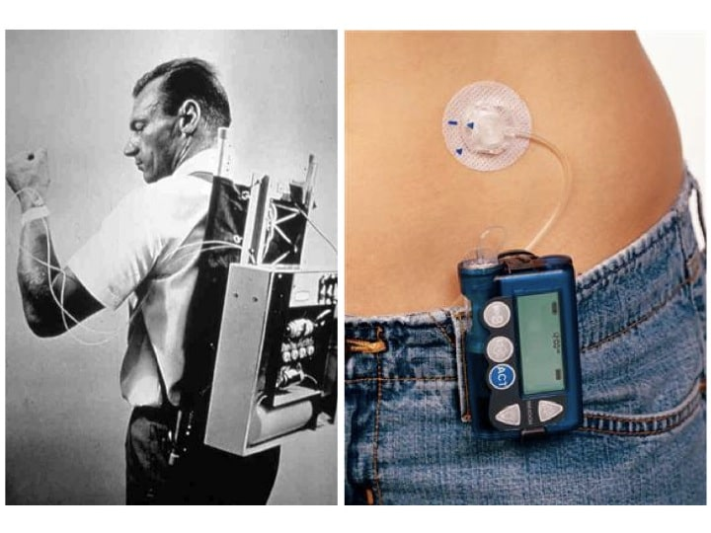
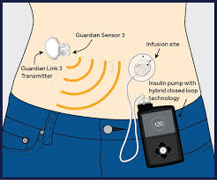

Slide 9
Education, increased awareness! New diagnosis Diabetes

Slide 10
Primary care physician- Type 1 CYP
Central role in diagnosing Type 1 diabetes in CYP
80% of children who develop diabetes seen in primary care prior to diagnosis
Children diagnosed at their first visit have a 3 fold reduced risk to develop DKA
Recognizing DKA when already developed and refer promptly – reduce complications
Most important is to consider the diagnosis (often non specific presentation)
Relatively rare (primary care physician looking after 2000 patients can see child with type 1 once every 10 years, 3-4 times during their career)³

Slide 11
Primary care physician- Type 1 CYP
Making a diagnosis - Point of care testing – Hyperglycaemia, ketonemia, glycosuria, ketonuria
Please test in SURGERY!
Polyuria/polydipsia – 66-99%
Wt. loss – up to 95%
Fatigue 10-70%
Polyphagia 30%
Abdo pain 25%
Constipation secondary to dehydration 10%
Secondary enuresis in previously toilet trained – up to 90% - earliest symptom in children>4 years ³

Slide 12
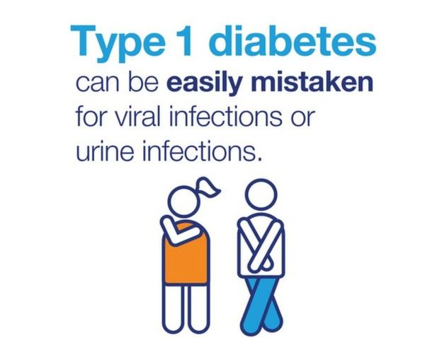
Often polyuria can be interpreted as UTI Exclusively treating concomitant disease (otitis media, pneumonia)

Slide 13
Primary care - DKA at diagnosis
Toddlers present in DKA 53-85%
More challenging – non specific symptoms –fever with vomiting, often viral URTI
Febrile illness, abdominal pain, difficulty breathing, vomiting
(can be misdiagnosed as acute abdomen, pneumonia, gastroenteritis)
Signs of dehydration (poor skin turgor, sunken eyes, dry mucous membranes, prolonged CRT, oliguria, shock)
Euglycaemic DKA – can occur! If concern of unwell child please refer!

Slide 14
DKA at diagnosis: sustained negative effect on glycaemic control
Severe inflammation – further depletes functional pancreatic islets
3.364 residents Colorado, Type 1 diabetes (0-17 years)
Monitored for 15 years
39% had DKA at diagnosis, 1/3 of them severe
HbA1c tracked 1.4% higher in those with severe DKA and
0.9% in those with mild/moderate DKA (p<0.0001)
Independent of ethnic minority, health insurance
Future studies are needed (measure C-peptide 1 month after diagnosis)

Slide 15
Case 1 RM
13 year old boy
1 week of polyuria, polydipsia, weight loss
Presented to GP on Monday 8/05/17
Fasting bloods organised for next day
9/05 started vomiting, came to hospital early hours 10/05
Wt. 43 kg
On arrival: HR139/’, RR 24/’, BP 144/89, CRT 3-4 sec, GCS 14
Blood glucose 31.7mmol/l, Blood ketones High
VBG: pH 7.059, pCO2 2.26, BE -23.8, HCO3 4.7
Managed according to DKA ICP
Made full recovery
Discharged home 12/05 on Multiple Daily Injections (MDI)
Notes:
Having been sent to hospital same day as presented would have save his deterioration and DKA admission

Slide 16
Case 2 JG
15 year old girl presented 12/04/17
Known with Obesity, Acanthosis Nigricans
Insulin resistance
Metformin – poor compliance
Polyuria, polydipsia, abdominal pain, constipation
Vomiting
Breathing deteriorated, mum brought to hospital
Om arrival: HR 132/’ RR 28/’, CRT 2 sec, GCS 15
Glucose 15.4 mmol/l, ketones High,
pH 7.12, PCO2 1.0, BE- 24, HCO3 2.6
Weight 124 kg
Manged as DKA – challenging fluid calculations
Currently Metformin/insulin – referred for Bariatric surgery

Slide 17
Referral to the paediatric Team
Immediate referral to Paediatric on call team at local hospital (medical team if over 16yrs old)
Diagnosis confirmed (Capillary Blood Glucose)
Investigations requested
Treatment commenced as per care pathway
CYP Diabetes Team informed - will see the patient on the same or next working day

Slide 18
Diabetes Diagnosis Criteria
Symptomatic – Polyuria, Polydipsia, Weight loss, Tiredness
and Blood glucose ≥ 11.1 mmol/L (Random)
or Blood glucose ≥ 7.0 mmol/L (fasting)
But Do Not send for Fasting bloods please!
DO NOT USE HbA1c in diagnosing Diabetes in children!
Autoantibodies (GAD, Islet Cell, IA2) - support T1 DM
Obesity, Family History of Type 2 – suggests possible T2DM
Family history and very early onset can suggest MODY
All cases need to be seen same day in Hospital and are started on Insulin Treatment

Slide 20
Our Data
~280 patients (0-19)
3 - Type 2 Diabetes
1 post partial pancreatectomy
MODY – Service provided and close links with Exeter
2016-2017 – 26 NDD – 4 DKA (15%)
2017-2018 Quarter 1 – 12 NDD – 8 DKA (66%) – v. unusual!

Slide 21
At Diagnosis
Commenced on Multiple Daily Injections (MDI) with basal long acting insulin and analogue short acting insulin at mealtimes
Advice regarding – checking blood glucose – at least 5 times/day
Introducing Carbohydrate counting
Education regarding “Hypo”, Sick Day rules
Need to test for Ketones
School Education
24/7 access to telephone advice to families (up to 19 years)
Access to Insulin Pumps and Continuous Glucose Monitoring (CGMS) according to NICE guidelines

Slide 22
Targets – more challenging
Diabetes Control and Complications Trial (DCCT)
NICE UK HbA1c<6.5% (48 mmol/mol)
International Society for Paediatric and Adolescent Diabetes (ISPAD) < 7.5% (58mmol/mol)
American Diabetes Association (ADA) < 8.5% (69 mmol/mol)in < 6 years old
Developing brain more susceptible to hypoglycaemia – risk to develop cognitive dysfunction
Hypoglycaemia
Fear of Hypoglycaemia
Nocturnal Hypoglycaemia (reported 14-47%)

Slide 23
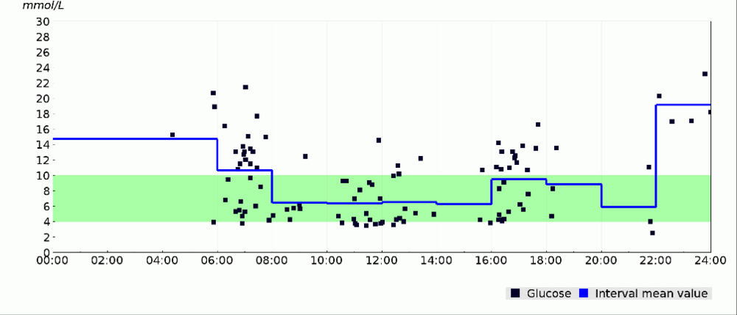
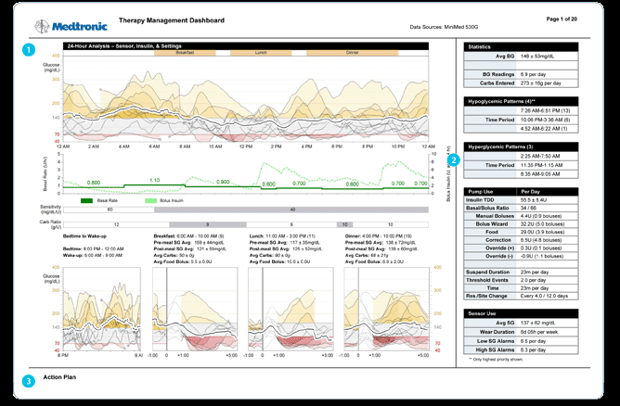
Diasend vs CGMS - large amount of data

Slide 24
Challenges – young children
Period of development – cognitive, behavioural, emotional
Growth
Reduced “honey moon period”
Parents responsible for whole management – burden and stress related to long term complications
Structural MRI showed decreased grey matter volume in children with significant hyperglycaemia compared to healthy controls - regions associated with cognitive capacities
Hypoglycaemia – unable to communicate
Eating behaviour, unpredictable intake
“constant vigilance”
Parents report isolation, depression, post-traumatic stress, work affected

Slide 25
Common Reactions to Diagnosis
Research indicates that common parental and or child reactions to a diagnosis of diabetes demonstrates a range of emotions (Smith & Kaye, 2012). Initial emotional distress typically subsides over time.
Coping and Resiliency (understanding what’s happened, asking questions)
Problem solving
Initial Fear and Shock
Denial
Blame
Anger
Reduced Self esteem/
Self efficacy
Grief
Distress
Worry/ concern
Confusion
Guilt/ Shame
Notes:
In most instances, there is no immediate need for psychological input when diabetes is diagnosed as negative reactions subside over time, and positive initial reactions, although helpful do not in themselves ameliorate the need for psychological input at a later date.
be those who respond well in a crisis, but the day to day routine of diabetes wears them down.

Slide 26
Challenges – adolescence
Biological - Puberty – increased insulin resistance (GH)
Psychosocial - Reduced insulin adherence
Increased need for independence
Risk taking
Body Image
Increasing cardiovascular risks – context of obesity
Locally – Transition service up to 19 years
TELE-HEALTH Project

Slide 27
When to Consider Psychology Input
DKA presentations
Persisting Emotional Distress; Health Anxiety, Adjustment.
Co- occurring Mental Health Conditions
Social factors
Notes:
‘Red Flags’
Individuals who are first diagnosed in DKA are found to be more likely to need psychological follow up
After 3 months, emotional distress should subside to a level that is manageable, and coping should be observable. If you notice persistent and enduring distress, and a paucity of coping, in the individual or family/ carers then referral should be considered, and first discussed with the patient.
Pre-existing and co- occurring mental health conditions may indicate this family/ individual requires assessment.

Slide 28
Diabetes Psychology Service Provision
Focus on Distress related to Diabetes
Referral Pathway
Via CYPD Team or Self referral
Annual Screening and follow up
Routinely Present in some clinics
Individual work
Onward referral to specialist mental health pathways.
Notes:
GP’s can encourage patients to contact the psychologist in clinic or contact the children and young people with diabetes team if they have any concerns about patients.

Slide 29
Future directions
Increasing overweight and obesity
Type 2 diabetes (at younger age)
Type 1 patients – overweight/obese
Adjuvant therapies – Metformin - type 2
? Benefit in Type 1 (Cochrane review 2009 benefit in adolescence with poor control)
GLP-1 receptor agonists (Liraglutide) – research showed benefit, but not yet in practice
Development of new technologies – Closed loop – soon
Immunotherapies in antibody positive CYP
Stem cell

Slide 30
Conclusion
Very important partnership between primary and secondary care to ensure prompt diagnosis/referral of Type 1 Diabetes
DKA – should be seen as preventable risk factor for poor control and long-term diabetic complications
Team work – essential for consistency and continuity of care, especially in order to ensure smooth transition into young adult period

Slide 31
E&N Herts NHS Trust CYP Diabetes Team
Paediatric Consultants – Drs Raffles, Matei and Jain
Adult Diabetologists- Drs Winocour and George
Lead PDSN – Jackie Angelo-Gizzi & Sue Courtman
PDSN and ADSN- Avril, Sharon, Michelle, Vikki, Beth, Anne & Sarah
Paediatric Diabetes Dietitian – Liz Kyriacos & Louise Carrington
Clinical Psychologist – Rebecca Windmill & Deborah Gale
Administrator- Sarah
Data coordinator - Denise

Slide 32
Contact Details
The Children and Young People with Diabetes Team
New QE II Hospital
Howlands Clinic
Welwyn Garden City
Herts AL7 4 HQ
Office: 01438 288311
Fax: 01438 288399
Email: childrensdiabetes.enh-tr@nhs.net
Children's A& E: 01438 284333

Slide 33
Psychological Service Provision
Single Point of Access
Tel: 0300 7770707
Fax: 03007770808
Local Service Provision – See Handouts on stand for East and North Hertfordshire and West Hertfordshire.
Notes:
Once the young person is in the children and young peoples diabetes team then they will be offered Psychological Support via Annual Review. PDSNs also have a direct referral route to the diabetes psychology service, and psychologists are present within routine clinics to be accessible to families.

Slide 34
Thanks
OUR PATIENTS - inspire, challenge but always give an example and reminder of why we have to continue this job!

Slide 35
“ Go confidently in the direction of your dreams;
dare to live the life you have imagined…”
Thoreau

Slide 36
That’s the Future!

Slide 37
Thank you for Listening!

Slide 38
Bibliography
Usher-Smith JA, Thompson MJ, Walter FM. ‘Looking for the needle in the haystack’: a qualitative study of the pathway to diagnosis of type 1 diabetes in children. BMJ Open 2013;3:e004068.doi:10.1136/bmjopen-2013
Usher-Smith JA, Thompson MJ, Sharp SJ, et al. Factors associated with the presence of diabetic ketoacidosis at diagnosis of diabetes in children and young adults: a systematic review. BMJ 2011;343:d4092.
Usher-Smith JA, When should primary physicians consider Type 1 diabetes in children and young people? Diabetes Manage. (2012) 2(6) www.futuremedicine.com
Watts W, Edge JA. How can cerebral edema during treatment of diabetic ketoacidosis be avoided?. Pediatric Diabetes 2014: 15: 271–276.
Duca LM, Wang B, Rewers M, Rewers A. Diabetic Ketoacidosis at Diagnosis of Type 1 Diabetes predicts poor long term glycaemic control. Diabetes Care 2017;40:1249-1255
https://www.nice.org.uk/guidance/ng18

