Slide 1
Improving diabetes Care - working, sharing and learning together
Bridget Turner
Director of Policy, Campaigns and Improvement

Slide 2
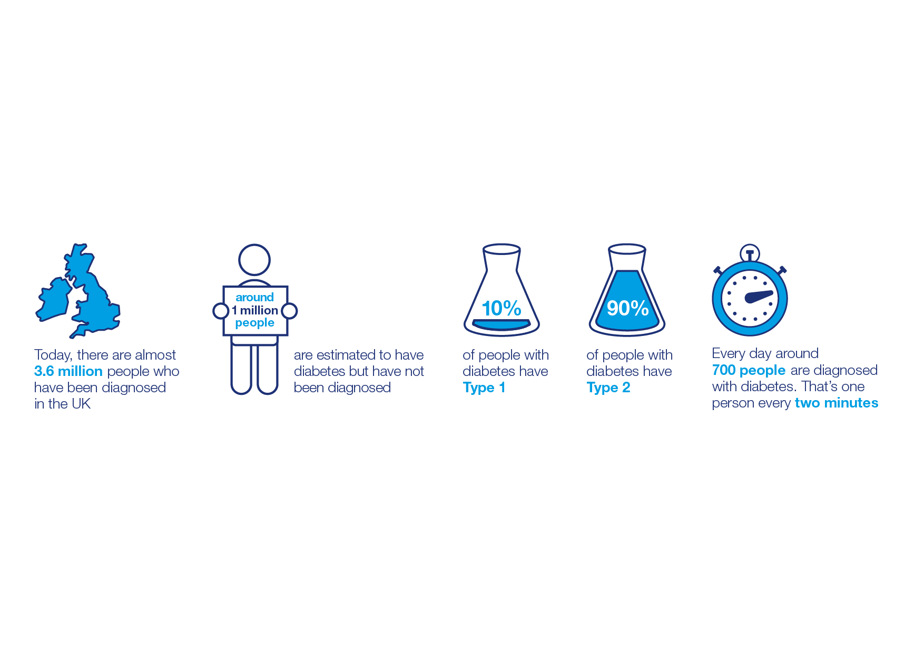
About diabetes
11.9 million people at increased risk of developing Type 2 diabetes

Slide 3
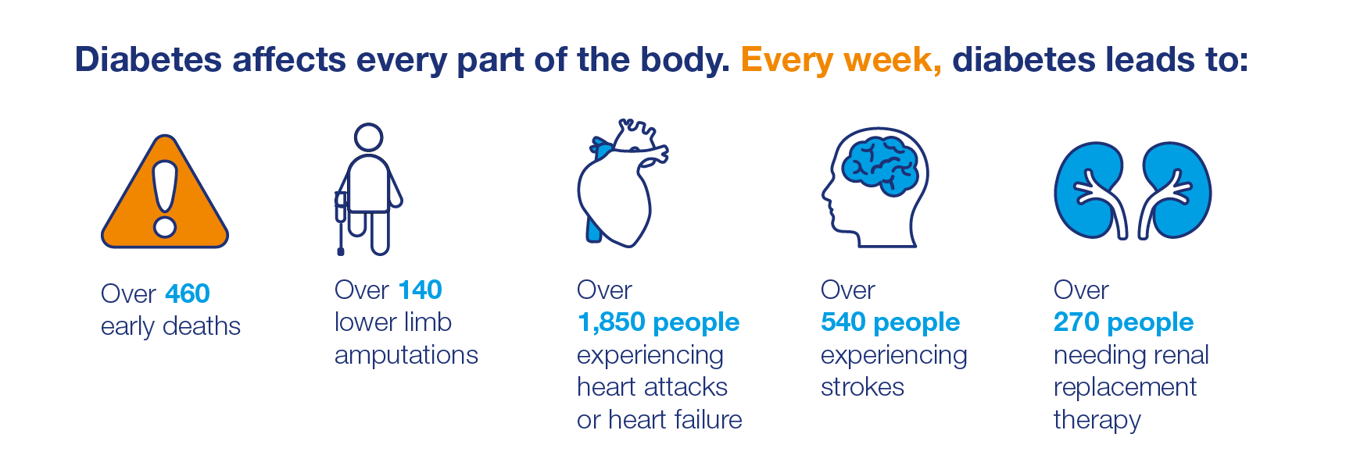
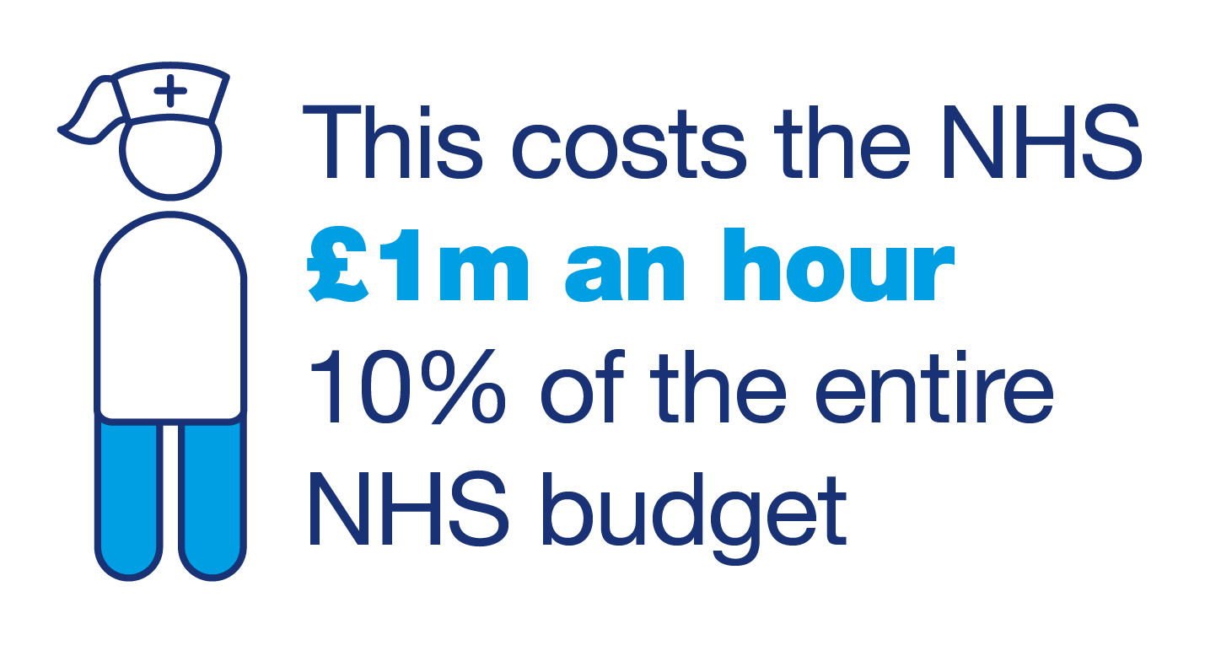
Diabetes is serious and costly
Notes:
And this is why diabetes is such an important issue for society, for the NHS and of course for people with diabetes and those at risk of Type 2. And the reason why you are all here today. Living with diabetes is not easy, you know this already. So the more people we can support together to reduce their risk of developing T2 and more people we can support to manage their diabetes day to day to reduce their risk of developing complications, the greater the opportunity to make more of a difference to creating a world where diabetes can do no harm. Because we know it is fixable.

Slide 4
Why?
Fastest growing health issue of our time
In line with rising obesity, prevalence is projected to continue rise
65 per cent increase in cases of Type 2 diabetes in the last 10 years
Only 25 per cent believe diabetes is a serious health condition and aren’t engaged in taking action to reduce their risk
69 per cent say they don’t fully understand their diabetes.
Significant variation in people with diabetes receiving the consistent, high-quality care needed to help them manage well & reduce complication risk
Variation in children’s, young people and adults care across transition specialist, primary and community care
Those under 65yrs have worst access to essential tests and worst outcomes
Notes:
Why is this happening? No one answer to this as it’s a complex questions and lots of different reasons including
Increase in cases of Type 2 diabetes driven by the nation’s expanding waistline.
69% living with diabetes say they don’t fully understand their own diabetes and only 25 per cent believe it is serious, until its too late to do something about it
Whether living with T1 or T2, what age, ethnicity one is or where someone lives, diabetes is hard to manage day to day. It’s a constant battle for some, or balance for others, requiring attention, planning and thinking. The devastating effects appear slowly, meaning it can be easier to ignore until its too late. At the same time it’s a condition that people with diabetes feel is stigmatised, and there is a lack of understanding about what it means, and the pressure it puts on people’es perception of themselves to be ‘good’ and the judgement that is felt from others who don’t understand. And taking action to change behaviour to be healthier and be more engaged is hard, taking time, commitment, motivation – which lets be honest is generally easier to ignore. But at what cost?
The cost is that without having the support, services in place, encouragement and education in place more people develop complications which costs society more.
Access to the encouragement and support to help people reduce their risk of developing Type 2 diabetes (and other conditions) has over the years been limited.
And access to the care, treatment, devices, motivation and support to live well with T1 and T2 diabetes day to day thereby reducing the of complications is variable.
NDA and NPDA stats, and slide about state of Care (one less words on slide) and review against NHSE slides

Slide 5
It’s fixable – good care improves outcomes and saves money
Achievement of the three treatment targets (adults) and HbA1c target (children and young people) will reduce complications
If national median reached (40 per cent adults & 27% children and young people) £10m saved after 5 years
More people attending structured education will help more people manage their diabetes well day to day
Only 5.7% of patients newly diagnosed recorded as attending
Increasing attendance by 10 per cent a year gives £4m saving (Type 1) and £10m saving (Type 2) after 10 years
Improving timely access to and availability of specialist foot teams reduces risk of amputation
Estimated 57 hospital sites don’t have access to a specialist diabetes foot team
For every £5m invested in specialist foot teams it brings savings of around £9m
Notes:
But, it is fixable, good care improves outcomes and saves money

Slide 6
Improving quality of diabetes care in hospital helped by Diabetes Inpatient Specialist Nurses reduces errors & length of stay
Estimated 54 hospital sites do not have inpatient specialist nurses
For every £5m invested, we can save £9m per year
Enabling more people to make lifestyle change will help prevent or delay Type 2 diabetes and avoid devastating complications
If 5,000 - 24,000 cases of Type 2 diabetes are prevented or delayed up to £1.1bn of health benefits can be accrued. By year 12, a national programme will become cost saving
26% reduction in risk of developing Type 2 (over 12- 8 months)
Notes:
This is the theory and delivering in practice is challenging. But the evidence is strong and we know what good practice looks like.

Slide 7

Integrated and co-ordinated care
Making it happen through
  Integrated IT
  Aligned Finances & responsibility
  Collaborative Care Planning
  Clinical engagement & leadership
  Clinical Governance
Local diabetes networks
Well organised transition between paediatric & adult services
Training & support for primary care, effective access to specialist diabetes teams and facilitating collaboration
Focusing on supporting people with diabetes to self manage through education and team working to identify needs, goals and agree actions.
Clear model of care to ensure access to quality and comprehensive services across the whole integrated diabetes pathway
Notes:
We know what good practice looks like and what works to achieve these goals. Integrated and co-ordinated care across the whole local system. Working together to make it happen through
Good practice is about delivering integrated and co-ordinated care across the whole local system, deploying a full range of instruments for change to promote the adoption of best practices across the country – people, engagement activities, education and training, facilitation and most importantly ‘leadership’.
To co-ordinate care around the person with diabetes because pwd only spend on average 3 hours a year in contact with a HCP. The remaining 8,757 hours they have to manage their own diabetes, with family, friends support.

Slide 8
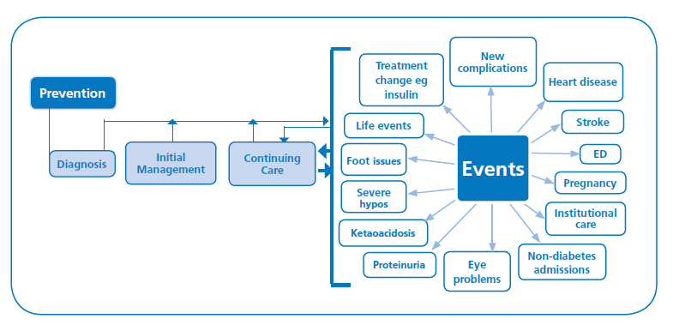
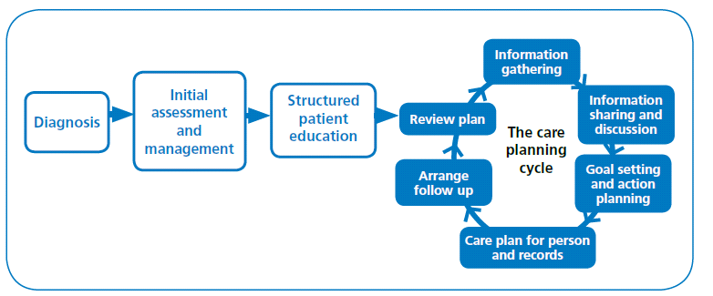
Notes:
We know what good practice is: its about delivering good quality care across the whole integrated care pathway, providing effective education ,learnng and care planning support, through collaborative care planning

Slide 9
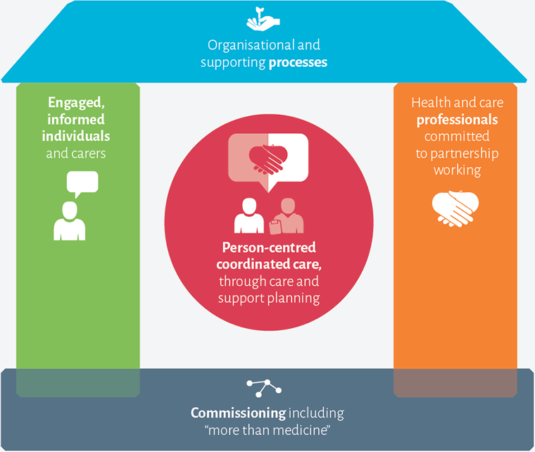
House of Care – supporting care planning
Notes:
Delivering this by organising care and supporting processes, commissioning the care so it is available, so pwd and arers and engaged and informed, and hcps are committed to supporting people with diabetes.

Slide 10
Progress is being made
Participation in the National Diabetes Audit 2015/16 increased to 82%
Offers of people with Type 1 and Type 2 diabetes are increasing year on year, particularly amongst newly diagnosed (National Diabetes Audit, 2015/16)
Good reason to believe attendance is higher than recorded, but not as high as offers
The steady decline in more advanced CKD (CKD stages 3-5) seen in recent years continues (National Diabetes Audit, 2015/16)
Deaths from vascular disease are declining year on year (National Diabetes Audit, 2015/16)
Almost all children & young people had an HbA1c (99.3%) and a BMI recorded (97.9%) (National Paediatric Diabetes Audit, 2015/16)
Increase in children and young people achieving good control (HbA1c <58 mmol/mol) from 23.5% in 2014/15 to 26.6% in 2015/16. (National Paediatric Diabetes Audit, 2015/16)
Notes:
We know if can be done, because its being done in some places for some people. And its great to see where progress being made in many areas
More people with T2 recorded as offered education, almost all CYP had an HBA1c and increase in those achieving good control
AND diabetes care treatment and prevention is recognised as a significant priority by the NHSE – which gives us all an opportunity to work together to achieve the potential that we can all see to improve health outcomes, quality of life and lives
And you will have some really good examples of what is working across your own local system. The key is transforming the local care so good practice is available everywhere. And that is why diabetes is now a priority for the NHS and all local areas.

Slide 11
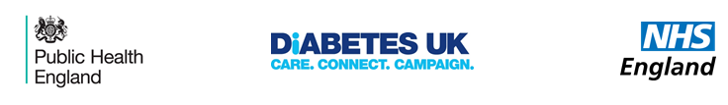
Diabetes prevention, care and treatment is a national priority – Working together to improve
Diabetes in the CCG Improvement and Assessment Framework and Five Year Forward View
NHS England Diabetes Type 2 Prevention Programme - ‘Healthier you’
  Covers half the country and set for 100,000 referrals by 2020
  Total referrals are 76,514 at end of July
  Current take up rate of 48% across the programme (Large variation across all providers and sites (between 26% and 83%).
  Wave 3 roll out to rest of England in 2018/19 and digital programme
£40m NHS England transformation funding to reduce variation
  Priorities based on economic case for structured diabetes education, treatment targets, multidisciplinary footcare teams and inpatient care.
  Good evidence this will have the most clinical impact, result in improved outcomes and be locally sustainable
Notes:
And along with the case for change the fact that its happening in some places for some people, along with a lot of national influencing from people with diabetes and healthcare professionals, this is why Diabetes Precention , care and treatment is a national priority. A partnership between NHSE, DUK and PHE to get good practice in place everywhere.

Slide 12
Outcome of bidding process
Bids of £36m across 166 CCGs approved in first wave (A rated bids)
Increased availability of structured education places from 54,000 to 148,000 places
Approximately 850,000 patients will receive new interventions to increase achievement of the treatment targets, across 99 CCGs
53 hospital sites or community teams, across 67 CCGs, will put in place new or expanded specialist diabetes foot teams
60 hospital sites, across 53 CCGs, will put in place new or increased numbers of Diabetes Inpatient Specialist Nurses
Further £6m made available to regional teams to use with sites where bids needed further work, with a focus on areas of inequality (B-rated bids)

Slide 13
Additional support
CCG Improvement and Assessment Framework (CCG IAF) rates areas on structured education and treatment targets indicators
£2.5m invested in clinical networks and £2m in regional teams to support focused diabetes roles
Roles supporting CCGs low on CCG IAF positions, whether or not they received transformation funding
Plans to develop and evaluate digital approaches to increase opportunities for flexible learning and uptake of structured education
NHS Right care better value pathway and teams to support local improvement www.england.nhs.uk/rightcare/wp-content
National Diabetes Audit (adults) and National Diabetes Paediatric Audit re-commissioned
Diabetes UK regional teams; service redesign support, clinical leadership and user engagement support; resources and information

Slide 14
Learning, Sharing and Working together
Diabetes UK key support programmes
Notes:
Dr Sam Rice, Consultant from Wales, has developed and rolled out education videos for people living with diabetes across Wales. These are now being implemented in other parts of the UK.
Dr Rice has also implemented and evaluated text messaging support for patients.
Frances Hanson, dietitian from Leeds has also developed educational videos – these contain food and dietary advice for schools, parents and young people with Type 1 diabetes.
Dr Alex Bickerton, Consultant from Yeovil set up Virtual clinics in the community to increase specialist input so that patients can be managed more locally.
Deborah Wake, Consultant from Scotland developed a website and portal, which has given people with diabetes online access to their own health records, tailored educational and self-care advice, online messaging between patients/ professionals, online peer support and skype clinics.
Dr Mayank Patel, Consultant from Southampton has developed a Free Massive Open Online Course (MOOC) available for healthcare professionals and patients on “understanding Insulin”.

Slide 15
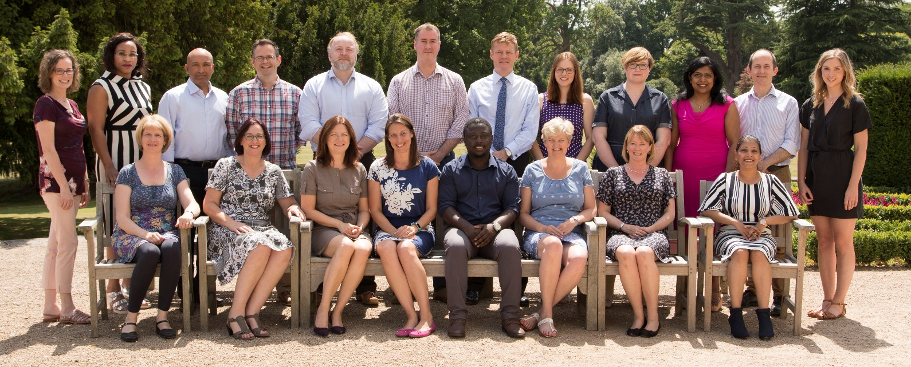
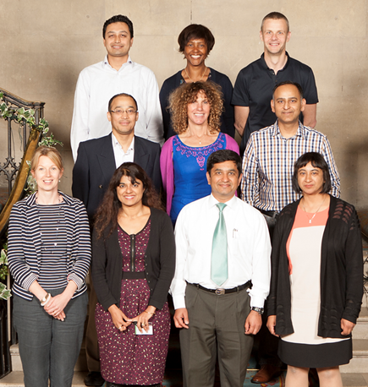
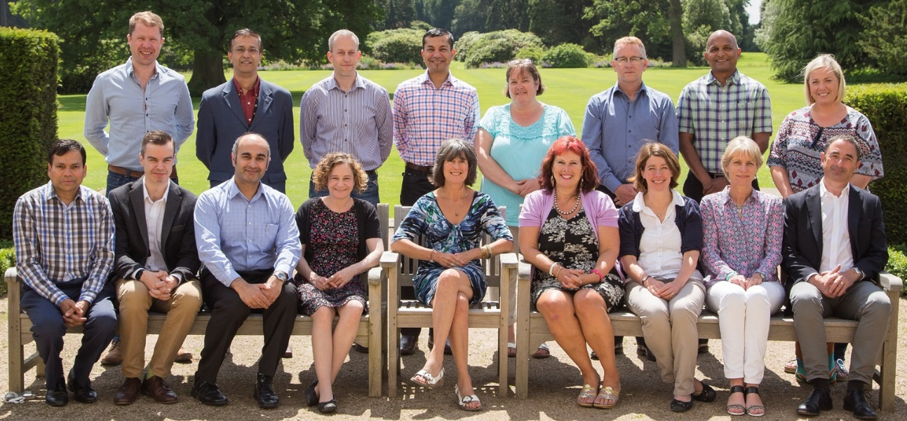
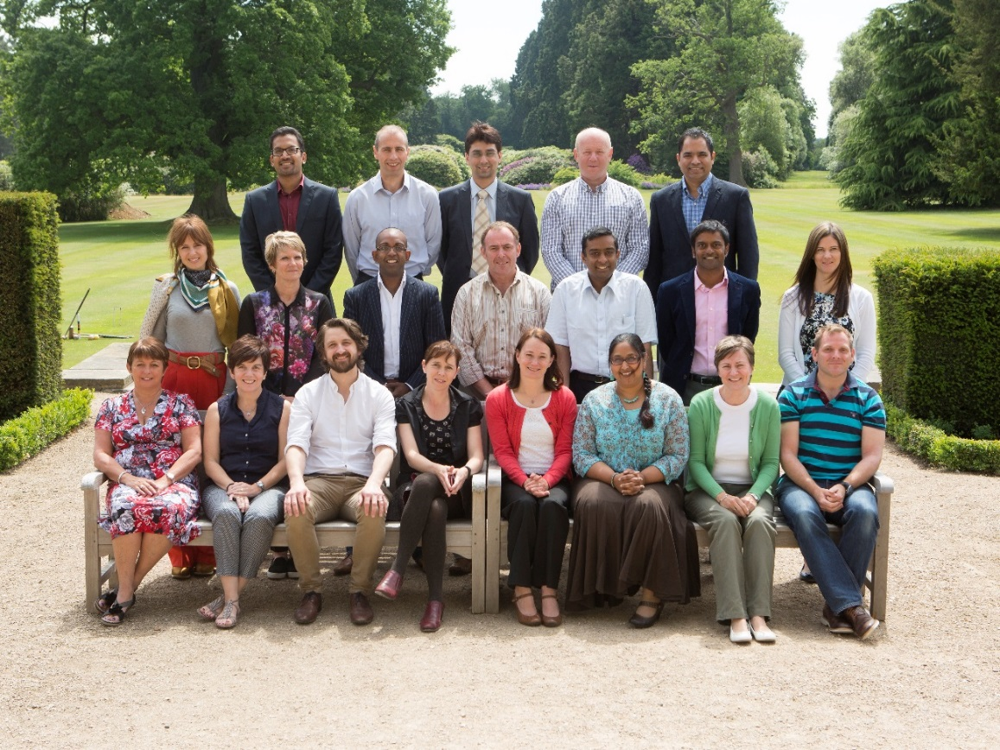




Clinical Champions Programme
Virtual & Skype
Clinics
Created new local diabetes networks
Diabetes training across inpatient wards
Portal to access patient records online
Turning clinicians into clinical leaders to drive improvement
2 year programme, Multi-disciplinary network of 65 champions
Bespoke package of leadership training, coaching and peer support, practical support and resources
This is a Diabetes UK project in collaboration with Novo Nordisk who are providing support and funding

Slide 16
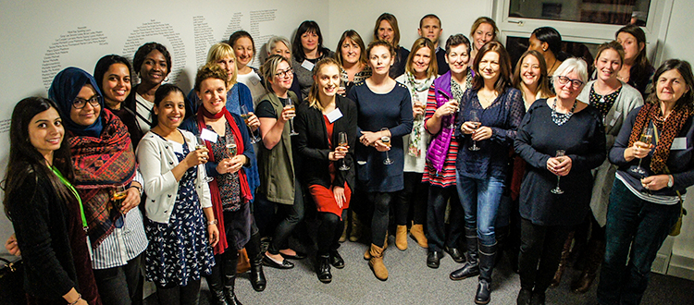
Tomorrow’s Leaders – Leadership Course
Leadership course for Diabetes Specialist Nurses (DSNs) and dietitians
Helps develop leadership skills, and boosts confidence and motivation to improve care
Partnership with Leicester Diabetes Centre and TREND-UK
57 attendees in 2017
100% of respondents feel more motivated to improve care, 87.5% felt they had further developed their skills and knowledge to help influence change locally
Current alumni of over 100 clinicians
“Inspirational. The positive energy was palpable. People who were quite low came back with not just ideas but action plans on the road to success!”
- 2017 Tomorrow’s Leaders participant.
Notes:
Tomorrow’s Leaders is a free 24 hour leadership course for DSNs and dietitians. The course includes training on effective communication, sources of power and influence, the new NHS, and breaking down barriers to quality care. Course participants are supported to develop an action plan to improve local diabetes care.
The course will gives participants the opportunity to learn:
- who and how to influence
- how to be an effective leader
- to identify the barriers to quality care and how to overcome them
- to work with a coach to develop your own action plan.

Slide 17
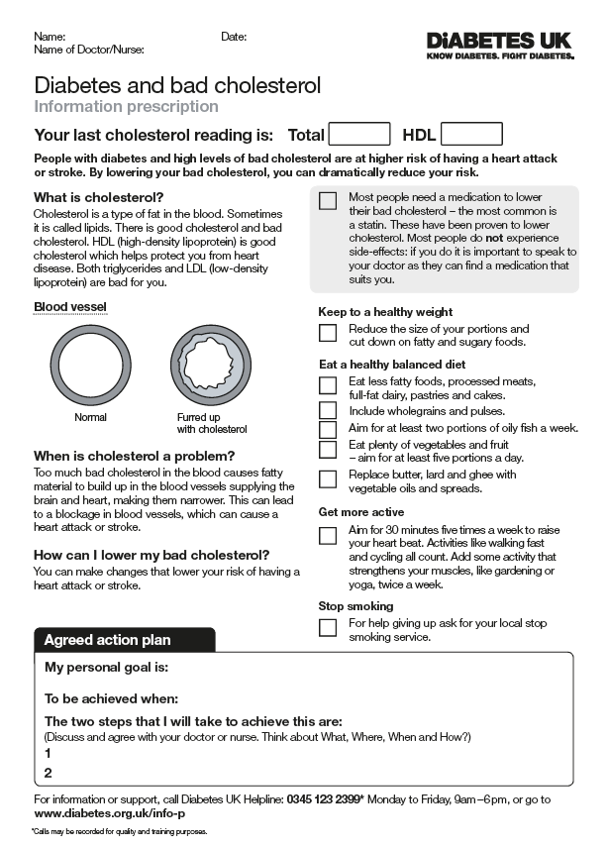
Information Prescriptions
Personal
Actions to reduce risk
Given by clinician to patient to support care planning and behaviour change
Clinically accurate and easy to read
Focussed on NICE treatment targets for BP, cholesterol and HbA1c
Built into clinical IT: targeted, personalised, specific, quick
Clear, clinically accurate, information
Personal care planning
Signpost for support and information
Notes:
Just to illustrate the different elements of the IP
Important to stress the importance of the focus on personalised actions as there is really strong evidence that shows that agreeing personalised goals has a clinically significant impact on HbA1c and weight.

Slide 18
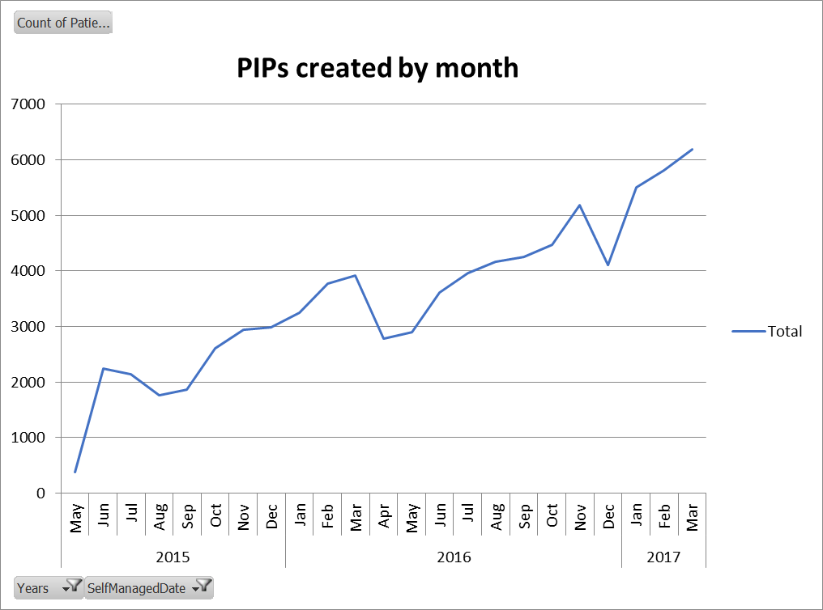
Information Prescriptions feedback
Diabetes teams:
One third of GP surgeries have activated the info prescription alerts
On EMIS Web >100k completed Info Prescriptions saved on patient records
Patient insights:
Revelation as to “ownership” of own diabetes “Are these my results?”, “Can I set my own goals?”
  New understanding of diabetes “I found this very interesting and informative.”,
  Pride/confidence in ability to self-care “I’m getting a folder to keep these in”
New confidence to challenge status quo “[They] help me to plan better if there is a problem with my test readings”, “My GP always tells me my results are fine. I will now ask what fine means.”
For more information www.diabetes.org.uk/info-p-qa
Notes:
Clinicians describe the alerts prompting them to intervene with patients who have slipped through the net for years.
One common observation is that patients tell them it is the first time that their condition has been explained- they would clarify that it is not, but clearly the IP was the first explanation that hit home.
The graph shows a steady rise in usage through EMIS web – illustrating that clinicians are finding them useful and using them again/telling colleagues
Clinicians describe the alerts prompting them to intervene with patients who have slipped through the net for years.
One common observation is that patients tell them it is the first time that their condition has been explained- they would clarify that it is not, but clearly the IP was the first explanation that hit home.
The graph shows a steady rise in usage through EMIS web – illustrating that clinicians are finding them useful and using them again/telling colleagues

Slide 19
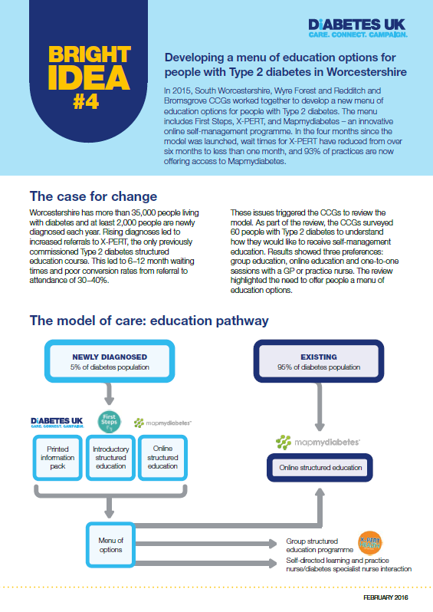
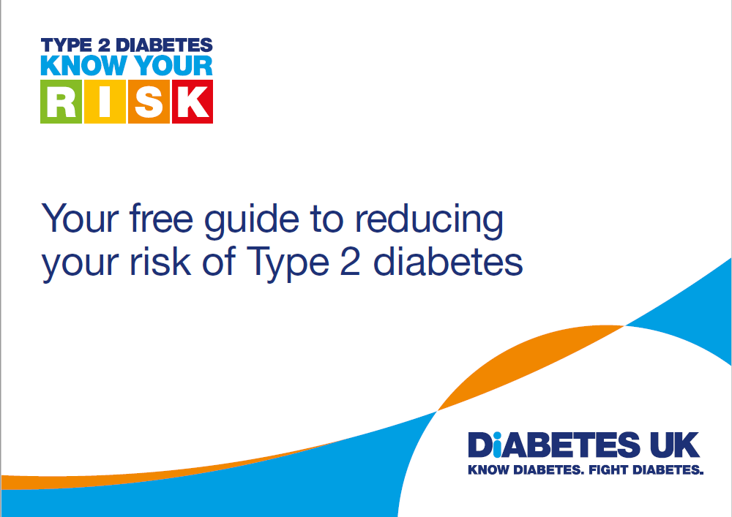
Information, tools, resources and networks
Tips about what local areas have done and how they have done it
  Shared practice library www.diabetes.org.uk/shared- practice
Free to join professional network groups
  Monthly diabetes e-newsletter
  Expert medical insight –short films
  Practical resource signposting e.g. Eating well postcard
  Patient and professional magazines (Balance and Update)
Membership
More information: and
www.diabetes.org.uk/pc
Notes:
The shared practice area of our website has a section for patient education that has really useful resources including a guide for healthcare professionals, a guide to commissioning structured education and a case study looking at an area that has successfully made changes

Slide 20
Tackling the diabetes challenge together means
Effective support to reduce risk of Type 2
Supporting people with diabetes to achieve treatment targets and have more control to self manage
  Early & effective treatments, technologies & devices
  Collaborative care planning: whole person
  Value of learning: consistent and quality information, education, peer support, social networks
Spreading effective models of integrated diabetes care, including transition by
  Making it relevant and personal to help manage day to day and prevent complications
  Improving clinical, wellbeing and psychological outcomes
Delivering better care in hospitals so people with diabetes are safe
Timely access to diabetes foot specialist teams to treat, support and manage effectively
Notes:
A key part of the course is developing an action plan. Participants then work through this plan with a coach, and pitch the plan to the rest of the group to develop their presentation skills. These action plans focus on making a specific change to improve diabetes care in their local area, i.e. improving communication between primary and secondary care, developing a diabetes education programme, or developing virtual clinics.

Slide 21


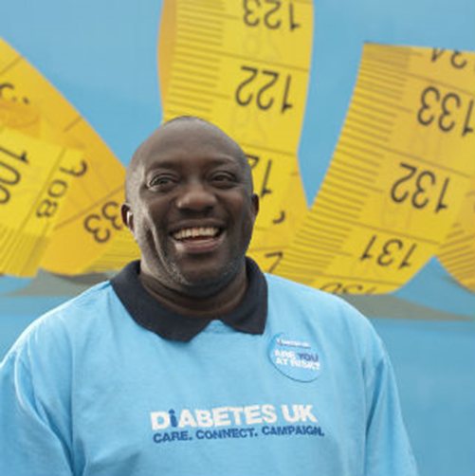
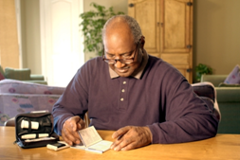


Notes:
Living with diabetes and preventing it is not easy. It takes effort, determination, planning, focus and getting into good patterns of behaviour so it can be incorporated into our lives, rather than determining them. Everyone has a part to play – CCGs, clinicians, NHSE, Govt, Public Health England, Health Education England, Diabetes UK, people with diabetes and their families
Working together, using all the levers in the system, we can make a difference to create a world where diabetes can do no harm. Living with diabetes is not easy, and I know for many of you you will feel working in it is not easy either at times. But each one of you I absolutely know do so much to support, help each plwd you come into contact with and the reason you are here today is because you do make a difference and want to make more of a difference to a future where we are part of a world diabetes can do no harm
Thank you for coming today, I hope you enjoy the opportunity to share, learn and work together today
I can see how much has been achieved over the last 3 years (when I was last here). It is exciting and you are leading the way in the ambition that the care, support systems and lives of children, adults, communities and families who already have diabetes can be improved – as well as preventing Type 2 diabetes in the future – to save the costs to the system and most importantly the costs that the devastating complications have on people and their families.
The ambition is to ensure all CYP and adults have a better quality of life, have better health and fewer complications and the more people are prevented from getting Type 2 diabetes. For the sake of everyone with diabetes in this picture – and the millions of others across England today.
Thank you.

Slide 22
“Give us the best care whoever we are and however severe our complications. Recognise that without our full co-operation you will be wasting your time. Do everything you can to ensure we stay motivated to look after ourselves, rescue us when we bugger it up, because as sure as hell we will. You can only do this through full integrated diabetes services of the highest quality, treating us as people and not as a medical condition and working with us as a team”
(Person living with diabetes)
Notes:
Leave you with a final quote …
A person with diabetes said this and I think it sums up the views of many, if not all, people with diabetes

