Slide 1
LAUNCH OF WEST HERTS DIABETES EDUCATION PLATFORM

Slide 2
MEET YOUR WEST HERTS DIABETES EDUCATION TEAM
LAUNCH OF WEST HERTS DIABETES EDUCATION PLATFORM

Slide 3
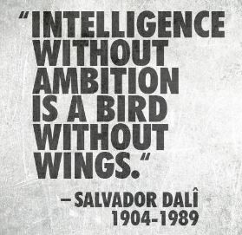
WE ARE AMBITIOUS

Slide 4
WE ARE ACHIEVERS

Slide 5
WE NEED YOU

Slide 6
FIRST AMBITION
WE WANT TO KNOW
WHERE WE ARE TODAY
SO WE CAN PLAN TOMORROW
WHAT ARE OUR SKILLS?
WHAT ARE OUR GAPS?

Slide 7
TOMORROW!
EXPECT A LINK TO A SKILLS AND KNOWLEDGE GAP ASSESSMENTSURVEY TO LAND IN YOUR PRACTICES TOMORROW
TAKES 10 MINUTES TO COMPLETE
PERSONALISED ANALYSIS WITHIN 1 MONTH
HELP US TO HELP EACH OTHER
COMPLETE THE SURVEY!
EVERY GP, PRACTICE NURSE AND HCA IN YOUR PRACTICE
INCENTIVISED VIA THE GP ENHANCED COMMISSIONING FRAMEWORK – SO OBLIGATORY!

Slide 8
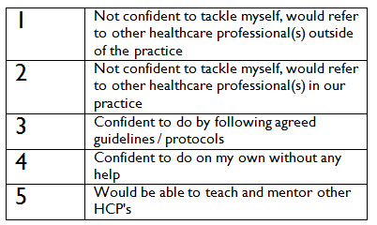
EDUCATION NEEDS ASSESSMENT
FOR EXAMPLE…
A knowledge and confidence question enables us to gauge a healthcare professional’s subjective opinion of their diabetes skills
R
2
3
4
CONFIDENT
1
5
2
3
4
1
5

Slide 9
SECOND AMBITION
NO MORE CLINICAL INERTIA
GONE
ELIMINATED
PLUG THE GAPS
REDUCE THE VARIATION
STANDARDISE ESSENTIAL LEVELS OF KNOWLEDGE AND SKILLS IN PRIMARY CARE
SPEAK THE SAME LANGUAGE OF DIABETES CARE
MAKE EVERY CONTACT COUNT

Slide 10
OCTOBER TO JUNE
EDEN IS COMING TO WEST HERTS!
A COMPETENCY BASED MODULAR EDUCATION PROGRAMME RUN OVER 12 MODULES ROOTEDIN IMPROVING CLINICAL OUTCOMES
WE NEED YOUR COMMITMENT TO THIS
SEND ONE PERSON, THE RIGHT PERSON,FROM YOUR PRACTICE TO EACH TRAINING MODULE
CASCADE THE LEARNING
TRANSLATE THE LEARNING INTO CHANGES IN PATIENT CARE
WE WILL SUPPORT YOU WITH SOME FINANCIAL INCENTIVISATION - £1000 PER PRACTICE
DIVE INTO A SUITE OF OTHER LEARNING OPPORTUNITES WE WILL BE GIVING YOU: ELEARNING, WEBINARS, PRACTICE VISITS, CONSULTANT TELEPHONE ADVICE, DEDICATED WEBSITE WITH LEARNING RESOURCES
WATCH OUT FOR NEWSLETTERS AND REGULAR UPDATES

Slide 11
WHAT IS EDEN?
COMPETENCY BASED TRAINING COURSES HCA TO MSC LEVEL
PRACTICE BASED KNOWLEDGE & SKILLS ASSESSMENT
INTEGRATING LEARNING INTO CLINICAL PRACTICE
PROFESSIONAL DEVELOPMENT
EDUCATION NEEDS ASSESSMENT & MONITORING
MENTORING
ANALYSING TRAINING LINKS WITH OUTCOME DATA
RCGP Accredited

Slide 12
THIRD AMBITION
To develop clinical diabetes champions and enhanced practices for the initiation and ongoing management of injectable therapies.
Let’s start building up expertise in practices
Let’s think about new models of care, hub and spoke models, how we can work together as networks of practices
Let’s keep patients in primary care
Let’s change the patient and professional journey
Let’s develop a team of West Herts Diabetes Champions who are interested in diabetes care and motivated to work at the top of their skill set to enhance the care and pathways within our own neighbourhoods

Slide 13
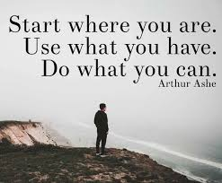
Exciting times… Shall we get started together?

