Slide 1
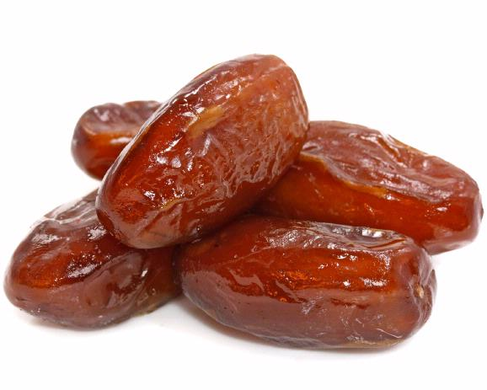
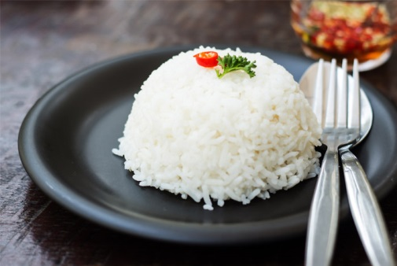
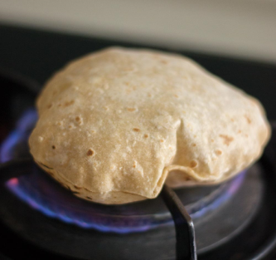
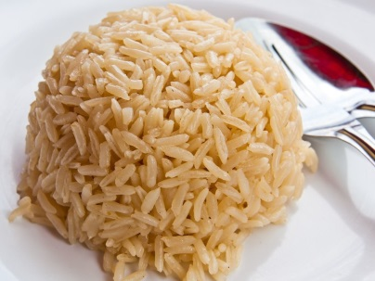
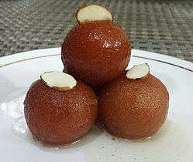
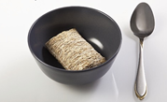
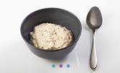
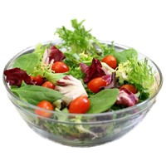
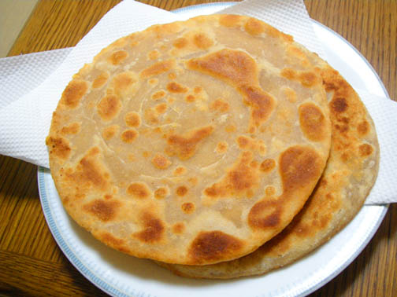
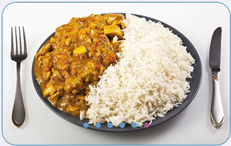
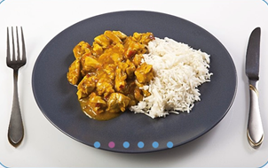
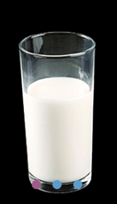
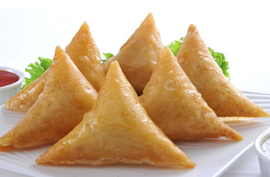
Helping people with diabetes make healthier choices during Ramadan
Notes:
WELCOME SLIDE
What are the best food choices for people breaking the fast/pre fast meal during Ramadan?

Slide 2
Dietary choices during Ramadan: Helping people make better choices
Key points to be considered:
Portion sizes
Carbohydrate content
Glycaemic index
Cooking methods
Healthier options
Hydration

Slide 3
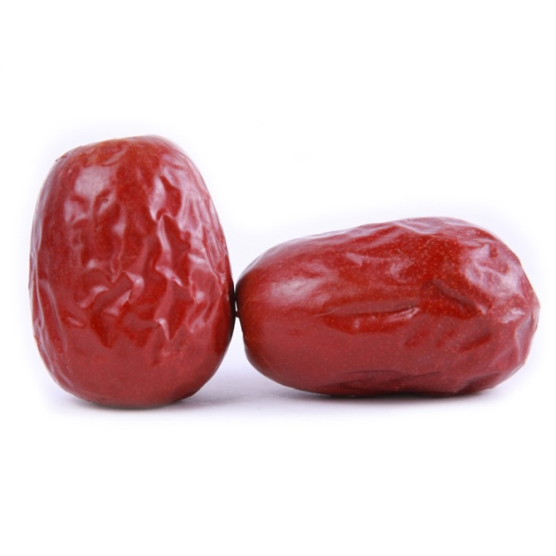
Portion sizes: breaking the fast
Notes:
1-2 dates is the recommended portion size for breaking the fast due to high sugar content (5g per date)

Slide 4
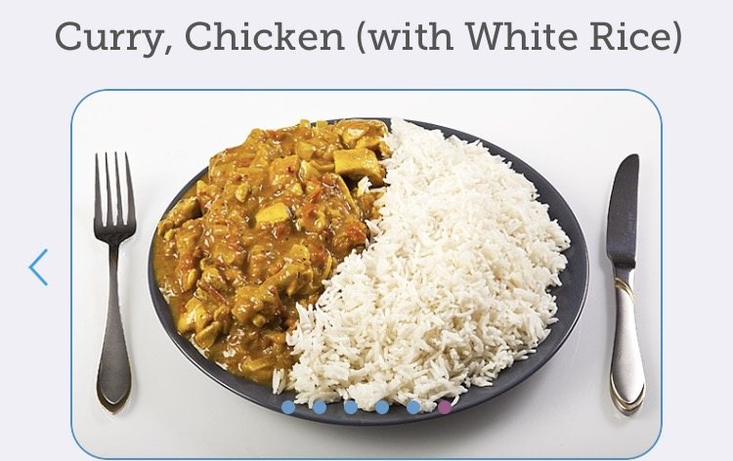
Portion sizes continued…
Notes:
35g carbs – smaller portion
126g carbs – large portion
Amount of carbohydrate has the most impact on blood glucose. Be mindful of portions of carbohydrates.
Meals should be balanced i.e. some protein, carbs and veg/salad.
By incorporating more veg/salad this reduces the portion size of carbs and protein as well as overall calorie content.

Slide 5
Glycaemic Index
Brown or basmati rice
White rice
Notes:
Lower GI foods can help keep blood glucose stables by releasing glucose slowly into the blood e.g. brown or basmati rice

Slide 6
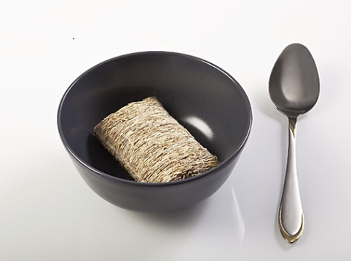
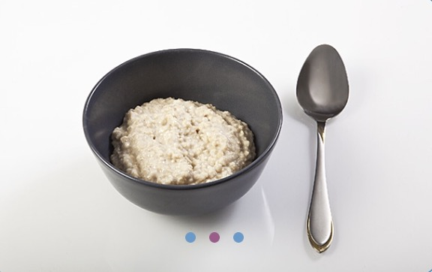
Glycaemic index continued…
Shredded Wheat
Porridge
Notes:
Low GI foods are beneficial at meal before sunrise (Suhoor/Sehri) e.g. porridge, shredded wheat

Slide 7
Cooking methods: breads
Paratha
Chapatti
Notes:
Which one would be the better choice and why???
Paratha
Made by baking wholewheat and then shallow frying (increase sat fat and kcal)
Thicker and more substantial than chapatis as they have either been layered by coating with ghee or oil and folded repeatedly
Commonly stuffed with potataoes, dal, cheese etc
Chapati
Wholewheat flour, cooked in an open flame (no added fat/oil in frying)
Less dense (encourages smaller portion size – therefore reduces kcal and Carbohydrates)

Slide 8
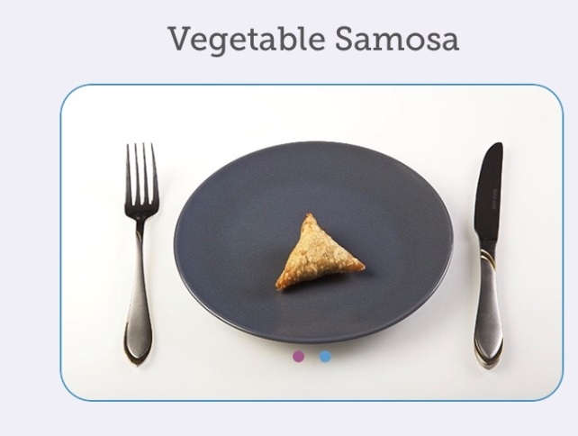
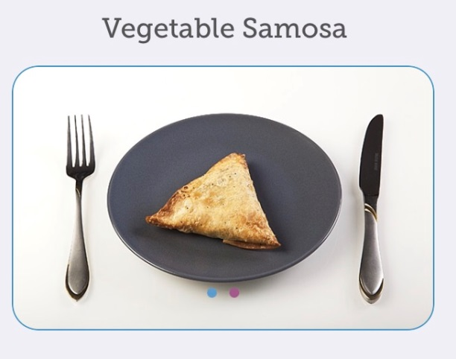
Cooking methods: samosas
Notes:
Problems??
Sizes of samosa
Small samosa- 6g carbs
Large samosa- 22g carbs
Made from MAIDA (wheat flour)
What could we advise our patients…….
Size of samosa Small =6g CHO Large 22g CHO
Mix the flours Maida (refined flour), Atta (Whole wheat flour) will increase fibre, lower GI.
Instead of deep frying, bake them in the oven reduces Kcal and saturated fat.
Swap potatoes for veg such as peas, cauliflower, carrot, or lean cooked meat. This will reduce carbohydrate.
Average Kcal Comparison
Baked 180kcal
Fried 310kcal

Slide 9
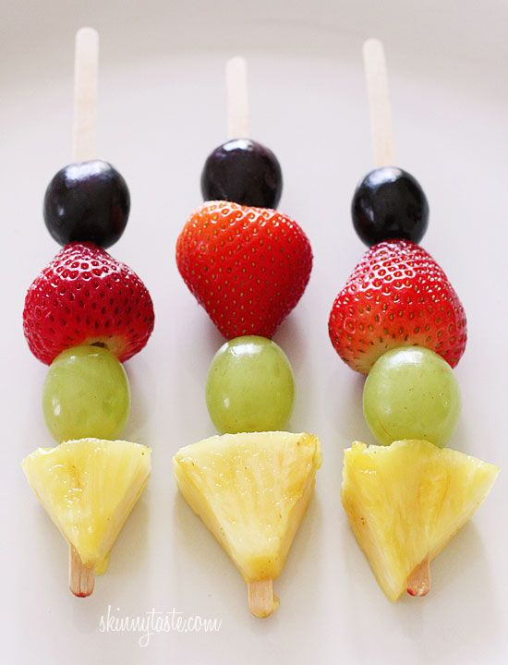
Healthier options
Notes:
Galub Jamin
-Approximately 17g carb per galub jamin
-Milk solid based South Asian sweet popular in Indian/Nepal/Pakistan/Bangladesh
-Milk solids are kneaded into dough, deep fried, soaked in light sugary syrup.
-Normally eaten at Eid.
-High fat
All indian sweets high sugar high fat, deep fried eg. Rasgulla, Balushahi/Badushah (like a doughnut), Baklawa/Baklava, Ras malai, Barfi/Barfee
Approx 5g carb per fruit kebab, low fat.
Other options lassi, Chai latte, natural yoghurt and fruit smaller portion of starchy carb with main

Slide 10
Hydration

Slide 11
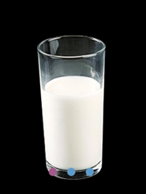
Hydration continued…
Notes:
Each 150mls
OJ – 12g CHO
Milk – 7g CHO

Slide 12
Key messages
Watch portion sizes (particularly of carbohydrates)
Opt for lower glycaemic index foods
Choose foods lower in fat (avoid deep fried foods)
Choose foods and drinks lower in sugar including fruit juice

Slide 13
Acknowledgements
Thanks to Carbs and Cals for images used

